Slide 1
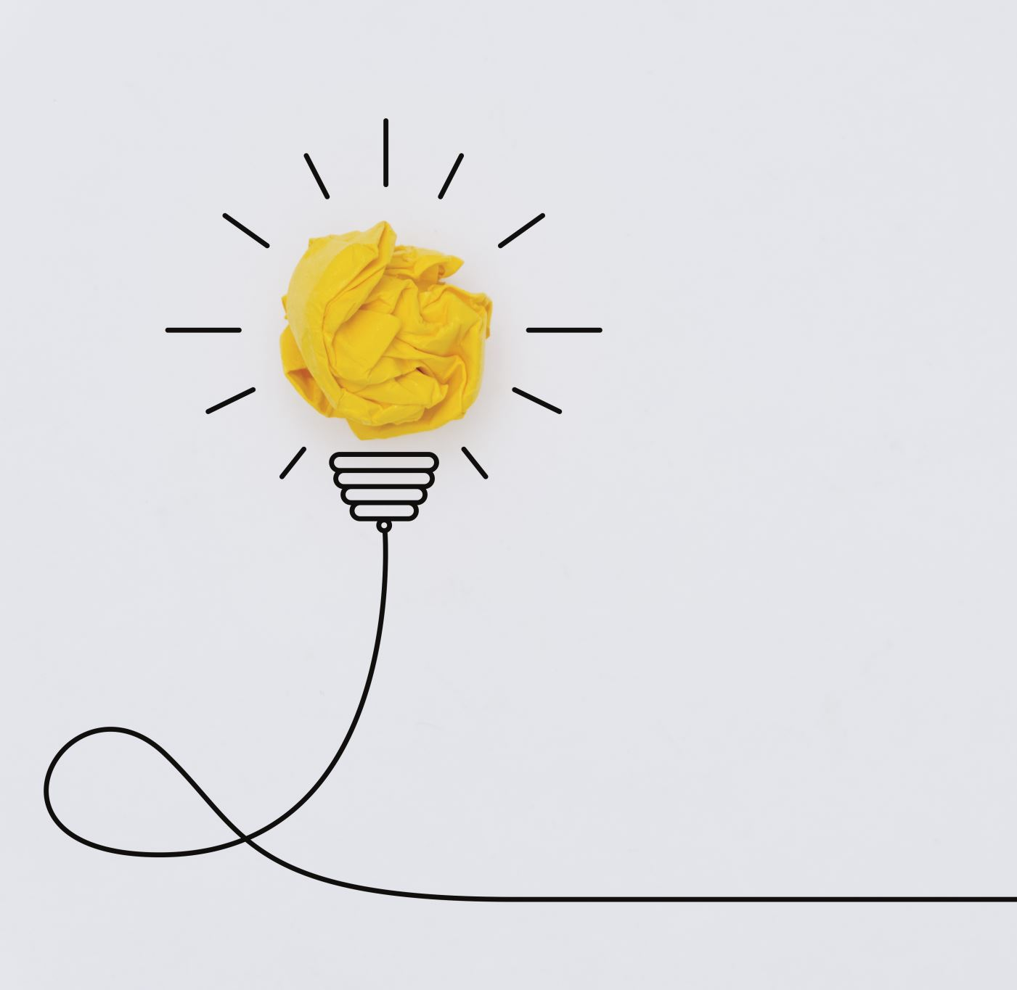
Electricity

Slide 2
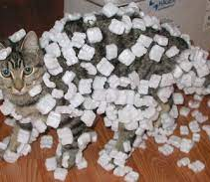
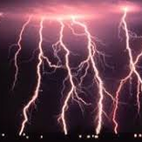
There are two types of electricity:
Static Electricity – is a build-up of charge that remains stationary in one place

Slide 3
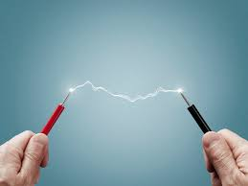
There are two types of electricity:
2. Current Electricity
– is moving charges (usually through a wire)
*more on this ahead

Slide 5
Charges in the Atom
If an electron is removed from a neutral atom, the atom becomes positively charged
If an electron is added to a neutral atom, the atom becomes negatively charged
The movement, or transfer of electrons from one atom to another changes the charge of the atom.
Notes:
In a solid material, the positive nucleus vibrates but remains in the same position at the centre of the atom. The negative electrons are outside the nucleus and can move quite easily. Only the electrons can move in the solid material, so all solid materials are charged by the transfer of electrons.

Slide 6
Friction and Electron Transfer
Friction occurs when objects rub against each other
Results in one object losing electrons and the other gaining electrons

Slide 7
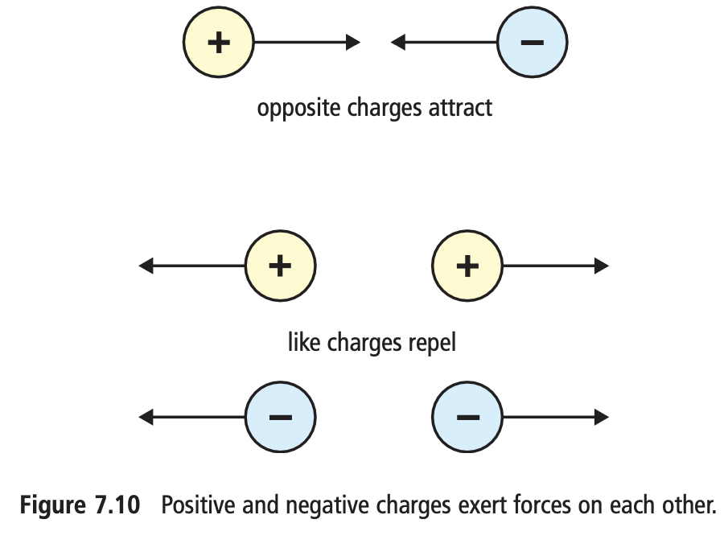
Law of Static Charge
The unit of electric charge is called the coulomb (C).
It takes the addition or removal of 6.25 x 10¹⁸ electrons to produce 1 C of charge.
A typical lightning bolt can carry 5 C to 25 C of charge.
Electric force is proportional to charge.
If you á the amount of charge, you á the electric force.
If you â the amount of charge, you â the electric force.
Also…
If you á the distance between charged objects, you â the electric force.
If you â the distance between charged objects, you á the electric force.
This relationship is called inversely proportional

Slide 8
Demos: Static Charge
Activity 1: Charged balloon + confetti
Charge a blown-up and tied-off balloon by rubbing it on a sweater (not your head).
Hover it over paper confetti & observe.
Activity 2: Charged balloon + water
Obtain two beakers. Fill one ¾ full with water. Charge a blown-up and tied-off balloon by rubbing it on a sweater.
Put the empty beaker on the table and hold the filled beaker ~30cm above it. Slowly pour into the empty beaker to create a small and consistent stream of water. Slowly bring the balloon close but do not touch the water & observe.

Slide 9
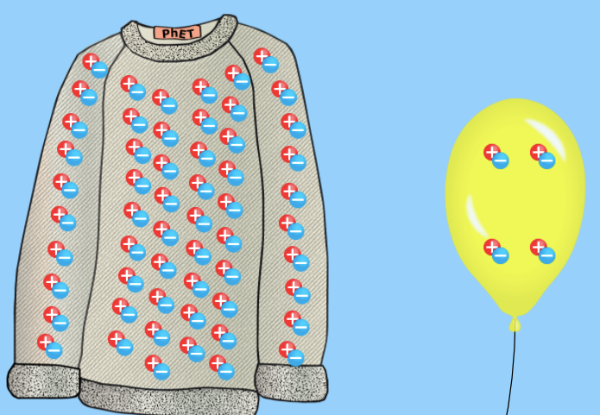
Expected Results
The stream of water should bend towards the balloon as it is attracted to the balloon.
Why?
When the balloon is rubbed on hair or clothes, electrons move onto the balloon giving it a negative charge.
When the negatively charged balloon is brought near the water, electrons are repelled and move away from the balloon, leaving a positive area of the water near the balloon.
The negatively charged balloon and the positive area of the water attract.

Slide 10
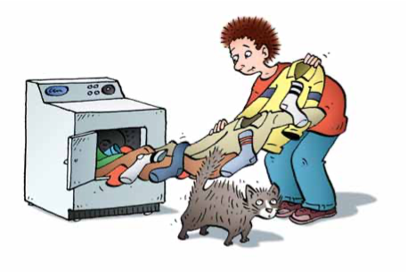
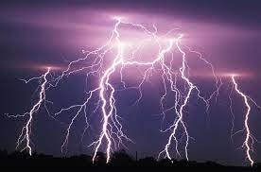
Charging an object by using friction occurs naturally in many situations in nature.
For example, the static charge in the clouds that produce lightening is due to friction as hot air rises rapidly in cloud banks.
Lightning is a giant spark of electricity in the atmosphere between clouds, the air, or the ground. In the early stages of development, air acts as an insulator between the + and - charges in the cloud and between the cloud and the ground. When the opposite charges build up enough, this insulating capacity of the air breaks down and there is a rapid discharge of electricity that we know as lightning. The flash of lightning temporarily equalizes the charged regions in the atmosphere until the opposite charges build up again.

Slide 11
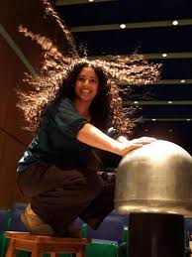
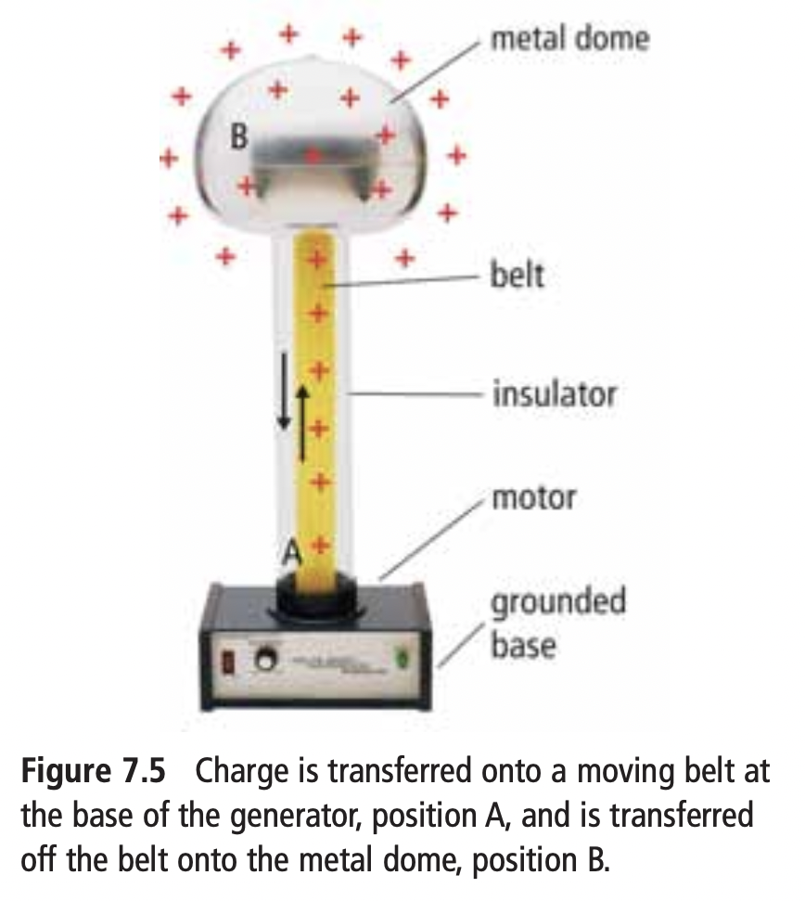
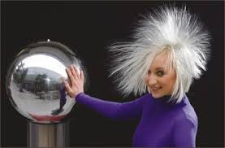
Van de Graaff Generator
The first successful “lightning” machine was invented in 1929 by American physicist Robert Van de Graaff.
Uses a moving belt to produce a static charge at the base of the generator. The belt carries this charge to the top where it collects on the dome.

Slide 12
Van de Graaff Generator – demos ☺

Slide 15
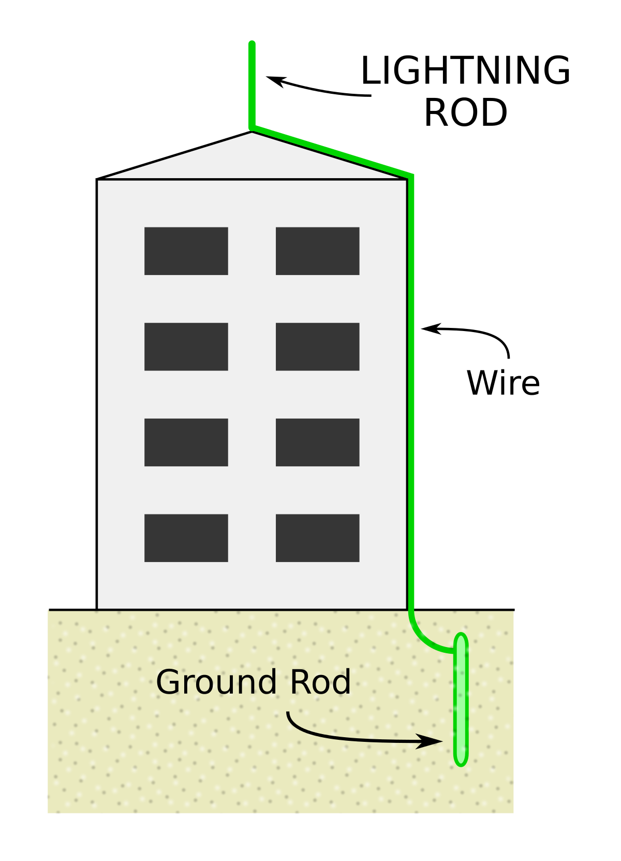
Dangers of Static Electricity

