Slide 1
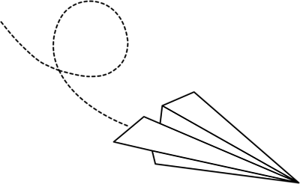
LAB
In your lab groups, design and carry out an experiment that aims to answer the following question:
Required components:
Question
Hypothesis
Materials
Procedure
Observations & Data
Analysis (Graph)
Concluding statement
You may work on a single document (digital shared doc or written)
In ALL science labs and activities…
First… Think about it
Second… Talk about it
Third… Then do it/ask it
“What is the best paper airplane?”
Paper Airplane
Lab

Slide 2
Let’s talk about that Paper Airplane Lab, shall we?
Now, you know you made mistakes on your first go-around (which is SUPPOSED TO HAPPEN
– it’s how we learn!!)

Slide 3
What was wrong with the QUESTION?
“What is the best paper airplane?”
What does ”BEST” mean?
Needs to be testable & measurable
flight distance
mass
airtime
length
What effect does _____ have on ______?
What are you manipulating?
What are you measuring?
= “independent variable”
= “dependent variable”

Slide 4
1. What MATERIALS do you need to re-do this experiment to make the data more accurate & reliable? Be specific ;)

Slide 5
What did the MEASUREMENT look like?
2. Let’s talk about the physical measuring of length that happened

Slide 6
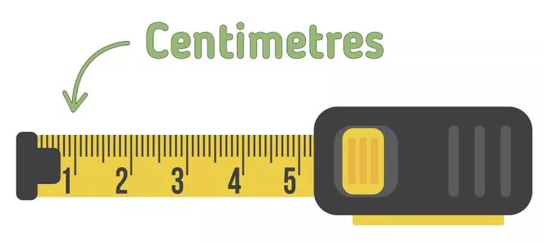
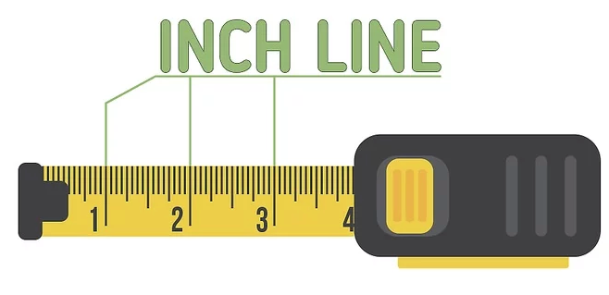
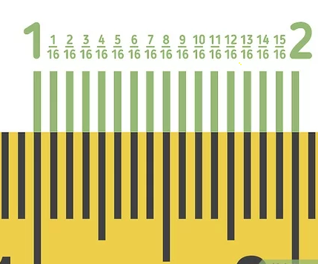
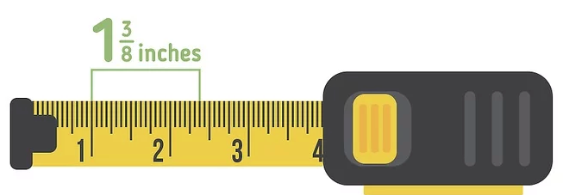
What did the MEASUREMENT look like?
3. Did you read the measuring tape correctly?

Slide 7
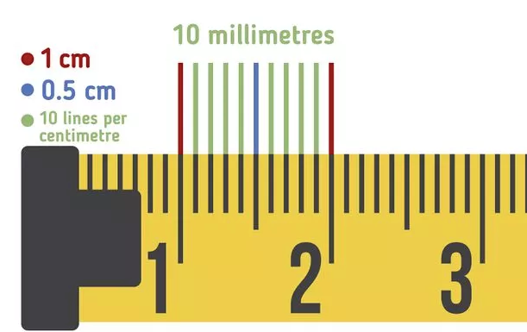
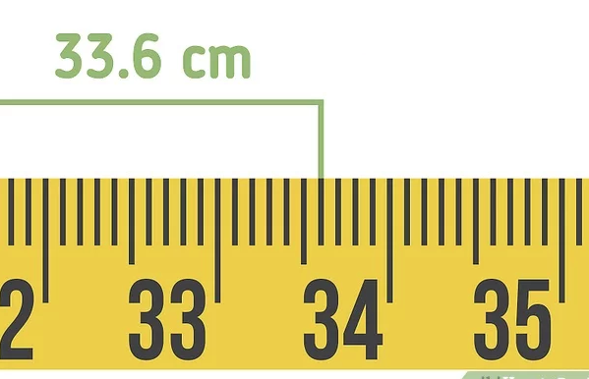
What did the MEASUREMENT look like?
3. Did you read the measuring tape correctly?

Slide 8
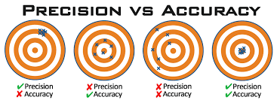
What did the MEASUREMENT look like?
4. Did you perform repeated trials?
Why is this important?
Repeated trials → averages that can be graphed and analyzed

Slide 9
What did your GRAPH look like?
5. What does a BAR graph tell us?
We don’t typically design experiments that generate a bar graph (but when can they be useful?)

Slide 10
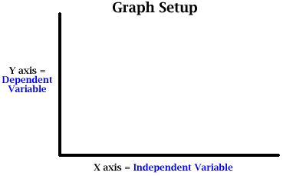
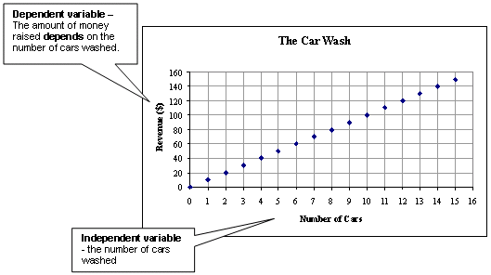
Then what kind of graph are we aiming for?
A scatter plot!

Slide 11
How to know which TYPE of graph to use
Always quantitative
Describes how it Looks
If qualitative…
If quantitative…
Mnemonic device
QUALITATIVE
QUANTITATIVE
BAR
SCATTER
Describes with a Number

Slide 12
ARE BAR GRAPHS AWFUL THEN?
No…
The bar graph can be used for preliminary data (why we chose the experimental set-up we did)
It’s less helpful in scientific investigations studying relationship between variables
If your question leads to a bar graph, continue the experiment!
New Question based off that data
Scatter with trendline ☺
Question
Bar
Graph

Slide 13
LAB
In your lab groups, design and carry out an experiment that aims to answer a measurable question (that you come up with), regarding a factor that affects paper airplane ‘success’
Required components:
Question
Hypothesis
Materials
Procedure
Observations & Data
Analysis
Concluding statement
You may work on a single document (digital or written). Upload to Teams before next class.
In ALL science labs and activities…
First… Think about it
Second… Talk about it
Third… Then do it/ask it
Let’s try this again, then!
Note: “success” is an unquantifiable word, like “best” (i.e. don’t use it) – you decide what you’re measuring!
Paper Airplane
Lab

Slide 14
Required components:
Question
Hypothesis
Materials
Procedure
Observations & Data
Analysis
Concluding statement
Measurable & testable. Has both IV & DV.
What effect does _(IV)_have on (DV)_?
Measurable & testable. Has both IV & DV. Basically rewords the question into a prediction.
Specific (incl type and quantity). List. Relevant items only (i.e. “pencil” not required)
Numbered step-by-step. SUPER clear and concise. Like a recipe. Someone else should be able to follow it and get similar results.
In a table. Pre-make the table ahead of time. What data are you planning to collect? Have a spot for averages. Make sure measurement units are in there.
Scatter graph! Both axes are labelled with units. IV (what you’re changing) is on the x-axis/horizontal and DV (what you’re measuring as a result) is on the y-axis/vertical
Two-liner. What does the shape of your graph tell you? Is your hypothesis accepted or rejected? (note: not right or wrong!)

