Slide 1
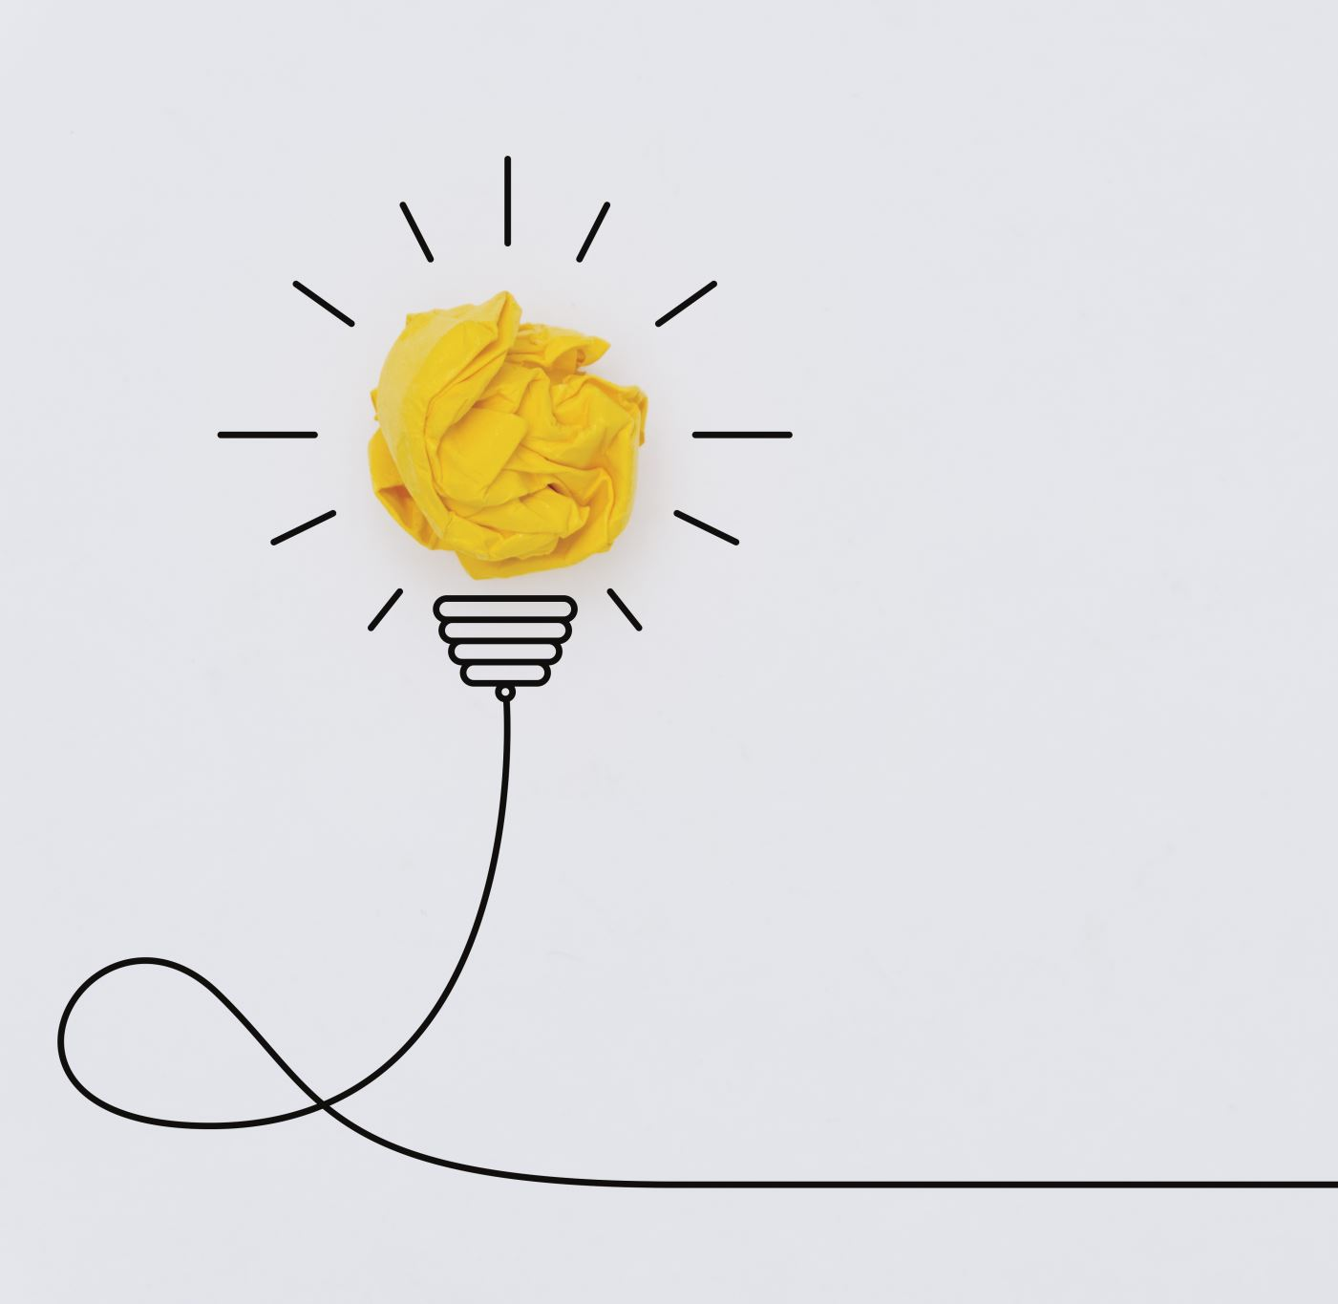
TOPIC: ELECTRIC POTENTIAL ENERGY AND VOLTAGE

Slide 2
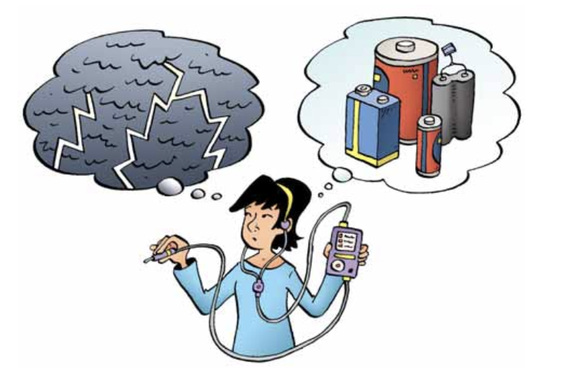
What do these have in common?
Separate positive and negative charges
How are these different?
Lightning is an uncontrolled burst of static electrical energy
A battery can provide a steady, controlled flow of electricity.

Slide 3
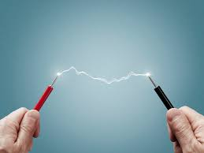
Recall….
Two types of Electricity
Static Electricity – is a build-up of charge that remains stationary in one place
Current Electricity – is moving charges (usually through a wire)

Slide 4
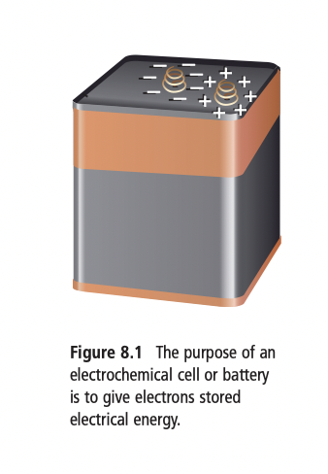
A battery is a combination of electrochemical cells connected together.
Electrochemical cells convert chemical energy into electrical energy
In a battery, chemical energy separates the + and - charges.
The battery terminals are the end points where we make a connection. Extra electrons accumulate on one of the battery terminals, making it negatively charged. The other terminal has lost these electrons and is therefore positively charged.
Notes:
The letters on a battery give the size, in height and width, of the battery. AA means “50.5mm x 14.5mm.” The later the letter the larger the battery. "D" is larger than "C", etc. "A" is larger than "AA" is larger than "AAA".

Slide 5
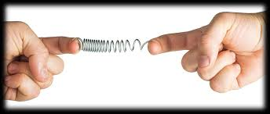
ELECTRIC POTENTIAL ENERGY
Energy is the ability to do work.
Kinetic energy is energy a moving object has because of its motion.
Potential energy is the energy stored in an object.
The electrical energy stored in a battery is called electric potential energy because the electrons have a stored energy and the ability to do work after they leave the battery.
If you stretch a spring and hold it, the energy in the spring is stored. This is an example of potential energy. The energy stored in the spring will not be released until you let go.
Likewise, in order for the electrons to lose their stored electrical energy, the battery must be connected to a device. When you connect a battery to a light bulb, the electric potential energy is “released” as the electrons move through the wire inside the bulb and the electrons’ energy is converted into heat and light energy.

Slide 6
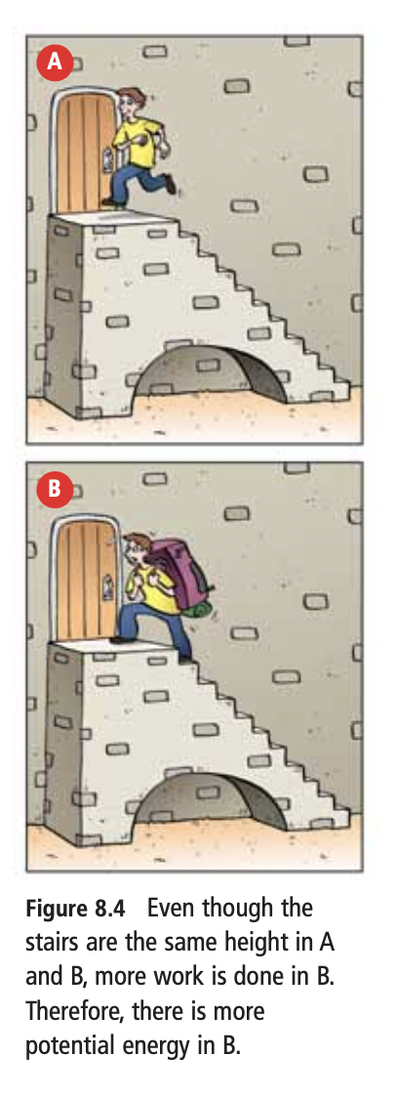
ELECTRIC POTENTIAL DIFFERENCE
Recall charge is measured in coloumbs
The amount of electric potential energy per 1 coulomb of charge is called the potential difference or voltage
Unit is the volt (V), measured with a voltmeter
COMPARING P.E. AND P.D.
You might compare potential energy and potential difference with climbing a staircase. When you climb a flight of stairs, your body has done work. The work you have done is now potential energy. If you had climbed the same set of stairs with a heavy backpack, you would have done more work. As a result, you and the backpack would have more potential energy. The potential energy thus depends on the height of the stairs and the amount of mass moved to the top.

Slide 7
You can think of the potential difference in a battery as being like the height of the stairs.
The amount of charge separated in a battery is like the mass moved up the stairs.
The potential energy in the battery is due to both the potential difference (volts) and the amount of charge that has been separated (coulombs).
COMPARING P.E. AND P.D.
You might compare potential energy and potential difference with climbing a staircase. When you climb a flight of stairs, your body has done work. The work you have done is now potential energy. If you had climbed the same set of stairs with a heavy backpack, you would have done more work. As a result, you and the backpack would have more potential energy. The potential energy thus depends on the height of the stairs and the amount of mass moved to the top.

Slide 8
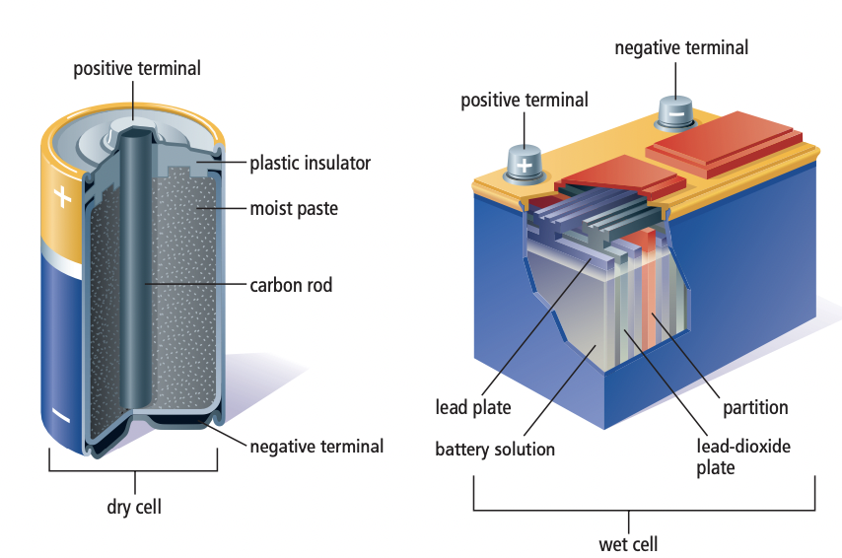
We can classify batteries into two groups:
dry cells : in devices like flashlights, toys, and watches
wet cells : in cars, motorcycles, and electric wheelchairs
Cells consist of the following parts:
a) two electrodes (2 different metals)
b) an electrolyte (conducting substance or acid solution)
Notes:
Dry cells are the batteries in devices like flashlights, portable CD players, and watches. Wet cells are commonly used in cars, motorcycles, and electric wheelchairs. Both types of batteries produce voltage in a similar way.

Slide 9
How batteries work

Slide 10
HOW IT WORKS
The acidic electrolyte attacks the zinc electrode and pulls atoms off the zinc. But the zinc atoms leave electrons behind on the electrode, and the electrode becomes negatively charged.
At the same time, chemical reactions pull electrons off the copper electrode. Therefore, the copper electrode has a positive charge. Because there is an opposite charge on each electrode, there is a potential difference (voltage) between the two electrodes.

Slide 11
Positive electrode
“cathode”
Negative electrode
“anode”

Slide 12
How an electrochemical cell works
In commercial electrochemical cells and batteries we use, the electrons are stored up at the anode (-), and prevented from reaching the cathode (+), (either by an insulating barrier or by the electrolyte solution itself)
The chemical energy has done the work of separating the positive and negative charges in a cell, and there is now electrical potential energy present in the cell, contained in the electrons.

Slide 13
How an electrochemical cell works
The electrodes are in contact with terminals in the cell, and when the terminals become connected to a completed electrical pathway, charges flow through it
electrons flow from negative → positive electrode

Slide 14
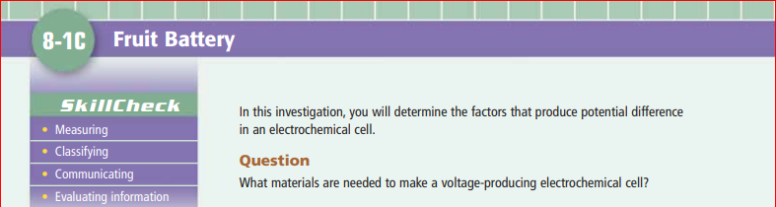
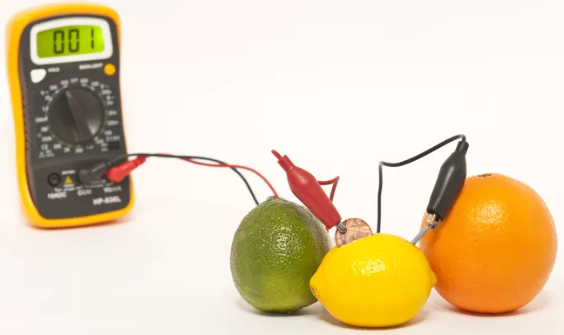
Pg. 276-277
BRING A BIG & JUICY ACIDIC FRUIT OR VEGGIE!!

Slide 15
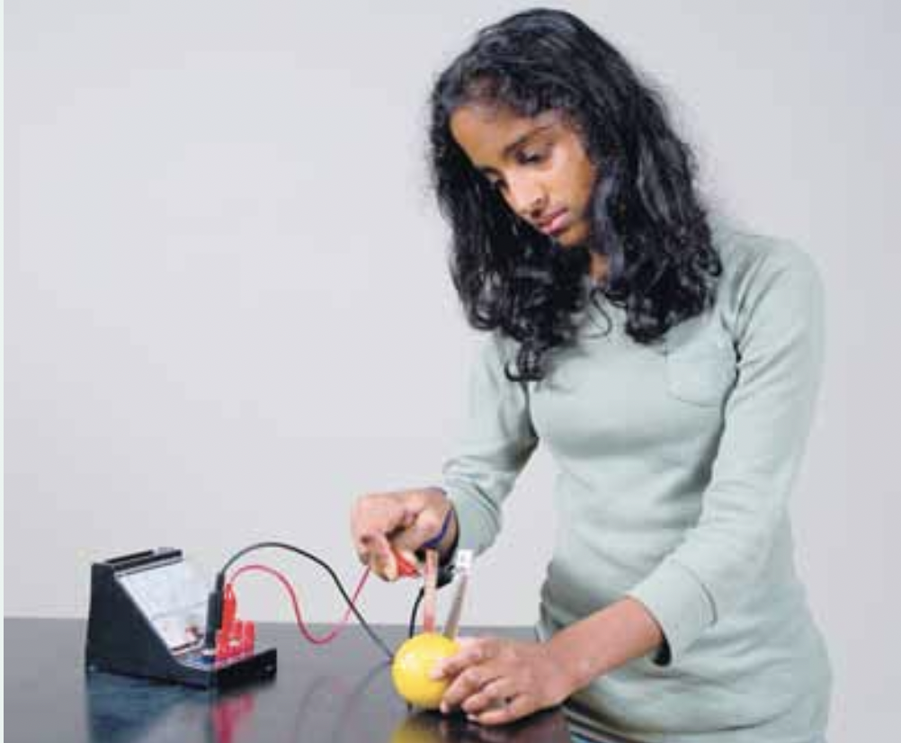
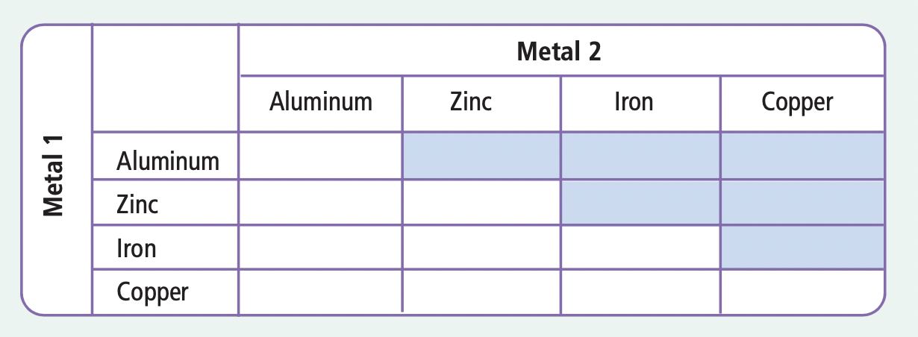
Fruit Battery Lab
(p. 276)

Slide 16
Fruit Battery Lab Instructions [pg. 276-277]
Get a MULTIMETER and test it first using a 1.5 V battery!
Multimeter instructions:
Turn dial to 20V
Put black (-) wire in “com”
Put red (+) wire in “VΩmA”
Turn dial to “OFF” when finished
Complete procedure.
When procedure is complete, bring your “fruit battery” with the “best” electrodes to the front for a “MEGA FRUIT BATTERY”. Use your results to predict what the final voltage will be for all cells combined!
Clean up: put fruit in compost, clean metal electrodes with water and steel wool then dry and put back rest of materials.
Complete all “analyze” questions orally with lab partner(s)

