Slide 1

Investigating
Matter
Chemical Change vs Physical Change
Describing Matter

Slide 2
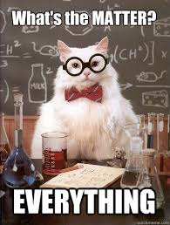
Investigating matter
Matter is anything that has MASS and VOLUME
  Mass is the amount of matter in an object
  Volume is the amount of space the matter occupies
Matter can undergo changes:
  chemical change
  Physical change

Slide 3

Chemical Changes
A chemical change is a change that occurs when substances combine to form new substances
Fireworks vid clip

Slide 4
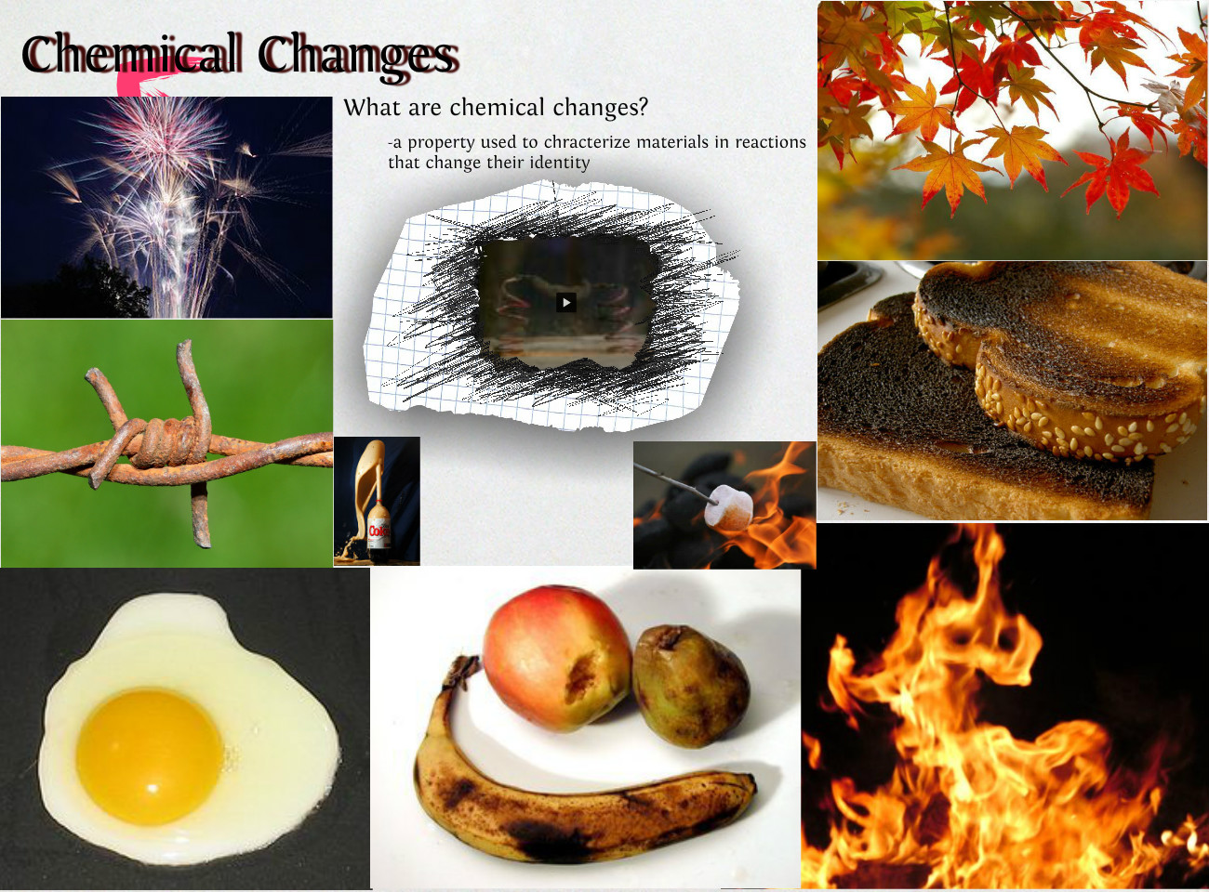
Notes:
What are chemical changes?
A property used to characterize materials in reaction the change their identity
CAN’T GO BACK!
Some examples here:
Fire works- changing solid into gas when heated
Rusting of iron fence (oxidation of the Iron)= Rust consists of hydrated iron(III) oxides Fe₂O₃·nH₂O and iron(III) oxide-hydroxide (FeO(OH), Fe(OH)₃).
Eggs cooking (fluid protein molecules uncoil and crosslink to form a network)
Diet coke and menthos (CLICK M FOR LINK DEMO)
Ethylene- Colourless flammable gas (sweet and musky odor), important natural plant hormone used to ripen fruit- The riper the fruit- the more ethylene it produces
Wounding fruits stimulates the production of ethylene leading to SENECENCE (or biological aging)
“One bad apple spoils the whole bunch”
If you want an avocado to ripen quicker stick it in a bag with a ripe apple– Place any fruit in a bag to ripen it (if bag is sealed ethylene congregates)
Leaves changing colour- Chlorophyll breaks down, the green colour disappears and the yellow to orange colours become visible, additonially, red anthocynanin pigments begin to develop.
Burning a log- chemical rxn that releases carbon.
The more severely a piece of bread is toasted, the more changes occur within the bread. When the sugars and amino acids in bread are heated up, they create acrylamide. This is a chemical linked to cancer in animals, though no human link has been proven. Burnt toast contains small amounts of polycylic aromatic hydrocarbons (PAHs). PAHs are also known to be carcinogenic, though no direct link in humans has been found.
Signs of chemical change: Change of odor, color, temp, composition (paper turning to ash), light or heat given off, precipitate, decomp of organic matter, change is difficult or impossible to reverse

Slide 5
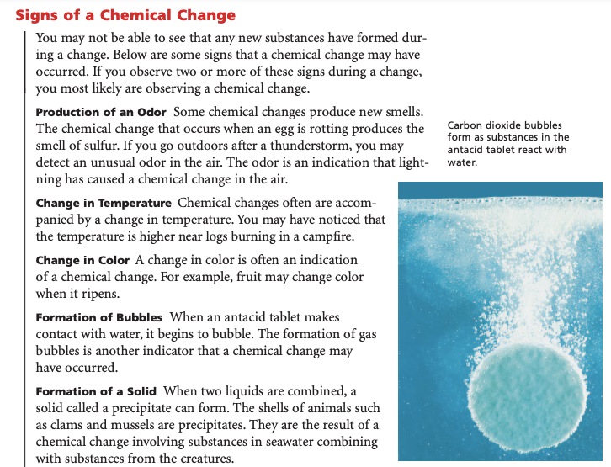

Slide 6
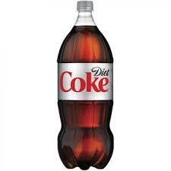


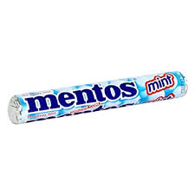
Demo

Slide 7
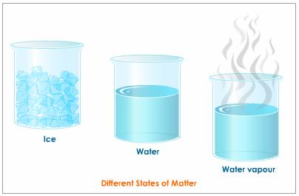
Physical changes
A physical change is a change in which the appearance of matter may change but no chemical bonds are broken or made and no new substance is formed
A change of state is a physical change

Slide 8
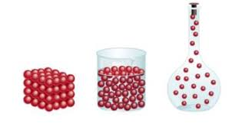
SOLID
Definite shape and volume.
KMT: particles packed together tightly and vibrating
LIQUID
Definite volume; shape determined by surroundings
KMT : particles in contact with each other and can move past each other (slip/slide)
GAS
shape and volume determined by surroundings
KMT : particles have very large spaces between them and move freely
States of Matter

Slide 9
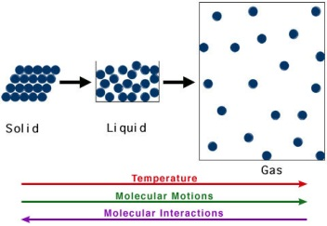
Kinetic Molecular Theory (KMT)
Describes what happens to matter when the kinetic energy of particles changes.
The main points in the theory are:
Matter is made of small particles.
There is empty space between particles.
Particles are constantly moving.
Energy makes particles move.

Slide 10
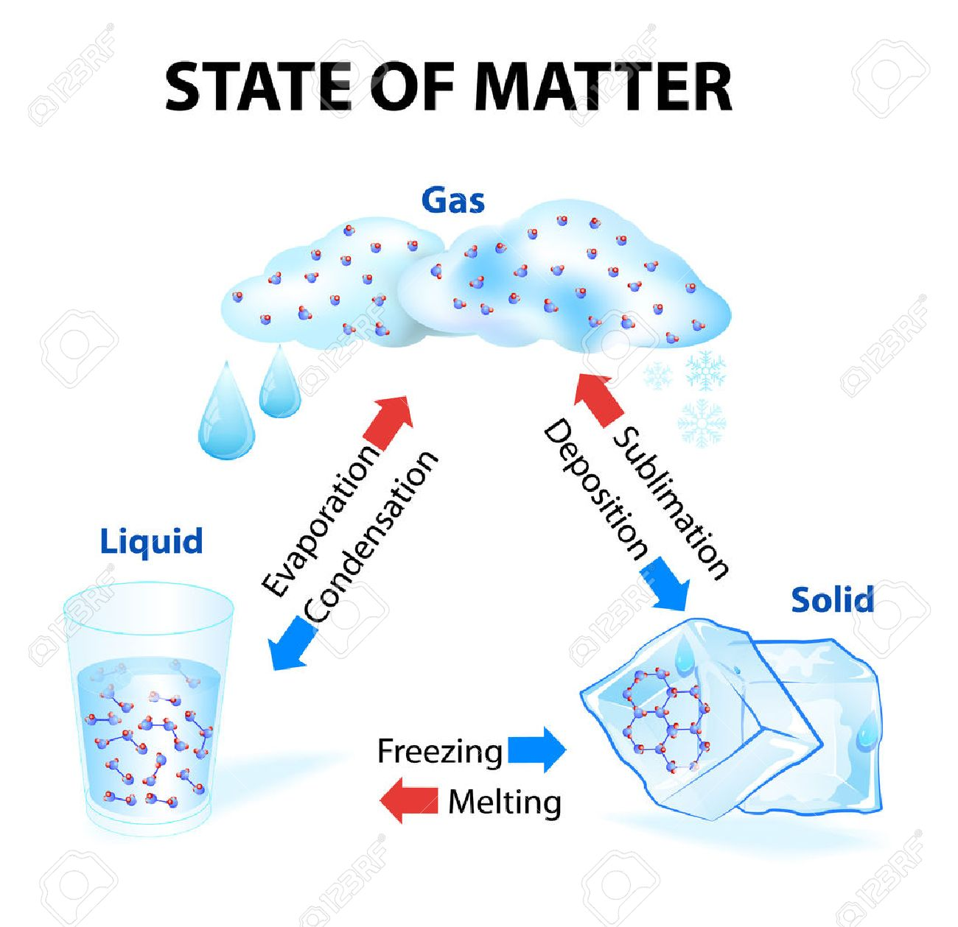
Changes of state depend on factors such as temperature
When heat is added to a substance, its particles gain kinetic energy and move faster, causing them to move farther apart
Melting point: the point at which solid → liquid
Water = 0○c
Boiling point: the point at which liquid → gas
Water = 100○c

Slide 11
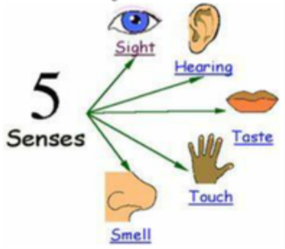
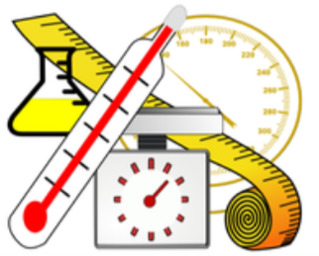
Describing matter
CHEMICAL PROPERTIES: describe a substances ability to react chemically with other substances to form new products.
PHYSICAL PROPERTIES are characteristics of matter that can be observed or measured.
  Qualitative properties: described but not measured; categorical
  Quantitative properties: measured numerically

Slide 12
What are properties?
PHYSICAL PROPERTIES: include characteristics such as state and colour
CHEMICAL PROPERTIES: describe a substances ability to react chemically with other substances to form new products.
example: reactivity

Slide 13
PHYSICAL PROPERITES - QUALITATIVE
PHYISCAL PROPERTY | DESCRIPTION
STATE | SOLID, LIQUID, GAS
COLOUR | COLOUR
MALLEABILITY | ABILITY TO BE BEATEN INTO SHEETS
DUCTILITY | ABILITY TO BE DRAWN INTO WIRES
CRYSTALINITY | SHAPE OR APPEARANCE OF CRYSTALS
MAGNETISM | TENDENCY TO BE ATTRACTED TO A MAGNET

Slide 14
PHYSICAL PROPERITES - QUANTITATIVE
PHYISCAL PROPERTY | DESCRIPTION
SOLUBILITY | ABILITY TO DISSOLVE IN WATER
CONDUCTIVITY | ABILITY TO CONDUCT ELECTRICITY OR HEAT
VISCOSITY | RESISTANCE TO FLOW
DENSITY | RATIO OF MASS TO VOLUME
MELTING/FREEZING POINT | TEMPERATURE OF MELTING/FREEZING
BOILING/CONDENSATION POINT | TEMPERATURE OF BOILING/CONDENSING

Slide 15
Demo
Calcium + Water
Ca(s) + 2H₂O → Ca(OH)₂(s) + H₂(g)
What is the evidence that it was a chemical change?
Chemical Changes

Slide 16
Demo
Elephant
Toothpaste
What kind of qualitative observations can we make regarding the following demo?
Materials:
30% H₂O₂
Dish soap
Catalyst, such as KI (or yeast + warm water)
Observing Chemical Changes

Slide 17
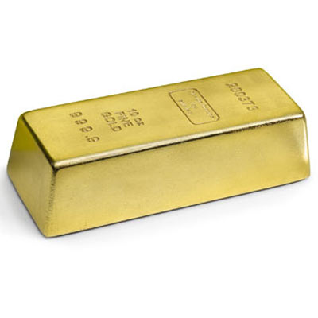
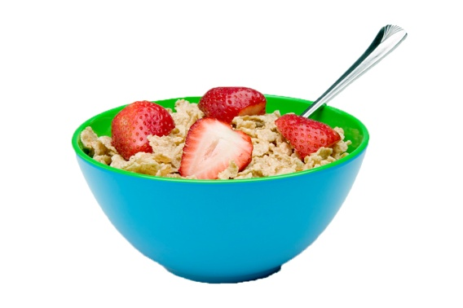
TWO CATEGORIES OF MATTER
PURE SUBSTANCES are substances that are made up of only ONE type of matter. Two types.
Eg. oxygen, water, gold
MIXTURES are substances that are made up of TWO or more types of matter which are mixed but not combined chemically. Three types.
Eg. breakfast cereal, sugar-water, salt-water
Notes:
There are two kinds of pure substances: elements and compounds.
An element is a pure substance that cannot be broken down or separated into simpler substances. Gold and oxygen are both elements.
Periodic Table
A compound is a pure substance composed of at least two elements combined in a specific way. For example, water is a compound that is made up of the elements hydrogen and oxygen.
Mixtures: made up of two or more types of matter which are mixed but not combined chemically

Slide 18


MATTER
Mixtures
Pure Substances
Solutions
Elements
Compounds
Mechanical
Suspensions

Slide 19
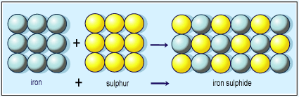
PURE SUBSTANCES
There are TWO types of Pure Substances:
1. ELEMENTS are pure substances that CANNOT be separated into simpler substances. An atom is the smallest particle of an element that retains the properties of the element
Eg. carbon, nitrogen
2. COMPOUNDS are composed of TWO or more elements that are combined chemically.
Eg. water, ethanol

Slide 20
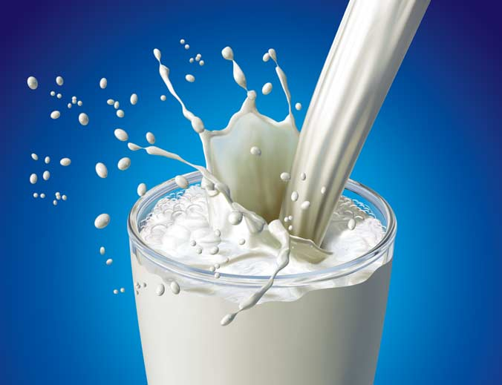
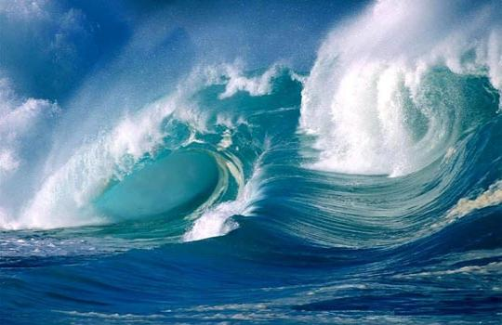
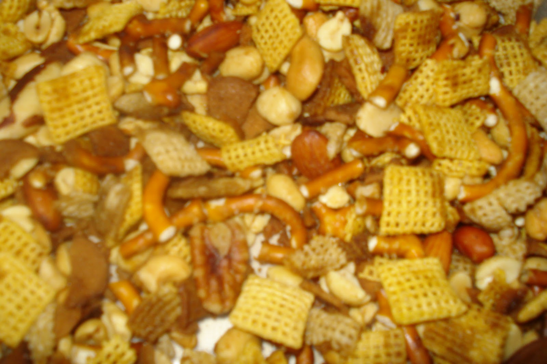
MIXTURES: 3 Types
SOLUTIONS are when one substance is dissolved in another substance.
Eg. sugar-water, salt-water
SUSPENSIONS are when a fluid contains solid particles that will settle out.
Eg. milk, orange juice
MECHANICAL MIXTURES are when the parts of the substance can be easily separated out again.
Eg. Raisin Bran Munchie Mix

Slide 21

To do
Cornell Notes: Describing Matter
Add to study aid
Pre-Lab:
  Bag of Change
  Slivers of Silver
  Detection of Hydrogen Gas
Labs (3!!) on Monday.
Test on Tuesday.

