Slide 1
Circuits

Slide 2
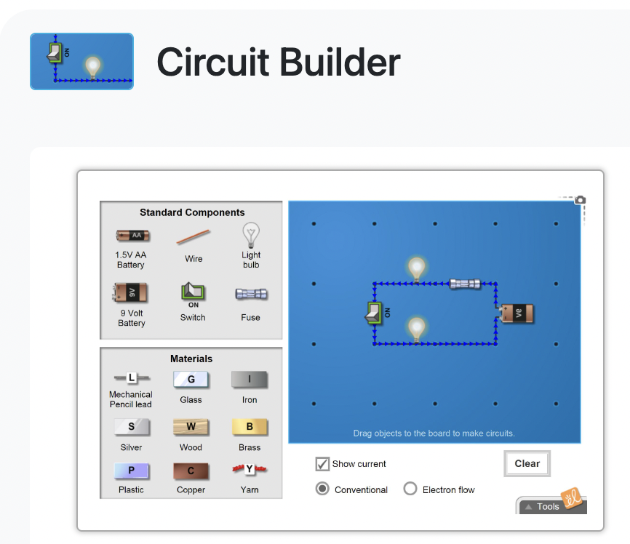

Slide 4
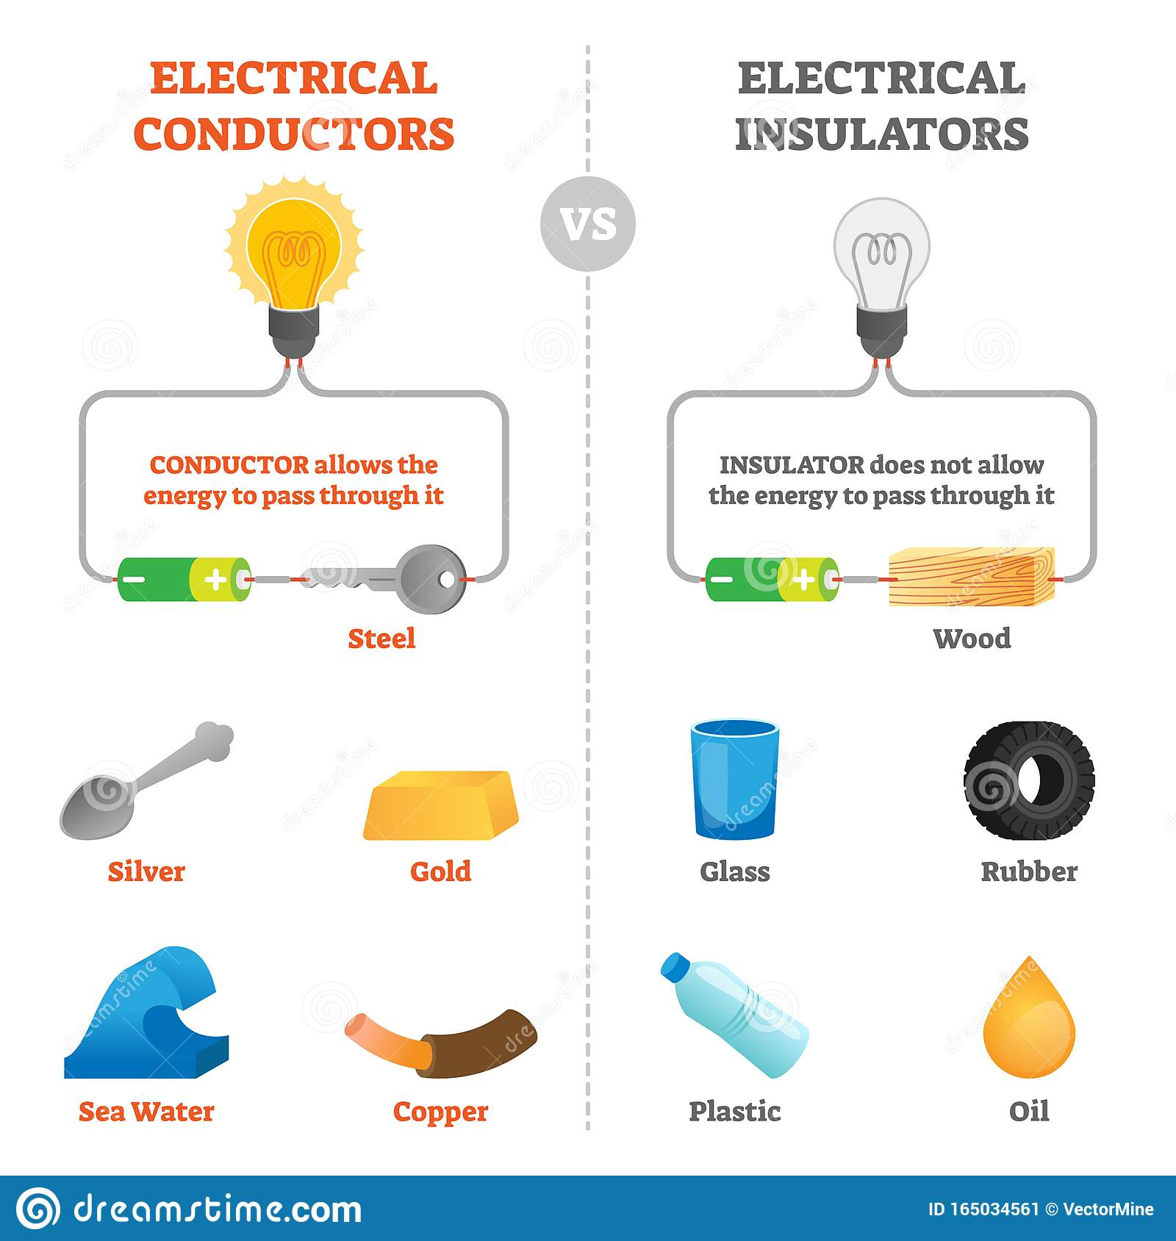
Conductors and Insulators
How easily charges move through a material is referred to as conductivity.
Electrons can move through almost all metals, but they move through some metals faster than others
Silver is the fastest conducting metal, so it is used in cell phones, keyboards, computer chips, etc.

Slide 5
Semiconductors
A semiconductor is a material product usually comprised of silicon, which conducts electricity more than an insulator, but less than a pure conductor.
Their conductivity and other properties can be altered with the introduction of impurities, to meet the specific needs of the electronic component in which it resides.

Slide 6
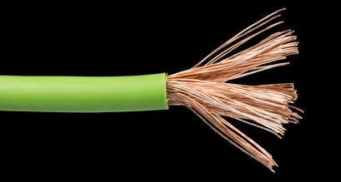
Electrical Safety
conductor = copper
Most electrical wiring is made of metals which are good conductors such as copper, and then are covered by an insulating material such as rubber or plastic for safety.
Safety tip: humans are made up mostly of water and are excellent conductors of electricity, so avoid touching exposed wiring, and stay at least 10 meters away from a downed powerline!
insulator = plastic

Slide 8
Electric Circuits
An electric circuit is a complete pathway that allows electrons to flow.
Electric circuits are made of four basic parts:
Source – the source of electrical energy
Conductor – the wire through which electric current flows
Load – a device that transforms electrical energy into other forms of energy (e.g. lamp) [note: a load also acts as a resistor]
Switch – a device that can close or open the circuit
Electric circuits may also have one or more resistors which hinder, or slow the flow of current, which are not loads.

Slide 9
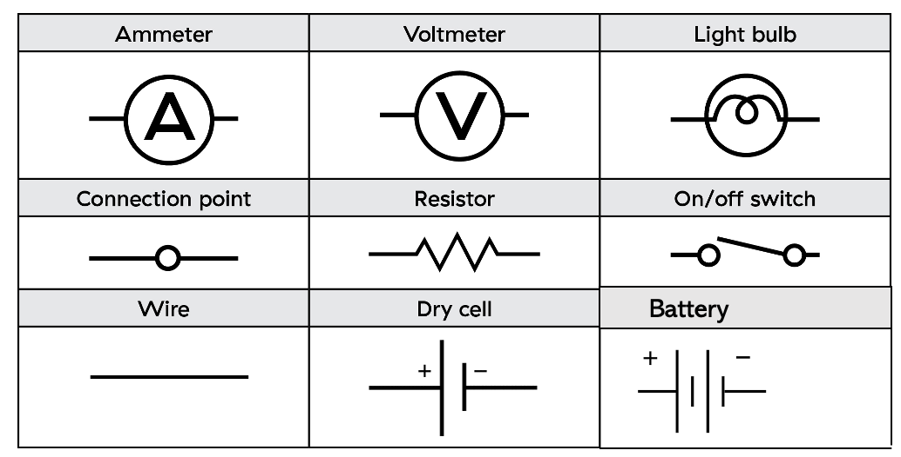
Circuit Symbols
Circuit symbols help identify parts of complex circuits:

Slide 10
Circuits Diagrams
Circuit diagrams use symbols to represent the different components of a circuit
Task: draw a circuit diagram for a circuit comprised of a battery, a switch and two lamps

Slide 11
Circuits Diagrams
Circuit diagrams use symbols to represent the different components of a circuit
Task: draw a circuit diagram for a circuit comprised of a battery, a switch and two lamps

Slide 12
Current Electricity
Current electricity is the continuous flow of electrons in a complete circuit
electrons travel only about 0.5 mm/s in a circuit.
Current will exist when electrons move from an area of high potential energy (where negative (-) electrical charges are built up = anode) to an area of low potential energy (where there is a lack of negative electrical charge (+) = cathode).
Both electric forces (repulsion between like negative charges, and attraction of opposite charges) are moving electrons along the wire!

Slide 13
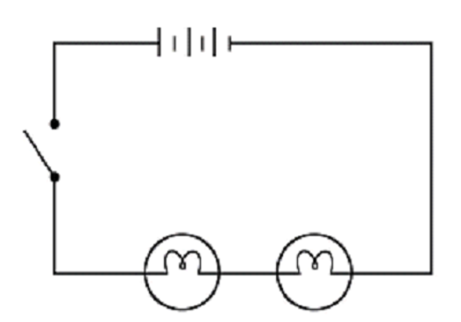
Current Electricity
+
-
**Use arrows on the example you drew to show the direction of electron flow (electric current) for this circuit!

Slide 14
Current Electricity
+
-
**Use arrows on the example you drew to show the direction of electron flow (electric current) for this circuit!

Slide 15
Electron Flow
From the anode, electrons depart with high electrical potential energy.
When they pass through a load, this energy is depleted as it is transformed into other forms of energy, such as radiant (light) energy.
When electrons return to the cathode, they have very low electrical potential energy.
Inside the electrochemical cell the electrons are continually being moved across a distance as the chemical energy is used to separate charges, and the electrons will gain high electrical potential energy at the anode.
[See figure 8.9 pg. 281]

Slide 16
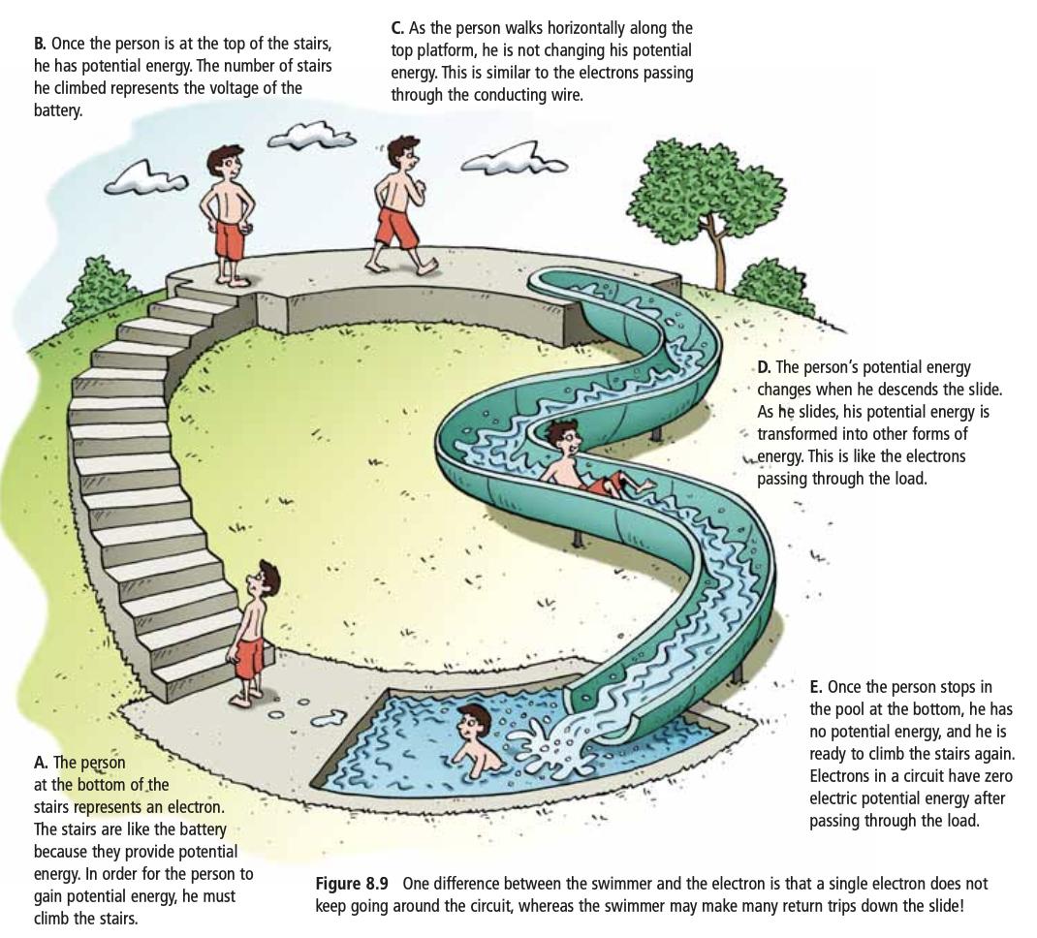

Slide 17
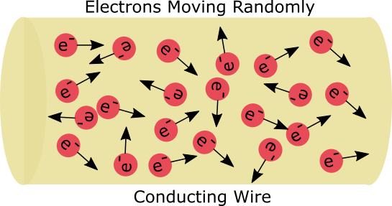
Open vs. Closed Circuit
When a circuit is NOT a completed pathway or closed loop (ex. the switch is open), the electrons are present, but move in random directions:
Electrons will NOT flow in a specific direction if the pathway to the positive terminal is incomplete

Slide 18
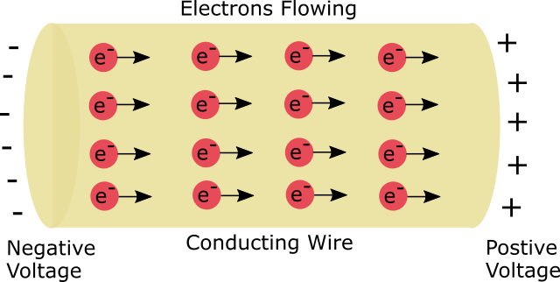
Open vs. Closed Circuit
When a circuit IS a completed pathway or closed loop, the electrons have a complete path through which to flow in order to reach the positive terminal (ex. the switch is closed). All the electrons will flow in a single direction.
When any loads (appliances or devices) are added along the pathway, the electrons will flow through the device to get to the positive terminal, effectively powering the device!

Slide 19
Closed vs Open Circuit

Slide 20
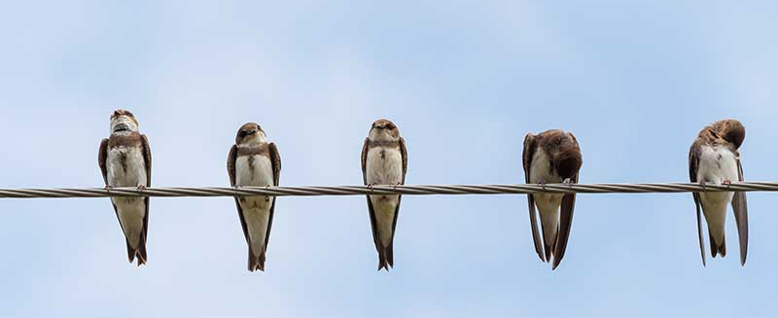
Short Circuits
Electrical charges (electrons) always seek the shortest route around the completed circuit back to the positive terminal of the source.
When there is no load present, the resistance is too low, and the current becomes dangerously high, this is called a SHORT CIRCUIT
When the current is so large, the conductor will overheat and could start a fire within a building’s wiring.
Note: because humans are excellent conductors, when you become part of the electrical loop by coming in contact with electricity, (especially when wet) the electrons will pass through your body, and you will become a SHORT CIRCUIT. This is very dangerous and can be fatal due to electric shock.
So why don’t birds get electrocuted when they sit on powerlines?

