Slide 1
Resistance and Ohm’s Law

Slide 2
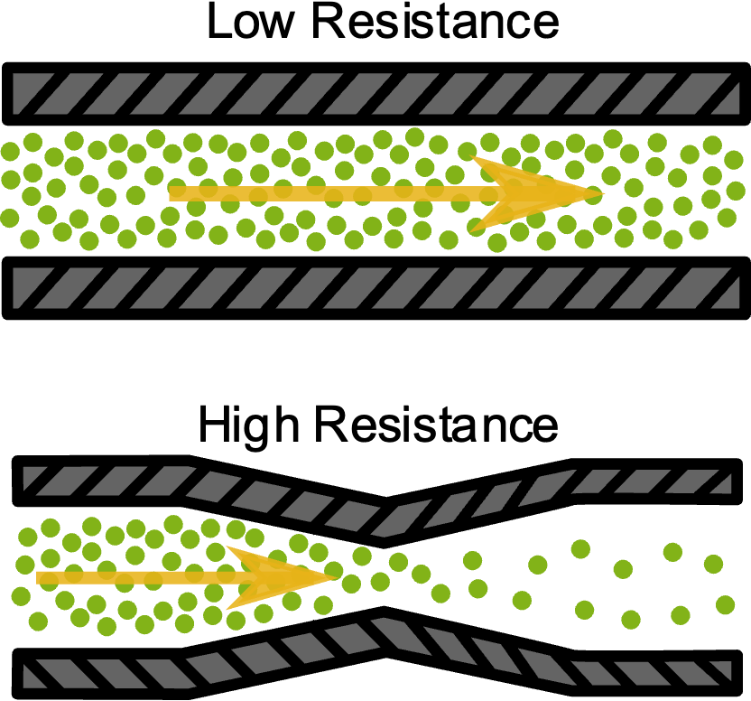
Resistance
Resistance is the property of any material that slows down, or hinders, the flow of electrons
A load, which converts electrical energy into other forms of energy, works as a resistor. While passing through the load, electrons in the current will collide with atoms that make up the load, or even with each other; these collisions interfere with current and slow it down.
For example, a conducting wire has low resistance, whereas the filament of a lightbulb has high resistance!

Slide 3
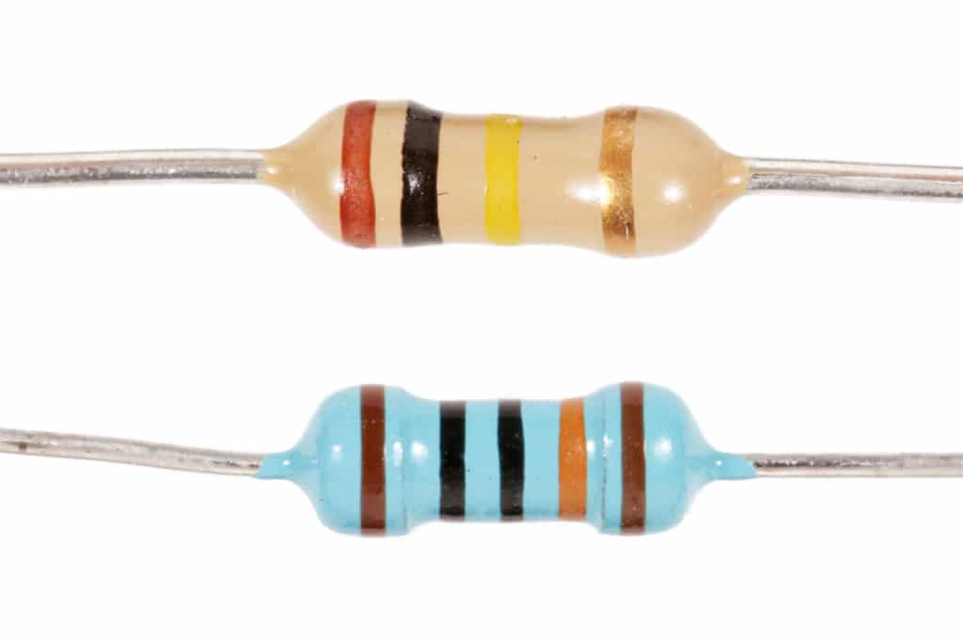
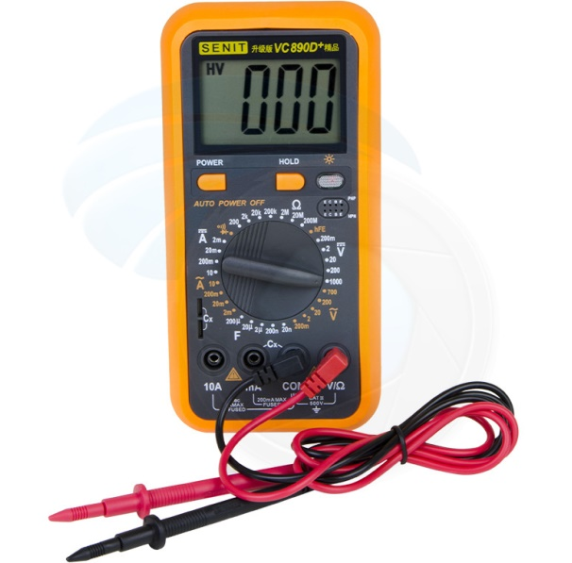
The Resistor
A resistor is an electrical component that has a specific resistance, designed to slow current. High voltage power lines that travel long distances often have very high current which must be lowered prior entering households.
Resistors transform electrical energy into other forms, such as heat.
The circuit symbol for a resistor is:
The symbol for Resistance is “R”, and it is measured in “Ohms” (Ω)
An Ohmmeter measures resistance in a circuit (it may be connected in parallel OR in series).

Slide 4
Resistor Colour Code
Resistors are marked with coloured bands indicating their resistance value, and there is a legend for which numbers these colours represent

Slide 5
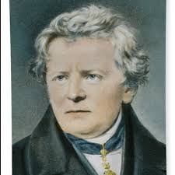
Ohm’s Law
German physicist Georg Ohm discovered a relationship between resistance, current and voltage (aka electrical potential difference) in a conductor.
For example, he found that when he increased the voltage in a conductor, the current also increased proportionally (for given resistance).
This relationship is defined as “OHM’S LAW”:
V stands for voltage (measured in volts, V)
I stands for current (measured in amperes or amps, A)
R stands for resistance (measured in ohms, Ω)
Voltage = Current x Resistance V = IR

Slide 6
Ohm’s Law

Slide 7
Ohm’s Law V = IR
By rearranging the variables in Ohm’s Law, we can use the equation to calculate any unknown value (if given the other two values)!
V = I R
R R
By dividing both sides of the equation by R, we get an equation for calculating current, I:
I = $\frac{V}{R}$ or I = V ÷ R
V = I R
I I
By dividing both sides of the equation by I, we get an equation for calculating resistance, R:
R = $\frac{V}{I}$ or R = V ÷ I

Slide 8
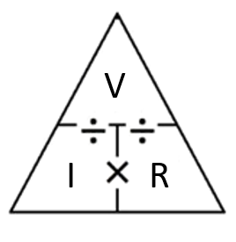
Ohm’s Law V = IR
$$I= \frac{V}{R}$$
$$R= \frac{V}{I}$$

Slide 9
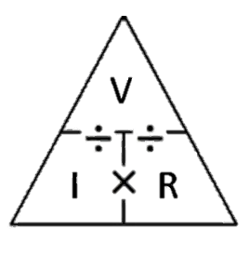
Example 1: Ohm’s Law V = IR
The current through a load in a circuit is 1.5 A. If the potential difference across the load is 12 V, what is the resistance of the load?
I = 1.5A V = 12V R =??
R = $\frac{V}{I}$ or R = V ÷ I
R = $\frac{12 V}{1.5 A}$ → R = 8 Ω

Slide 10
Example 2: Ohm’s Law V = IR
The resistance of a car headlight is 15 Ω. If there is a current of 0.80 A through the headlight, what is the voltage across the headlight?
R = 15 Ω I = 0.80 A V = ??
V = IR
V = (0.80 A )( 15 Ω ) → V = 12 V

Slide 11
Practice time!
1. A small portable stove operates from a 120 V outlet. When it is in use, 6 A flow through it. What is the resistance of the heating element of the stove?
I = 6A V = 120V R =?? R = $\frac{V}{I}$ = $\frac{120 V}{6 A}$ = 20 Ω
2. What is the current flowing through a 24 Ω resistor, if it has a voltage of 90 V across it?
I = ?? V = 90V R =24Ω. I = $\frac{V}{R}$ = $\frac{90 V}{24 Ω}$ = 3.75 A
3. What is the voltage through a hair dryer if 15A flows, and the resistance of the dryer is 8 Ω?
I = 15A V = ?? R =8Ω V = IR = 15A x 8Ω = 120 V

Slide 12
Ohm’s Law & Metric Conversions
Ohm’s Law V = IR
Units used in the equation must be:
Amps for current
Ohms for resistance
Volts for voltage
**If we encounter a problem with different units than the base units, we must convert the units to the base unit before using the Ohms’ Law equation!
Unit factor method!!

Slide 13
Metric Conversions Review
Convert the following, showing all steps of the unit factor method:
1) 25 mA = ________ A
2) 5.0 kΩ = ________ Ω
3) 12 MV = ________ V
4) 0.5 A = ________ mA
5) 600,000 V = ________ MV
6) 0.02 Ω = ________ mΩ

Slide 14
Metric Conversions Review - Solutions
1) 25 mA = 0.025 A
2) 5.0 kΩ = 5,000 Ω
3) 12 MV = 12,000,000 V
4) 0.5 A = 500 mA
5) 600,000 V = 0.6 MV
6) 0.02 Ω = 20 mΩ

Slide 15
Example 3:
A 15 mA current flows through a 400 Ω lamp. What is the voltage across the lamp?
I = 15mA R =400Ω V = ??
Convert 15mA to ____A (unit factor method!!)
15 mA x $\frac{1A}{1000 mA}$ = 0.015A
V = I R
V = (0.015A) (400 Ω)
V = 6 V

Slide 16
Example 4:
A 12 kΩ load is connected to a 90 V power supply. What is the current through the load, in milliamper3es (mA)?
R = 12 kΩ V =90 I = ?? ← in mA
Convert 12 kΩ to ____ Ω (unit factor method!!)
12 kΩ x $\frac{\text{1000}\text{Ω}}{1 k\text{Ω}}$ = 12000 Ω
I = $\frac{V}{R}$ I = $\frac{90 V }{12 000\text{Ω}}$ I = 0.0075 A
x $\frac{\text{1000 }\text{mA}}{\text{1 }\text{A}}$ = 7.5 mA

Slide 17
Scientific Notation Review
You will encounter scientific notation either in the questions, or you will be asked to write your answers in scientific notation!
Convert the following into scientific notation:
12 000 Ω = ____________
0.00005 mA = _____________
2300 V = _____________

Slide 18
Scientific Notation Review - Solutions
12 000 Ω = 1.2 x 10⁴ Ω
0.00005 mA = 5.0 x 10⁻⁵ mA
2300 V = 2.3 x 10³ V

