Slide 1
Series vs Parallel Circuits

Slide 2
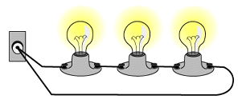
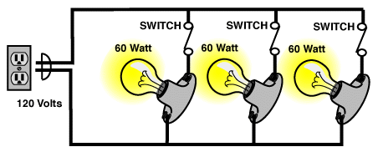
There are two ways to connect components in a circuit:
IN SERIES
IN PARALLEL
When one bulb goes out, they all go out, because there is only ONE pathway for the current to flow!
When one bulb goes out, the other bulbs stay lit, because there is MORE THAN one pathway for the current to flow!
Which one of these scenarios is more practical?

Slide 3
Series Circuits - One Pathway
All components are connected one after another (negative to positive)
Electrons must pass through EACH load in the circuit on their way back to the source
Only ONE path for electrons to flow (no branches)
Brightness of each bulb decreases

Slide 4
Series circuits - One pathway
VOLTAGE:
The sum of the voltages lost on the loads equals the total voltage supplied by the battery
CURRENT:
Current measured anywhere in the series circuit will be the same

Slide 5
Series circuits - One pathway
Resistance:
The total resistance of the circuit is increased when resistors are placed in series (add together)
The total current leaving the battery (and throughout the circuit) therefore decreases!

Slide 6
PARALLEL CIRCUITS - MULTIPLE PATHWAYS
Components are arranged in different branches throughout the circuit = separate paths the electrons can take to get back to source
At each branch point (aka junction point) the current splits, then rejoins again at the source
If there is a break in one branch, the components on other branches still work!
Brightness of each bulb is overall higher than in series

Slide 7
Parallel circuits - Multiple pathways
VOLTAGE:
Voltage remains the same throughout each pathway of the parallel circuit
CURRENT:
Current splits up between the different current pathways (adds together)

Slide 8
Parallel Circuits are Safer
When large amounts of current flow through a wire, it can overheat and start a fire. This is an example of a short-circuit

Slide 9
Parallel circuits - Multiple pathways
RESISTANCE:
The total resistance of the circuit is decreased when resistors are placed in parallel
The total current leaving the battery (and throughout the circuit) therefore increases!

Slide 10
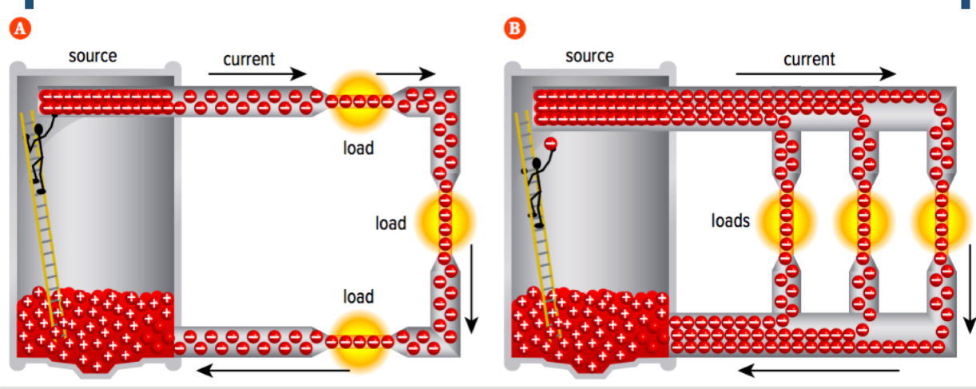
Series vs. Parallel Current
Series: Current is equal in ALL parts of the circuit. | Parallel: Current splits (not always equally) into multiple paths.

Slide 11
Series vs Parallel Circuits
SASS:
Series Amps Stay the Same
You will need to apply these principles in problem solving!
PVSS:
Parallel Voltage Stays the Same

Slide 13
RECAP:
SERIES
“SASS”: series amps stay same
I = I₁ = I₂
V = V₁ + V₂
R = R₁ + R₂
PARALLEL
“PVSS”: parallel voltage stay same
I = I₁ + I₂
V = V₁ = V₂
$\frac{1}{R}$ = $\frac{1}{R1}$ + $\frac{1}{R2}$

