Slide 1
Asexual Reproduction
Section 5.2

Slide 2
Asexual Reproduction
In asexual reproduction, only one parent is required.
Asexually produced offspring, or clones, have identical genetic information to each other and to the parent.
Ex: Bread mould is a group of clones that come from a single mould spore
Asexually reproducing unicellular organisms reproduce quickly and in large numbers.
Knowledge of asexual reproduction enables biotechnologists to clone both organisms and cells.

Slide 3
Types of Asexual Reproduction
binary fission
budding
fragmentation
vegetative reproduction
spore formation

Slide 4
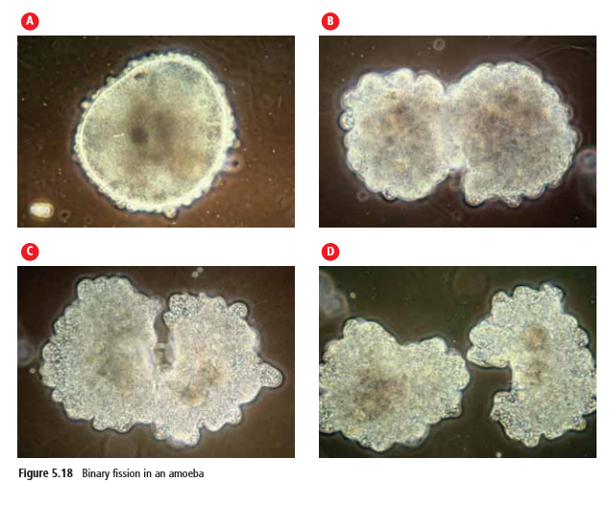
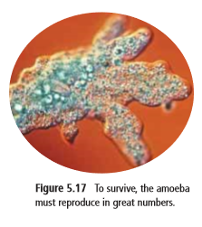
Binary Fission
The term “binary fission” comes from the Latin words binarius, meaning two together, and fissio, meaning to split.
In binary fission, a single parent cell replicates its genetic material and divides into two equal parts.
Examples: Small, one-celled eukaryotic organisms like the amoeba reproduce by binary fission.

Slide 5
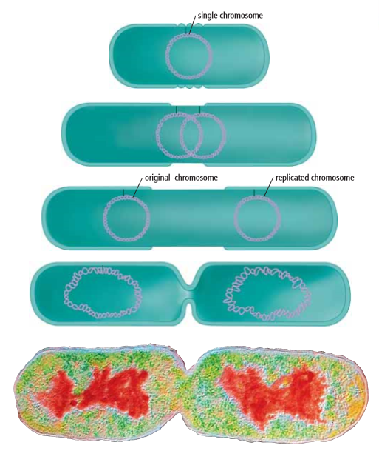
Binary Fission
Example: Bacteria
Binary fission is the only method of reproduction for some types of bacteria. Since bacteria do not have a nucleus, they do not undergo mitosis. However, the one ring of DNA does replicate.
If the environmental conditions are favourable, a bacterium can reproduce every 20 minutes by this method (can multiply into millions very quickly)

Slide 6
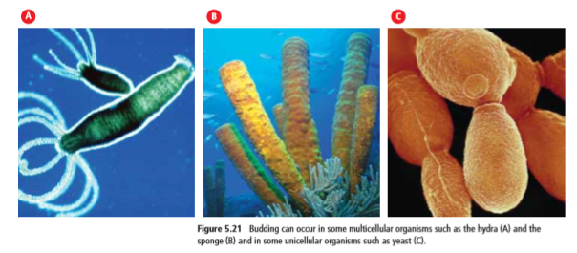
Budding
Budding is advantageous for animals such as sponges, which attach to rock and move very little. Colonies can be maintained in the same place, or new colonies can be established when buds break away from their parents and are carried to new locations
Since some multicellular organisms, such as hydras and sponges, have only a few different cell types, they are also able to reproduce asexually. Areas of an individual may undergo repeated mitosis and cell division and can develop into an identical organism in a method called budding
Ex: The hydra and the sponge develop an outgrowth or bud. The bud may detach from the parent and become a new individual or remain attached

Slide 7
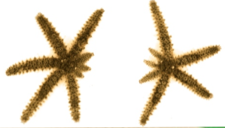
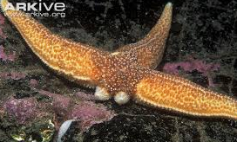
Fragmentation
If an organism breaks apart as a result of injury, each fragment then develops into a clone of its parent.
Some animals, such as certain species of sea star, can reproduce asexually from fragments. In these species, if one of the arms detaches from the parent’s body, it can develop into another sea star if it contains enough of the parent sea star’s genetic information

Slide 8
Vegetative Reproduction
Vegetative reproduction occurs when special cells, usually in plant stems and plant roots, divide repeatedly to form structures that will eventually develop into a plant identical to the parent.
Tulip, daffodil, and hyacinth bulbs, strawberry stem runners, and potato sprouts or “eyes” produce new plants by this natural method of asexual reproduction
The main disadvantage of vegetative reproduction is that the new plants will all grow very close to each other and to the parent. This can lead to a competition for soil, nutrients, and light and can cause the plants to be less healthy.

Slide 9
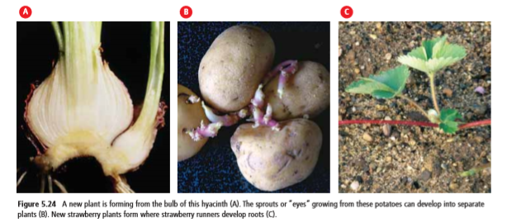
Vegetative Reproduction

Slide 10
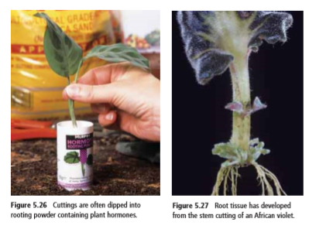
Vegetative Reproduction: Human Assisted - Cutting
A plant grower removes a section of stem (or leaf or root) and plants the cutting in a special growing medium.
Plant hormones, which are chemical messengers, are often applied to the cut stem. The hormones signal the nuclei in the cells of the cutting to stimulate cell division and growth, which causes some cells to develop into root tissue

Slide 11
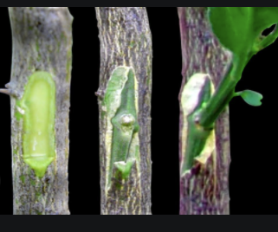
Vegetative Reproduction: Human Assisted - Grafting
In grafting, stems called scions are attached to the rooted stock (or “rootstock”) of a similar plant species.
Ex: Often used to reproduce apple trees & rose plants.
Grafting has several advantages:
It can help the scion benefit from a more vigorous root system.
Grafted trees produce fruit much earlier because of the developed root system onto which they are attached
Grafting can also control the eventual size of the plant. For example, apple scions are often grafted onto dwarfing rootstock so that they will develop into smaller trees

Slide 12
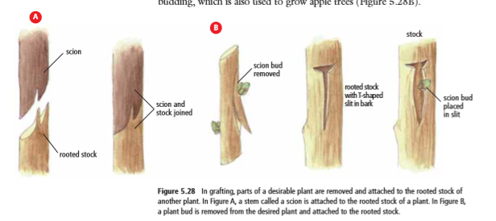

Slide 13
Spore formation
A spore is a reproductive cell that grows into a new individual by mitosis.
Ex: bacteria, micro-organisms, fungi, mosses and ferns
Spores are very light in weight, and spore producers rely on water or wind to carry the spores away from the parent.
If there is enough moisture, the temperature is right and there is a source of food, a new individual will begin to grow wherever it lands.
Many spore types have a tough outer coating that allows them to survive in harsh conditions such as drought or extreme temperatures until conditions become favourable.

Slide 14
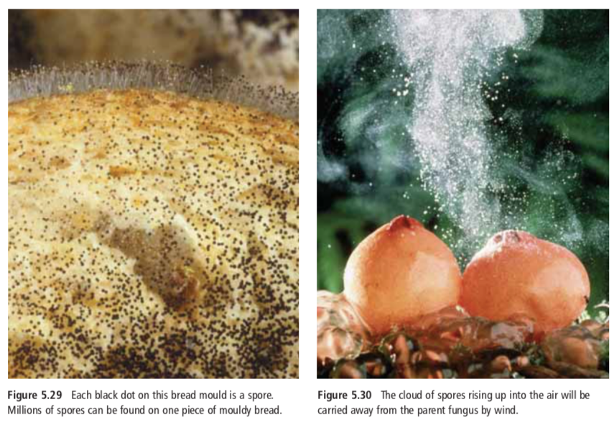

Slide 15
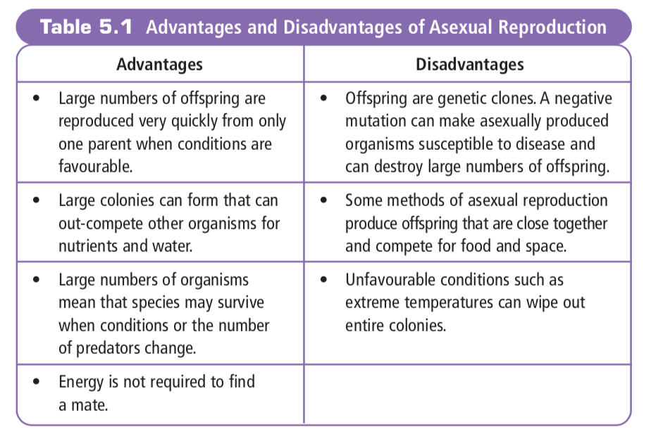

Slide 16
We didn’t get beyond this unfortunately (so you won’t be tested on it) but you can read on about human assisted cloning and STEM cells

Slide 17
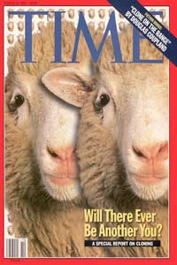
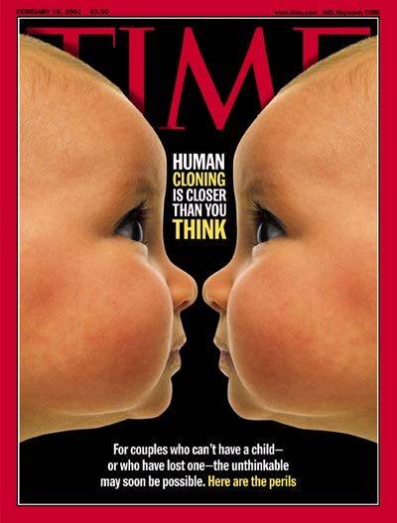
Human Assisted Cloning
Humans use all the asexual cloning methods in order to produce desired results with organisms.
This is done in several ways:
Reproductive cloning
Therapeutic cloning

Slide 18
Reproductive Cloning
-to produce a genetic duplicate of an existing or dead organism.
Steps involved:
Remove nucleus from an egg cell
A mammary gland cell is removed from an adult female
Electricity fuses mammary and egg cell
Fused cell begins dividing
Dividing embryo is inserted into surrogate mother

Slide 19
Hello, Dolly!
DOLLY (July 5 1996- Feb 14 2003)
The method used to clone Dolly, the world’s most famous cloned sheep, transferred the nucleus from a mammary gland cell into an egg cell without a nucleus (Figure 5.32). The fused cell was then transplanted into a surrogate (substitute) mother, and Dolly was eventually born. A problem with this process is that only 10 percent of clones usually survive. Also, the surviving clones can be abnormally large and have higher rates of infection and cancer. Dolly lived for only six years, dying of a lung disease common in sheep. Before her death, she appeared to be aging faster than sheep usually do.

Slide 21
Therapeutic cloning
Purpose is to correct health problems
Very important to therapeutic cloning are stem cells - cells that can become different types of cells
Stem cells can be used to replace cells damaged from injuries or disease
Diabetes, spinal injuries, Parkinson’s disease are only a few that can benefit from stem cell therapy

Slide 22
Therapeutic cloning
Stem cells come from:
Embryonic stem cells: come from embryos that are three to five days old. At this stage, an embryo is called a blastocyst and has about 150 cells. These stem cells can divide into more stem cells or can become ANY type of cell in the body.
Adult stem cells: cells have a more limited ability to give rise to various cells of the body
Perinatal stem cells: Researchers have discovered stem cells in amniotic fluid as well as umbilical cord blood. These stem cells also have the ability to change into specialized cells.
Mayoclinic.org

Slide 23
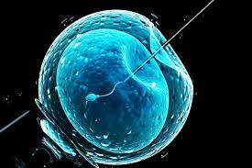
Why are embryonic stem cells controversial?
The embryos being used in embryonic stem cell research come from eggs that were fertilized at in vitro fertilization clinics but never implanted in a woman's uterus. The stem cells are donated with informed consent from donors. The stem cells can live and grow in special solutions in test tubes or petri dishes in laboratories
Mayoclinic.org

Slide 24
