Slide 1
Atomic Size trend in the table

Slide 3
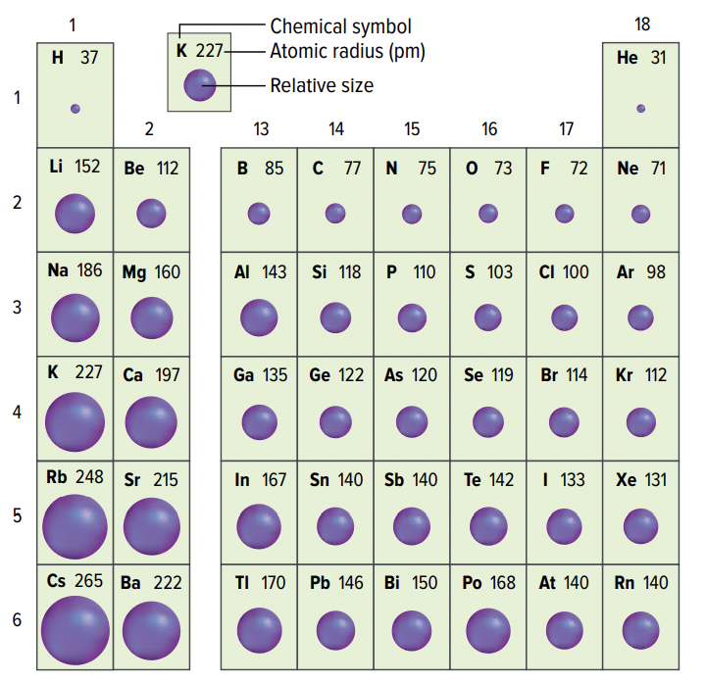
ATOMIC SIZE
Trend: Atomic size increases moving down a group
Why? Elements have atoms with increasing numbers of energy shells
The greater the number of shells, the farther the valence electrons are from the nucleus and the larger the atom is

Slide 4
ATOMIC SIZE
Trend: Atomic size decreases moving left to right across a period
Why? Elements have increasing numbers of electrons in their valence shells as you move L→R across a period BUT the number of occupied valence shells stays the same.
The number of protons in the nucleus increases so effective nuclear charge increases, pulling the valence electrons more tightly to the nucleus

Slide 5
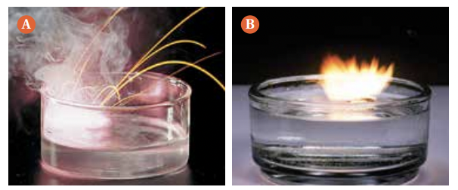
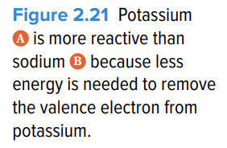
METAL REACTIVITY & ATOM SIZE
Trend: Reactivity increases moving down the table
Why? In a group, the number of valence electrons is the same. But as you go down the group, the atomic size increases. The valence electron(s) becomes farther away from the nucleus so as a result the pull of the nucleus is weaker and the electron(s) is easier to remove.

Slide 7
Build a model of an atom!

Slide 8
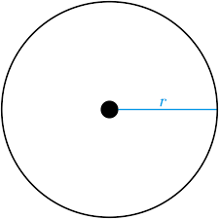
Build a model of an atom!

