Slide 1
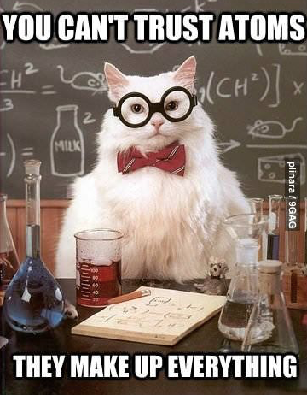
Atomic Theory

Slide 2
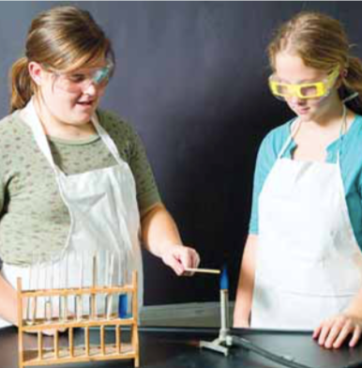
Flaming Metal Ions
Background info
Copy/paste from WORD doc file
Question
Copy/paste from pdf file of textbook
Hypothesis
You create. Use if…then…because format. Note: no IV or DV in this one. Use the background info as scientific rationale (“because…”)
Experimental Set-up → Controlled Variables
Bullet list CVs
Materials
Copy/paste from WORD doc file
Procedure
Do not copy it all out, reference it
Observations & Data
Make data table skeleton with table title.

Slide 3
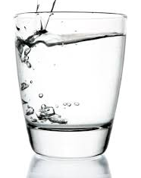
Pure substances
A pure substance is a substance that is made up of only ONE kind of matter.
Gold, water, and oxygen are all pure substances
Two kinds of pure substances:
An ELEMENT is a pure substance that cannot be broken down or separated into simpler substances.
EXAMPLES: Gold and oxygen
An atom is the smallest particle of an element that retains the properties of the element

Slide 4
Pure substances
A pure substance is a substance that is made up of only ONE kind of matter.
Gold, water, and oxygen are all pure substances
Two kinds of pure substances:
A COMPOUND is a pure substance composed of at least two elements combined in a specific way.
Example: water is a compound that is made up of the elements hydrogen and oxygen.

Slide 5
Atomic theory through time

Slide 6
Atoms
compounds
Is an atom the smallest thing?
No!!
Atoms are made up of smaller, subatomic particles
molecules
atoms
protons
neutrons
electrons
quarks

Slide 7
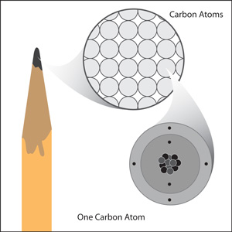

Slide 8
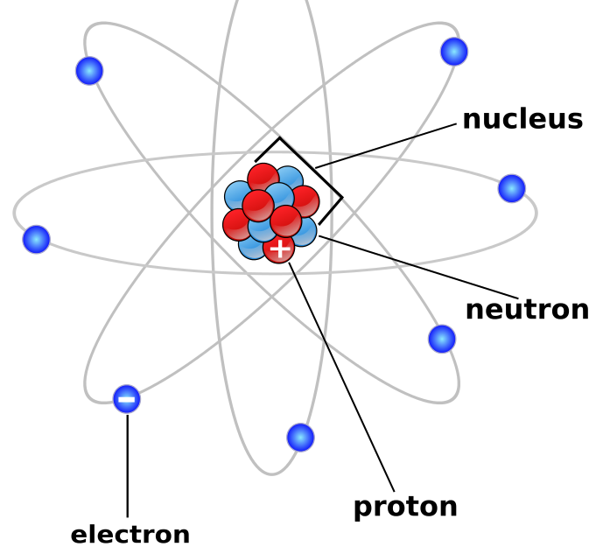
ATOMIC STRUCTURE
NOTE: We recognize this is not the current, cloud-theory model.

Slide 10
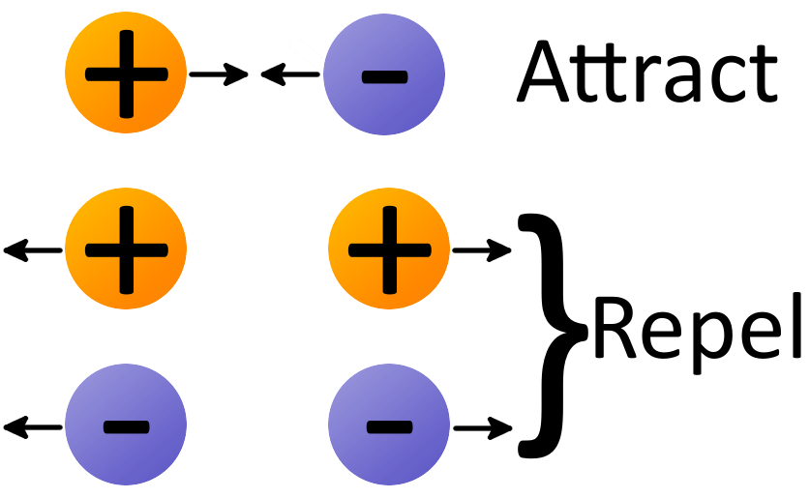
ELECTRIC CHARGE & ATOMS
Electric charge comes in two types: + and -
Charges that are opposite attract each other
Charges that are alike repel each other
The charge on the proton (+) and electron (-) are exactly the same size but opposite, so they are attracted to each other
This is what holds the atom together
Demo: Using balloons to observe electric charge
Attraction/repulsion animation

Slide 11
Using Balloons to Demo Charges
Activity 1: Charged balloon + confetti
Charge a blown-up and tied-off balloon by rubbing it on a sweater (not your head).
Hover it over paper confetti & observe.
Activity 2: Charged balloon + water
Obtain two beakers. Fill one ¾ full with water. Charge a blown-up and tied-off balloon by rubbing it on a sweater.
Put the empty beaker on the table and hold the filled beaker ~30cm above it. Slowly pour into the empty beaker to create a small and consistent stream of water. Slowly bring the balloon close but do not touch the water & observe.

Slide 12
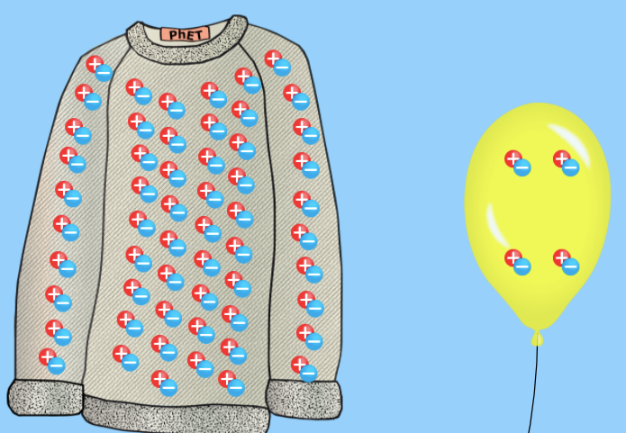
Expected Results
The stream of water should bend towards the balloon as it is attracted to the balloon.
Why?
When the balloon is rubbed on hair or clothes, electrons move onto the balloon giving it a negative charge.
When the negatively charged balloon is brought near the water, electrons are repelled and move away from the balloon, leaving a positive area of the water near the balloon.
The negatively charged balloon and the positive area of the water attract.

Slide 13
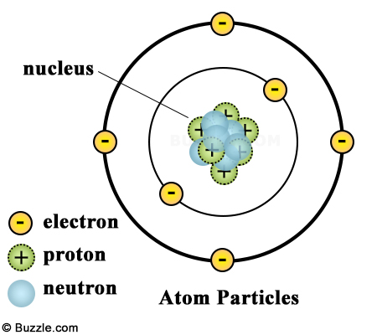
THE NUCLEUS = PROTONS & NEUTRONS
Tiny region at the centre of the atom
It would take 10 000 nuclei lined up side-by-side to stretch across the diameter of a typical atom!
Most of the atom is empty space
Contains protons and neutrons
Protons and neutrons cannot leave nucleus (held together by ‘the strong force’)
Hydrogen is the only atom that has no neutrons in its nucleus. A hydrogen atom has one proton and one electron orbiting it
Hydrogen animation

Slide 14
THE NUCLEUS = PROTONS & NEUTRONS
PROTONS
Positively charged particles in the nucleus of the atom.
The number of protons in an atom’s nucleus is the atomic number of the element on the periodic table.
NEUTRONS
Neutrally charged particles (no charge) in the nucleus of an atom
Has about the same mass as a proton
For the atoms of the first 20 elements, the # of neutrons is either equal to or slightly greater than the # of protons.
NUCLEUS as an overall (+) charge because of the protons

Slide 15
ELECTRONS
Negatively charged particles that occupy special regions called energy levels, or shells, which surround the nucleus
The energy levels containing electrons account for 99.99% of the volume of an atom!
The # of electrons = the # of protons
The electrons that occupy the outermost shell (those farthest from the nucleus) have the strongest influence on the properties of an atom.
These are called valence electrons

Slide 16
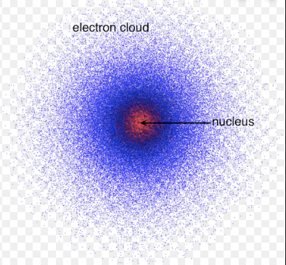
ELECTRONS
Electrons orbit the nucleus very fast, creating a spread-out negative charge, kind of like a cloud
This is the current model of understanding an atom, called the electron cloud model or quantum model
We use older models like the Bohr model (stay tuned) still to understand the probable locations and spacing of electrons, but it is important to understand the cloud model is the most accepted/up-to-date.
Hydrogen animation – cloud

