Slide 1
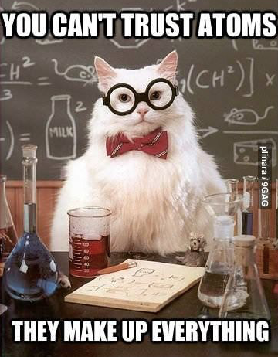
Atomic Theory

Slide 2
Atomic theory through time

Slide 4
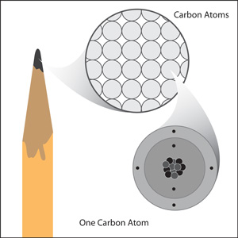

Slide 5
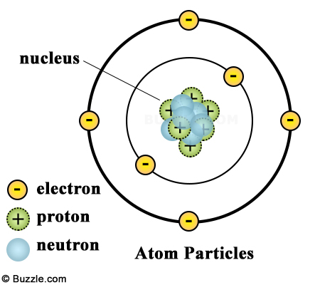
ATOMIC
STRUCTURE
Subatomic Particles:
Neutrons: in nucleus; no charge
Protons: in nucleus; + charge
Electrons: orbiting* nucleus; - charge
*spread-out charge. We say electrons exist in energy levels (sometimes called shells or orbitals)
Overall charge of nucleus is +
NOTE: We recognize this is not the current, cloud-theory model.

Slide 6
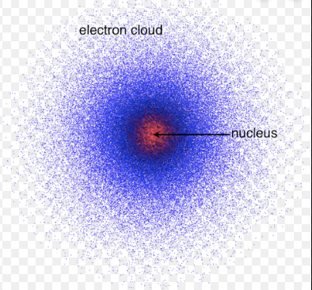
ATOMIC
STRUCTURE
Subatomic Particles:
Neutrons: in nucleus; no charge
Protons: in nucleus; + charge
Electrons: orbiting* nucleus; - charge
*spread-out charge. We say electrons exist in energy levels (sometimes called shells or orbitals)
Overall charge of nucleus is +
Hydrogen animation – cloud

Slide 7
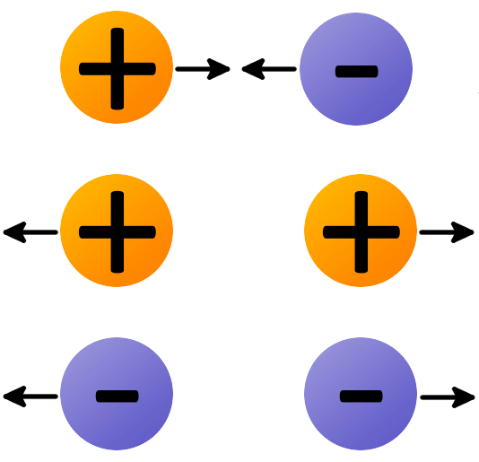
ELECTRIC CHARGE & ATOMS
Charges that are opposite attract each other
Charges that are alike repel each other
The charge on the proton and electron are exactly the same size (strength) but opposite, so they are attracted to each other.
This is what holds the atom together
Attraction/repulsion animation

Slide 9
READING
SYMBOLS
Atomic Number: the number of protons in the nucleus of each atom. It is always a whole number.
Pattern: atomic numbers increase one by one through the periodic table
Atomic Mass: the mass of an average atom of an element. It is written as a decimal. Mass is a combo of protons & neutrons
Pattern: atomic mass tends to increase along with atomic number
*There are some exceptions, i.e. Co and Ni

Slide 10
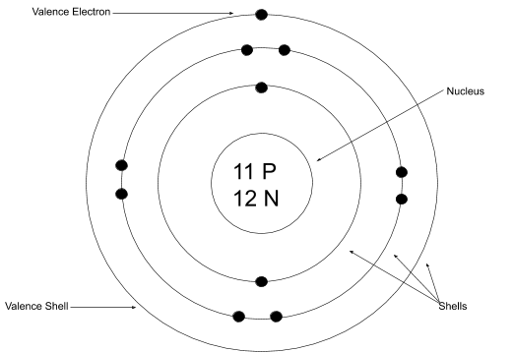
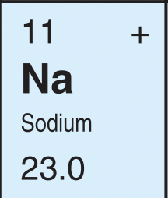
protons (p⁺)= 11
electrons (e⁻) = 11
neutrons (n⁰) = 12
Mass = p⁺ + n⁰
or
mass – p⁺ = n⁰
23-11=12

Slide 11
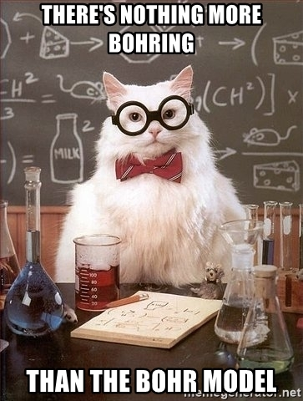
Bohr Model
Energy Level Model

Slide 12
What atom is this?
How many electrons:
Which means there are how many protons:
And the # of protons represents the:
Which element has this atomic number:
8
p⁺ = 8
n⁰ = 8
8
atomic #
oxygen

Slide 13
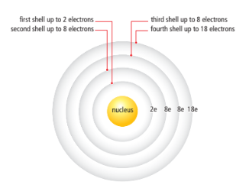
Electrons exist in 2-8-8-18 pattern, filling from inside → outside shells
The electrons in the outermost shell (those farthest from the nucleus) have the strongest influence on the properties of an atom
These electrons in the outermost shell are called valence electrons
The shell that contains the outermost electrons is called the valence shell.

Slide 14
Example: Let’s draw the Bohr model of Neon
Atomic # = # protons
10
neutrons = atomic mass – protons
20.18 – 10 $≅$10
electrons = protons
10
Electrons arranged 2-8-8-18 pattern
2E ) 8E )
p⁺ = 10
n⁰ = 10

Slide 15
Draw the Bohr model of Phosphorus
Atomic # = # protons
15
neutrons = atomic mass – protons
30.97 – 15 $≅$16
electrons = protons
15
Electrons arranged 2-8-8-18 pattern
2e⁻ ) 8e⁻ ) 5e⁻)
p⁺ = 15
n⁰ = 16

Slide 16
Lewis Dot Structures

Slide 17
STOP AT 1:40
Notes:
STOP AT 1:40

Slide 18
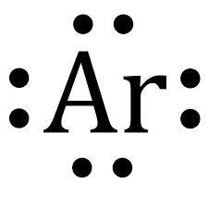
LEWIS STRUCTURES
EXAMPLE: CONSIDER ARGON
Show arrangement of VALENCE electrons only
BOHR DIAGRAM
LEWIS STRUCTURE

Slide 19
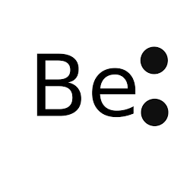
LEWIS STRUCTURES
Show arrangement of VALENCE electrons only
EXAMPLES: Draw the following
Beryllium Magnesium Fluorine Chlorine
What do you notice??

Slide 20
Pick two elements from ONE FAMILY DRAW THEIR LEWIS STRUCTURES. THEN PICK ANOTHER TWO FROM ANOTHER FAMILY. DRAW THEIR LEWIS STRUCTURES. WHAT DO YOU NOTICE?

Slide 21
WHAT TREND(S) DO YOU NOTICE ABOUT THE LEWIS DIAGRAMS ON THE PERIODIC TABLE?

