Slide 1
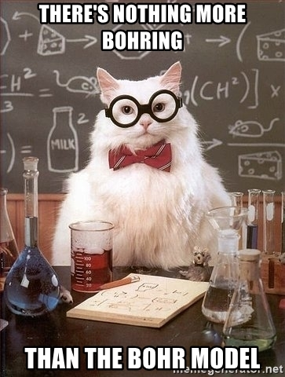
Bohr Model
Energy Level Model

Slide 2
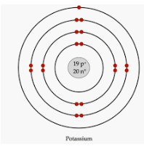
Electrons surround the nucleus of an atom in three dimensions, making atoms spherical.
Think of electrons as being in the different energy levels like concentric spheres around the nucleus.
Since it is very difficult to show these spheres, the energy levels are typically shown in 2 dimensions, which we now know is NOT the most accurate/current version of the atomic model (Quantum mechanical model)

Slide 3
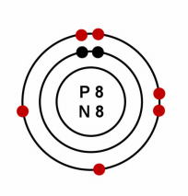
What atom is this?
The nucleus is represented by a dot in the center which contains both protons and neutrons. Some models show it as a dot, other models show
P = # and N = #
The smaller dots surrounding the nucleus represent electrons in the energy levels.
How many electrons:
Which means there are how many protons:
And the # of protons represents the:
Which element has this atomic number:
8
8
Atomic #
Oxygen

Slide 4
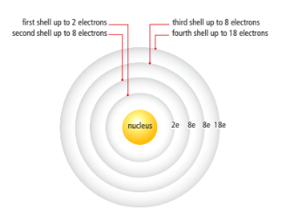
ELECTRONS EXIST IN 2-8-8-18 PATTERN, FILLING FROM INSIDE SHELL TO THE OUTSIDE
The electrons in the outermost shell (those farthest from the nucleus) have the strongest influence on the properties of an atom.
These electrons in the outermost shell are called valence electrons.
The shell that contains the outermost electrons is called the valence shell.

Slide 5
Example: Let’s draw the Bohr model of Neon
Atomic # = # protons
10
Neutrons = atomic mass – protons
20.18 – 10 = roughly 10
Electrons = # protons
10
Electrons arranged 2-8-8-18 pattern
2E ) 8E )
P=10
N=10

Slide 6
Draw the Bohr model of Phosphorus
Atomic # = # protons
15
Neutrons = atomic mass – protons
30.97 – 15 = roughly 16
Electrons = # protons
15
Electrons arranged 2-8-8-18 pattern
2E ) 8E ) 5E )
P=15
N=16

Slide 7
Build a model of an atom!

