Slide 1
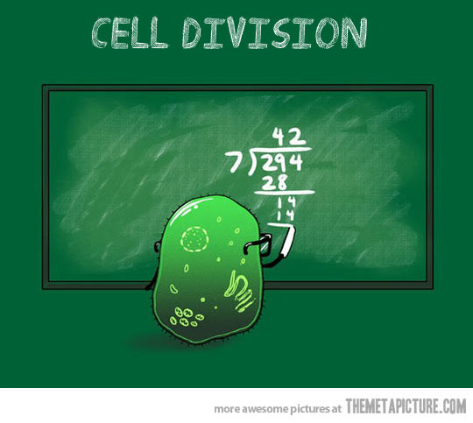
The cell cycle
Text section 5.1

Slide 2
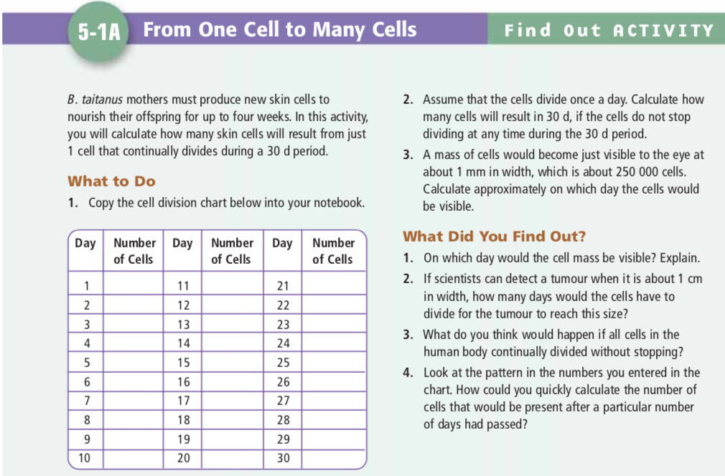
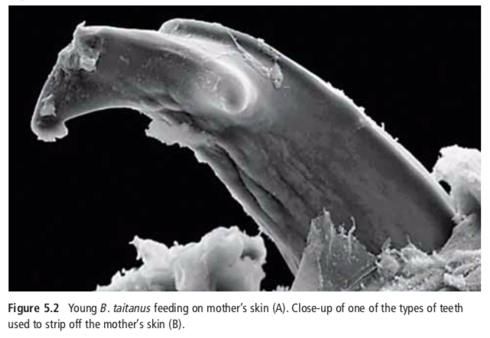

Slide 3
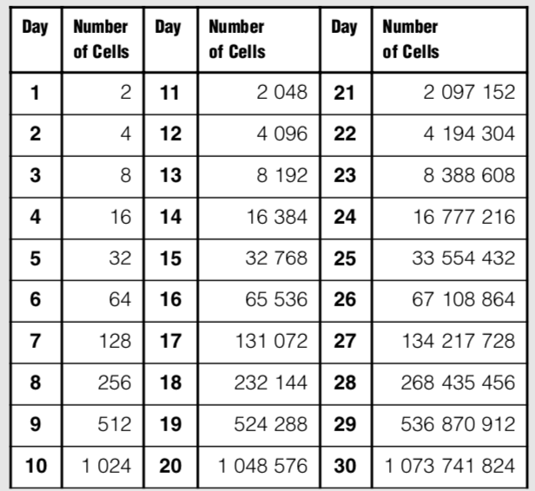
Notes:
To calculate the number of cells on a particular day, you could multiply 2 times the power of the number of days;

Slide 4
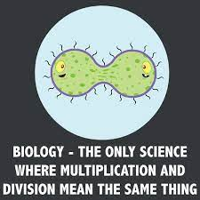

Slide 5
Why do cells divide?
Instead of dividing, why don’t cells just grow larger and larger?
If the cell grows too large, it will have trouble moving enough nutrients and wastes across the cell membrane.
As the cell grows, the volume of the cell increases much more rapidly than the surface area of the cell membrane.
The larger a cell becomes, the more demands the cell places on its DNA.

Slide 6
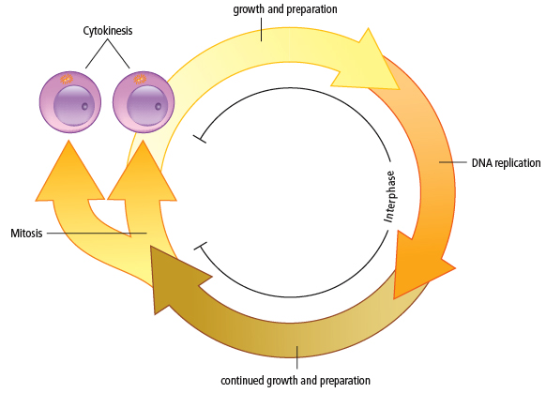
Due to the loss and death of cells, the body must replace them.
A good example of this is human skin cells: Each day millions are shed.
The life of a cell is divided into three stages known as the cell cycle

Slide 7
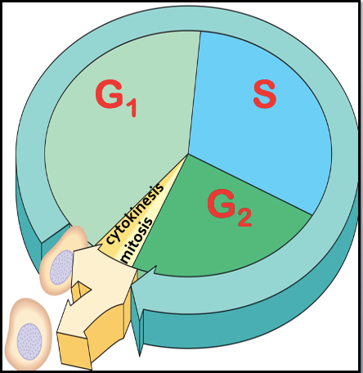
The cell cycle consists of three major phases, but often represented as five, since the first phase (interphase) is long:
1. Interphase is normal cell function and growth
i. G₁ (first gap)
ii. S (synthesis)
iii. G₂ (second gap)
2. Mitosis is the division of the nucleus.
3. Cytokinesis is the division of the cytoplasm.
End result: 2 new, identical cells are produced.

Slide 8
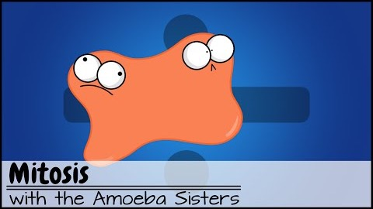
Notes:
Stop at 5:30…just cover interphase in first time showing this video

Slide 9
1. Interphase
G₁, S, G₂

Slide 10
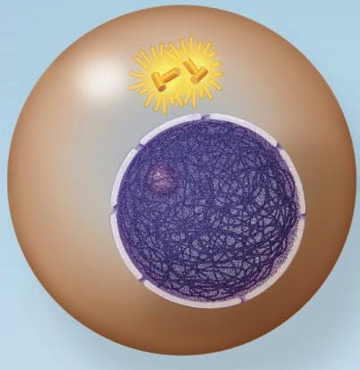
To start…
Nucleus is well-defined and bounded by the nuclear membrane.
Outside of the nucleus are two centrioles.
Their function is to organize the microtubules into a spindle. They will begin to move apart as spindle microtubules grow out of them.
centrioles
nuclear membrane
nucleolus
chromosomes

Slide 11
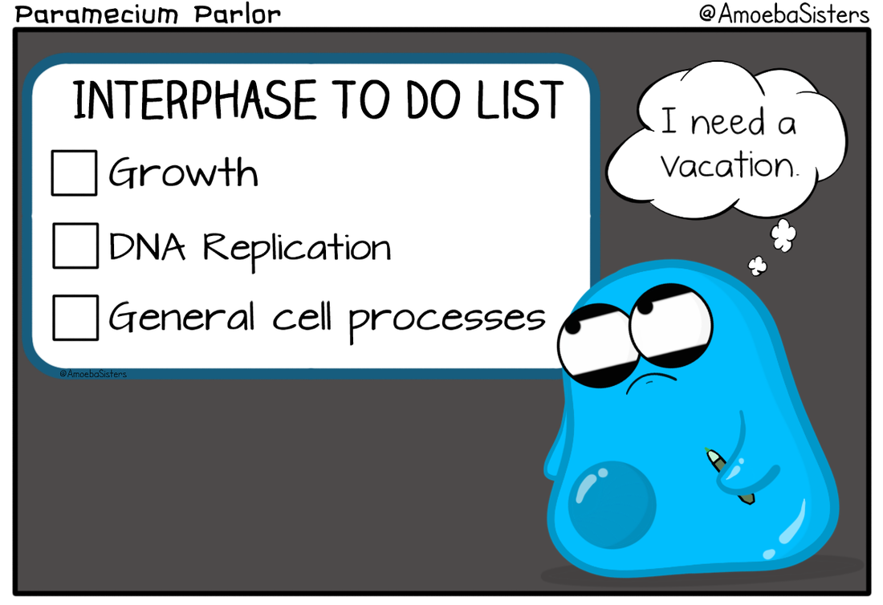

Slide 12
G1 – 1st Gap (Interphase)
Cell increases in size and makes the proteins and molecules necessary for the cell to function.
Some organelles begin to duplicate.

Slide 13
S – synthesis (Interphase)
Replication of DNA occurs.
The DNA molecule unwinds with the help of an enzyme.
New bases pair with the bases on the original DNA.
Two new identical DNA molecules are produced.

Slide 14
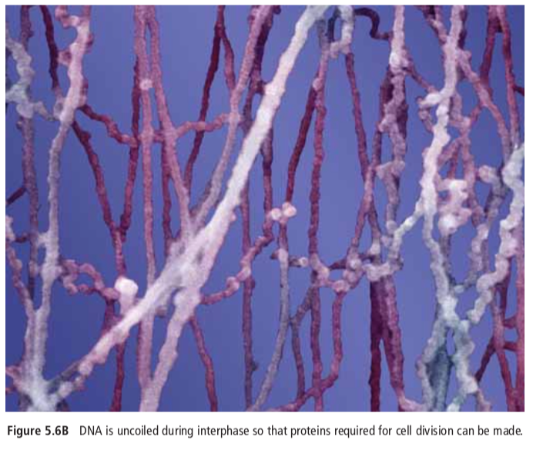
S – synthesis (Interphase)
The chromosomes have duplicated and appear as a jumbled mass of fibers.
They have not yet condensed.

Slide 15
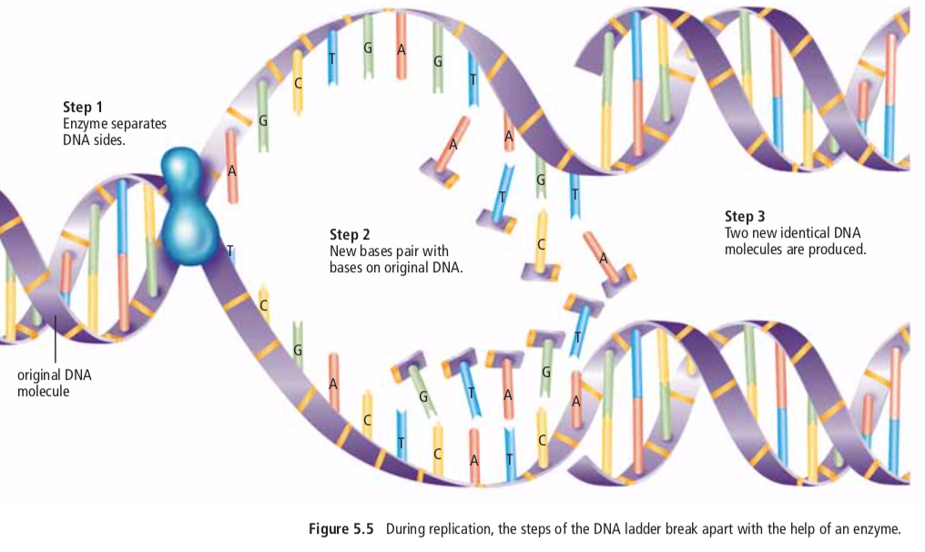

Slide 16
G₂ – 2nd Gap (Interphase)
Cell continues to grow and make materials such as proteins
The chromatin, which contains the replicated DNA, is in its loosely coiled form
Remaining organelles (such as mitochondria and chloroplasts) are duplicated.
Now the cell is ready to divide!

Slide 17
Recap

Slide 18
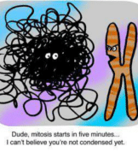
2. MITOSIS

Slide 19
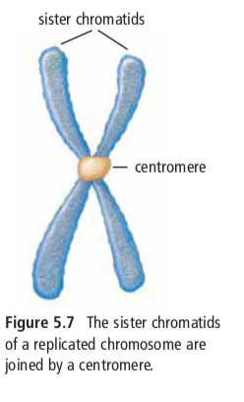
MITOSIS
The shortest stage of the cell cycle where the nuclear contents divide, and two daughter nuclei are formed.
As the nucleus prepares to divide, replicated DNA in interphase joins to form sister chromatids, joined by a centromere.

Slide 20
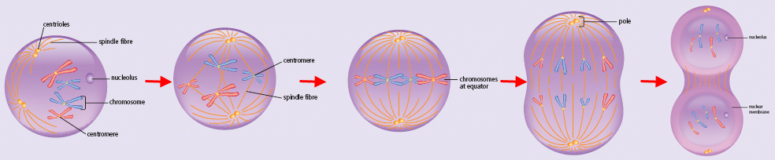
Early
Prophase
Late
Prophase
Prophase
Metaphase
Anaphase
Telophase
Mitosis occurs in 4 (well, kind of 5) stages

Slide 21
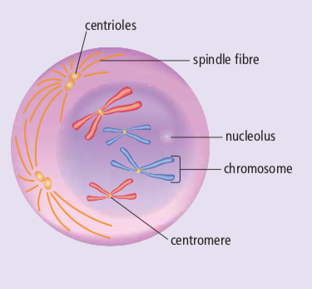
EARLY PROPHASE
PMAT
The chromosomes coil and thicken and become distinct from one another. The chromosomes are now visible.
The nucleolus disappears
The chromosomes are doubled throughout their length.
The centrioles separate and start moving to opposite ends of the cell. A spindle made of microtubules begins to form.

Slide 22
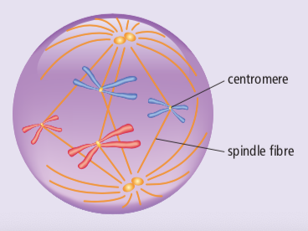
LATE PROPHASE
PMAT
The nuclear membrane disappears
The centrioles move to the opposite poles, completing spindle (microtubules form spindle)
The chromosomes attach to the spindle fibres at their centromeres

Slide 23
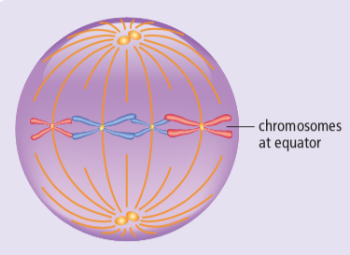

METAPHASE
PMAT
Each chromosome is connected to a spindle fiber at its centromere.
The centrioles are now at opposite sides of the cell.
The spindle fibers will push and pull the chromosomes.
The chromosomes line up at the center of the cell.
meta = middle = chromos at the middle of the cell

Slide 24
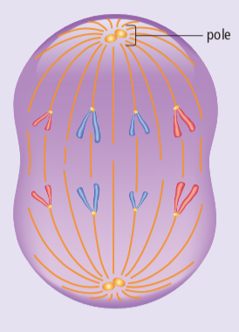
ANAPHASE
PMAT
The microtubules begin to shorten and this pulls the chromatids apart to opposite sides of the cell
Once they separate, each sister chromatid is considered to be a chromosome.
By the end of anaphase, the two ends of the cell have equivalent and complete sets of chromosomes.
look at the shape of the chromos.. Little A’s?

Slide 25
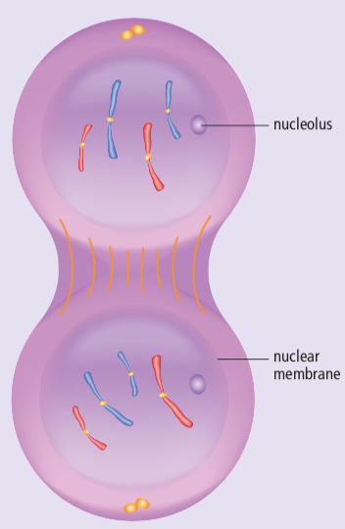
TELOPHASE
PMAT
One complete set of chromosomes is now at each pole of the cell
Spindle fibres begin to disappear
Nuclear membrane forms around each set of chromosomes
A nucleolus appears within each nucleus
Now there are two nuclei in one cell, and the cell is ready to divide

Slide 26
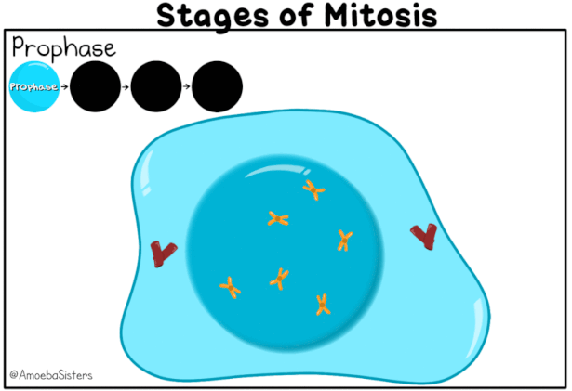

Slide 27
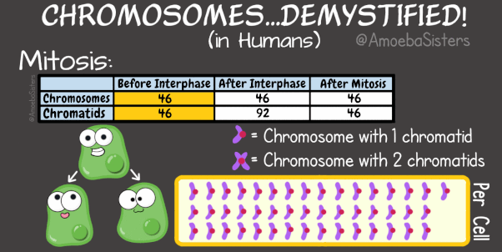

Slide 28
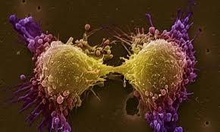
CYTOKINESIS
The final stage in the cell cycle, and happens in conjunction with telophase
The two nuclei are separated into two daughter cells
These new cells are identical to the original parent cell

Slide 29
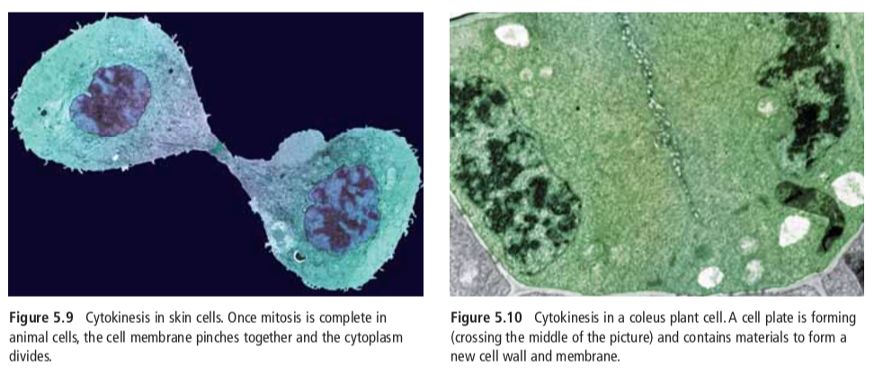
Cytokinesis in ANIMAL cells
Cytokinesis in PLANT cells

Slide 31
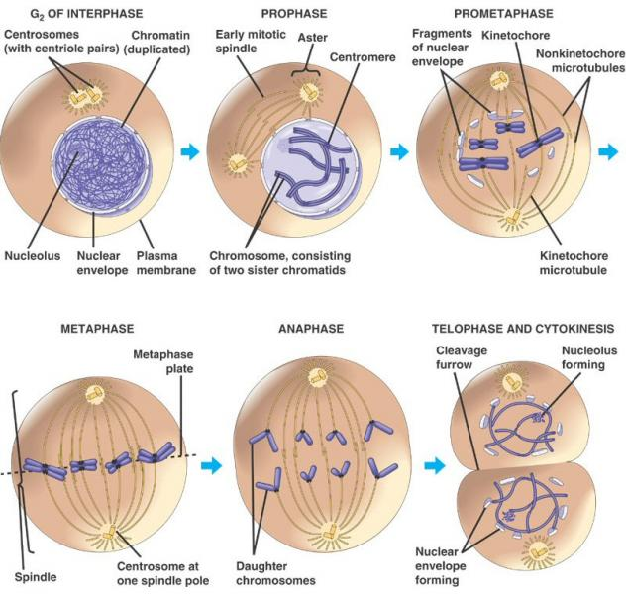

Slide 32
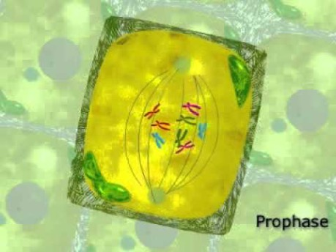
Cell Division in Plant Cells
Notes:
<40 second vid clip

Slide 33
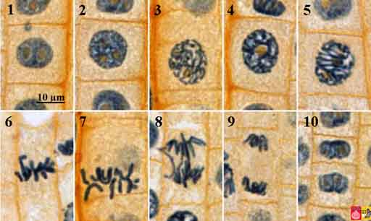
Notes:
Mitosis in Onion Root Tip

Slide 34
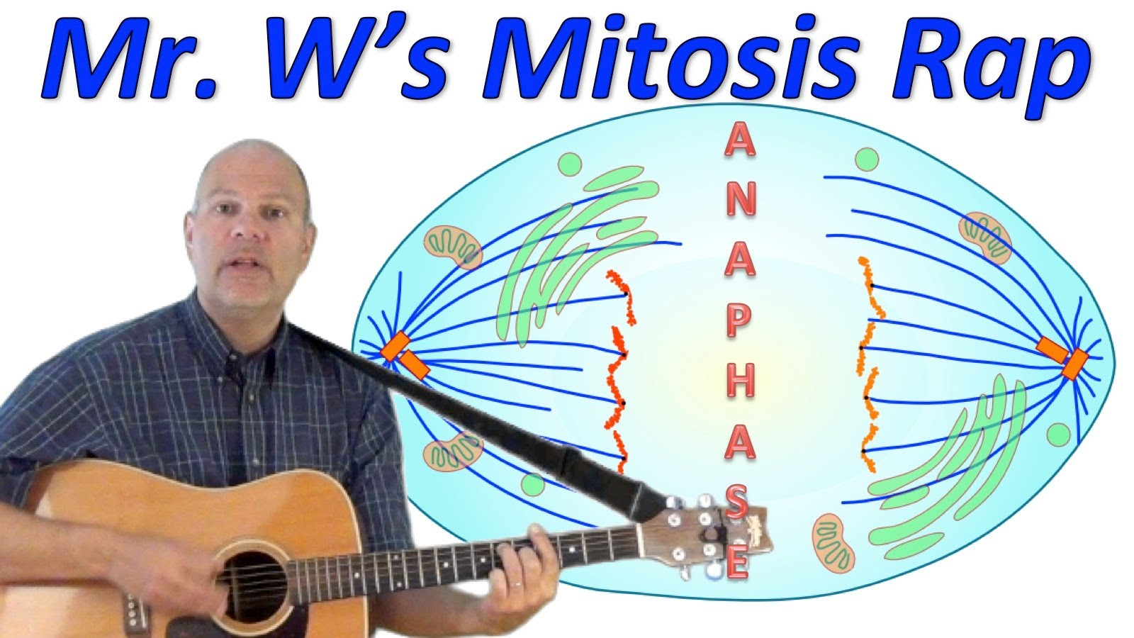

Mitosis Rap
Ok so you can see he’s, um, not a rapper, but this is a good little review ☺

Slide 35
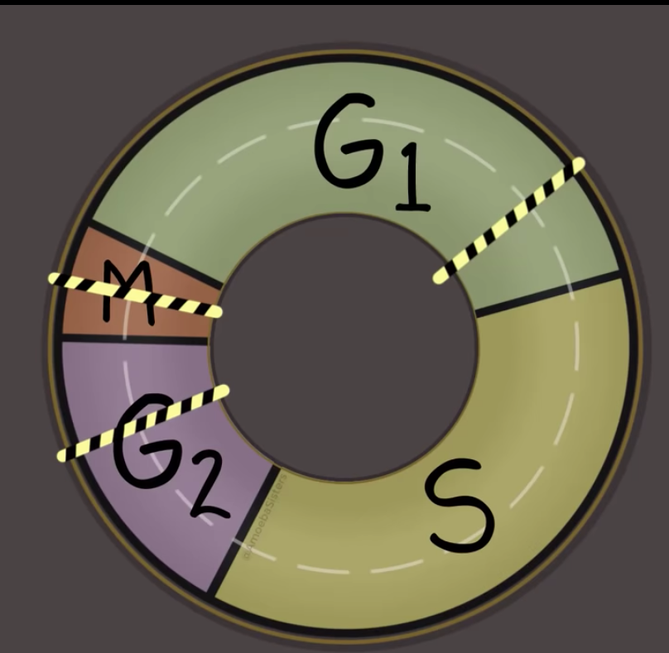
Cell cycle Checkpoints
©Amoeba Sisters

Slide 36
Cell Cycle Problems
Checkpoints in the cell cycle will prevent division if:
  If the cell is short of nutrients
  If the DNA within the nucleus has not been replicated
  If the DNA is damaged
Mutations in genes involving checkpoints can result in an
out-of-control cell cycle.
The result can be uncontrolled cell division: cancer.

Slide 37
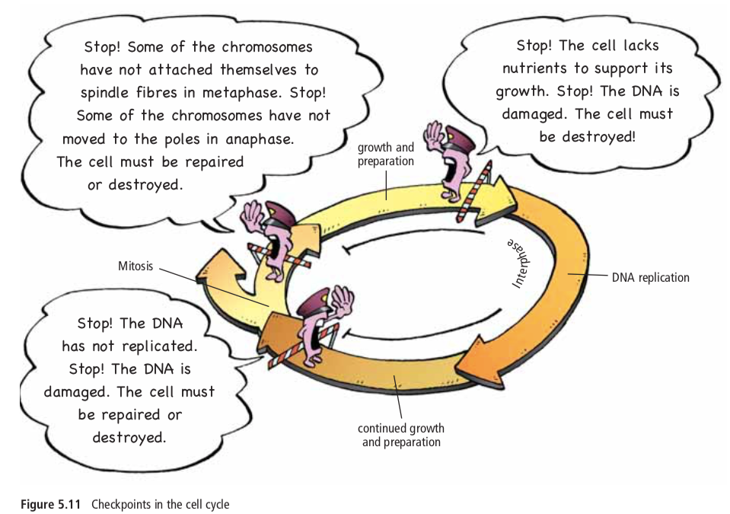

Slide 38
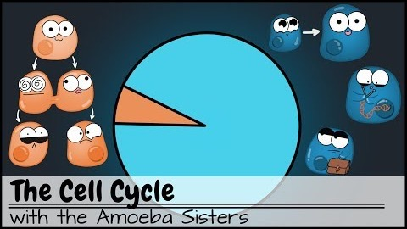

Slide 39
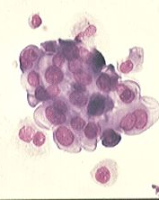
CANCER
Cancer is a loss of a cell’s ability to control its own rate of mitosis.
Typically results from a mutation in the genetic control mechanism.
Cancer isn’t a disease in the conventional sense because:
  -It isn’t caused by a specific pathogen
  (although viruses are suspect in some)
-Cancer isn’t characterized by one set
of symptoms.
In its simplest sense, cancer is rapid and uncontrolled cell growth.

Slide 40
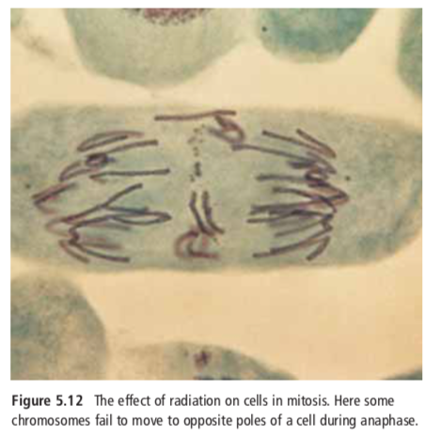

Slide 41
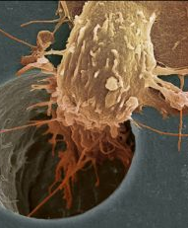
Characteristics of Cancer Cells:
1. They lack differentiation
2. Have abnormal shaped nuclei
3. Form tumors
4. Lack contact inhibition
5. Don’t stick to each other
6. Can migrate
7. Can stimulate vascularization

Slide 42
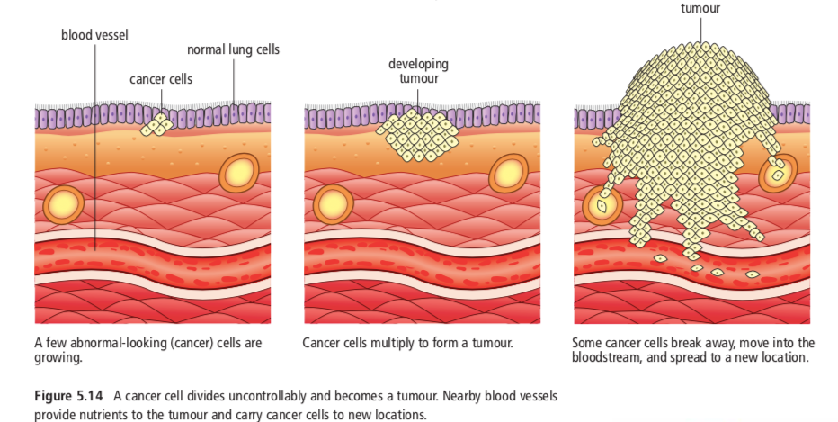

Slide 43
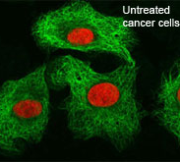
Why is it problematic?
These cells are reproducing so rapidly (up to once every 3 hours) that they do not have a chance to differentiate and become useful.
Despite being useless, they still must be fed and provided with the metabolites of life. They survive at the expense of normal cells that do have a function.
This ultimately can lead to the death of the individual as so many normal cells become sacrificed to satisfy the voracious appetite of the cancer cells.

Slide 44
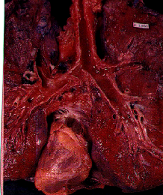
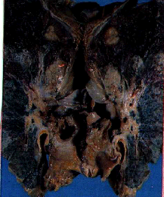
Lung Cancer

