Slide 1
Compounds

Slide 2
COMPOUNDS
A compound is a pure substance made up of more than one kind of element in which the atoms of the elements are joined together.
By combining in elements, compounds can form more complex substances
Compounds form through chemical bonds, which are links between 2 or more atoms that hold the atoms together

Slide 3
Compounds – 2 basic types
Covalent compounds:
non-metal + non-metal
electrons are shared
Ionic compounds
metal + non-metal
electrons are lost/gained

Slide 4
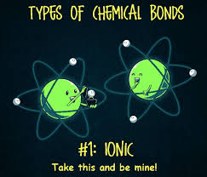

Slide 5
We can use various tests in the lab to determine if an unknown compound is ionic or covalent
Crush Test:
Ionic compounds: can withstand considerable force and then crush suddenly into a gritty powder
Covalent compounds: more flexible and crush like wax or plastic

Slide 6
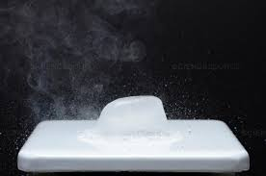
We can use various tests in the lab to determine if an unknown compound is ionic or covalent
Melting Test:
Ionic compounds: do not melt except at very high temperatures
Covalent compounds: melt at relatively low temperatures

Slide 7
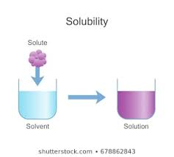
We can use various tests in the lab to determine if an unknown compound is ionic or covalent
Solubility Test:
Ionic compounds: will dissolve in water (although there are some exceptions)
Covalent compounds: not soluble in water (“insoluble”)

Slide 8
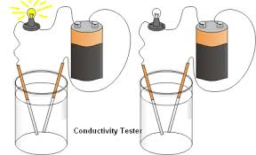
We can use various tests in the lab to determine if an unknown compound is ionic or covalent
Conductivity Test:
Ionic compounds: will conduct an electric current
Covalent compounds: will not conduct electric current

