Slide 1
Compounds with polyatomic ions

Slide 2
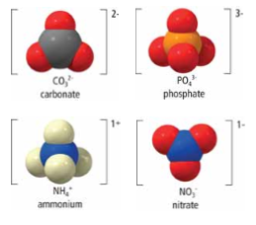
MOLECULAR IONS //POLYATOMIC IONS
Covalent & ionic bonds can be found in the same compound!
It is possible for some molecules (i.e. compounds) to gain or lose electrons (ionic bonding) as their atoms combine to form a molecule (covalent bonding)
In doing so, they become a molecular ion, called a polyatomic ion.
“an ion with many atoms”

Slide 3
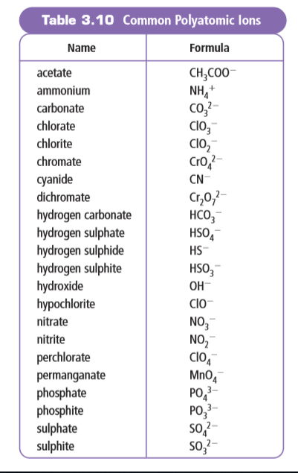
FORMULAS OF POLYATOMIC IONS
Polyatomic ions often have common names, so if you do not see the word listed as an element on the periodic table, chances are it is a polyatomic ion so refer to the table of common polyatomic ions

Slide 4
POLYATOMIC IONS
Because a polyatomic ion carries an electric charge, it cannot exist on its own.
It is always paired up with ions that carry an opposite charge.
The charges need to cancel out. Compounds are neutral!!

Slide 5
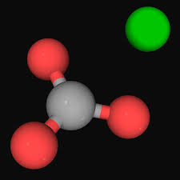
Example: CO₃
When carbon (non-metal) bonds with oxygen (non-metal), they form a covalent bond
It takes 3 oxygen atoms and 1 carbon atom to create one molecule.
Like many covalent compounds, it takes a common name, carbonate
CO₃ carries an electric charge of 2-, so it cannot exist on its own. It needs to be paired up with a metal (because, +) to make the compound neutral

Slide 6
What metal would be “easy” for carbonate to bond ionically with?
²⁺
Ca
+
CO₃ ²⁻
Recall, we always start with the metal on the left

Slide 7
What metal would be “easy” for carbonate to bond ionically with?
Ca²⁺ CO₃²⁻
²⁺
Ca
+
CO₃ ²⁻
Ca CO₃
Charges equal & opposite, so they cancel

Slide 8
Part A: Writing Formulas of compounds with polyatomic ions

Slide 9
lithium carbonate
Example
WATCH this example
Li⁺
CO₃ ²⁻
Li⁺
CO₃ ²⁻
Don’t put the “1”
Li
CO₃
There’ll be some to record coming up
²

Slide 10
Example:
sodium chromate
Na ⁺
CrO₄ ²⁻
We don’t need to put the “1”
Na CrO₄
2
Answer: Na₂CrO₄

Slide 11
Example:
tin(II) hydroxide
Sn ²⁺
OH ⁻
NEED brackets to ensure it’s two of the whole hydroxide molecule, not just the “H”
( )
Sn OH
2
Answer: Sn(OH)₂

Slide 12
Part A: Practice a few…

Slide 13
Solutions

Slide 14
Part B: naming compounds with polyatomic ions

Slide 15
Example:
NaCH₃COO
NaCH₃COO
sodium
acetate
That’s it!

Slide 16
Example:
Cr(OH)₃
chromium
(III)
hydroxide
WAIT!!
Don’t forget to check if you’re using a multivalent metal. Is chromium multivalent?
YES!! So we need a Roman Numeral to indicate which ion we’re talking about
Answer: chromium(III) hydroxide

Slide 17
Example:
Ba₃(PO₃)₂
barium
phosphite
Check: is the metal (barium) multivalent?
Nope!
Answer: barium phosphite

Slide 18
Part B: Practice a few…

Slide 19
Part B: Solutions

