Slide 1

Cornell
Notes

Slide 2
The Curve of Forgetting
By day 2, if you do not think about or review your notes, you will lose 50%-80% of what you learned.
By day 30, if you do not think about or review your notes, you remember only 2% - 3% of what you learned on day 1.
Source: Counseling Services, Study Skills Program at the University of Waterloo

Slide 3
The Value of Cornell Notes
Students who take no notes or some notes retain less than 59% of what was learned.
Students who take and use Cornell Notes as a study tool retain 90%-100% of what was learned.

Slide 4
When to Take Notes
The speaker says to take notes
The speaker says something you
don’t already know
The speaker presents using
PowerPoint
The speaker writes on the board
The teacher says, “This will be on the test.”

Slide 5

Why take notes?
Cornell note taking stimulates critical thinking skills.
Note taking helps you remember what is said in class.
A good set of notes can help you work on assignments and prepare for tests outside of the classroom.

Slide 6
Why take notes?
Good notes allow you and your peers to help each other problem solve.
Good Notes help you organize and process data and information.
Helps you recall by getting you to process your notes 3 times.
Writing is a great tool for learning!

Slide 7

History of Cornell Notes
Developed in 1949 at Cornell University by Walter Pauk.
Meant to be easily used as a test study guide.
Adopted by most major law schools as the preferred note taking method.

Slide 8
First & Last Name
Class Title
Period
Date
Topic
Questions,
Subtitles,
Headings,
Vocabulary,
Drawings,
Diagrams
Etc.
Class Notes
3 to 4 sentence summary across
the bottom of the last page of the day’s notes
2 1/2”

Slide 9
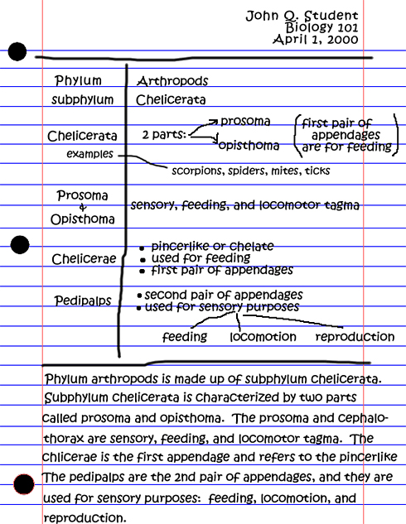
Anthropods
Cornell
Notes
Sample

Slide 10
What goes where?
Questions,
subtitles,
etc. go here,
in the left
hand column.
Remember,
we want
higher level
critical
thinking
questions.
Don’t forget the heading:
Name, Class, Period, Date, Topic
Notes go here, in the
large right hand column.
A 3 to 4 sentence summary down there on the bottom of the last page of notes. Written after questions are finished.

Slide 11


Handouts
Student Samples

Slide 12
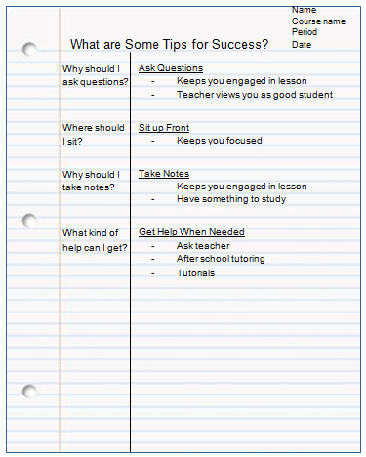
Apply Your Thinking
Within 24 hours of taking notes (or while note taking), review your notes and write questions on the left side of the page.

Slide 13
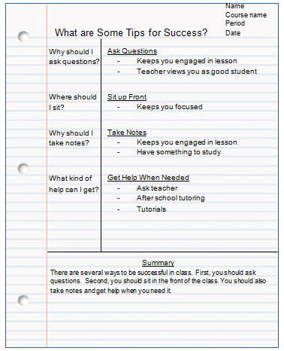
Reflect on Notes
Add a summary to your notes. Answer the essential question as your topic sentence and turn each “chunk” of information into supporting sentences.

Slide 14
Revise Notes
Review notes with a partner and add details that you each missed.
v
v

Slide 15
Revise Notes
Look in your textbook or online (reputable source) and add details from the book to your notes.
v
v

Slide 16

Review Notes
Fold your notes so that the questions show, but the notes do not. Quiz yourself or work with another student to quiz each other.
Cover the right side of your notes; review and answer study questions from the left using the right side as an answer key
Quiz yourself out loud
Cover the right side with blank paper; write out answers to the left column study questions

