Slide 1
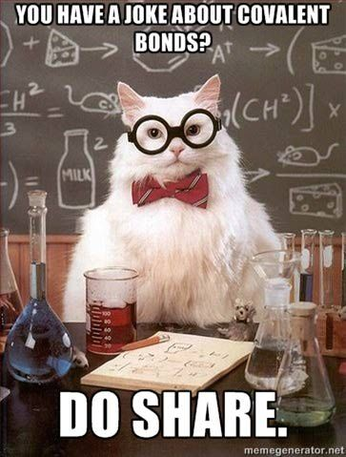
Covalent Compounds

Slide 2
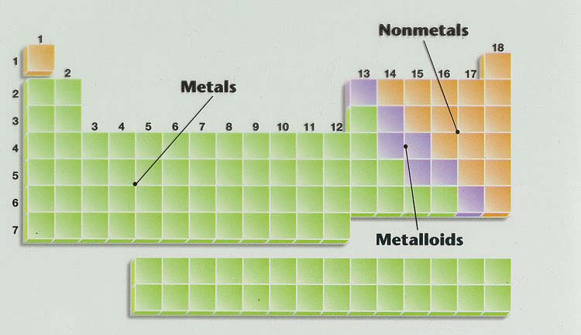
COVALENT COMPOUNDS
Covalent compounds are made up of two non-metals.
Covalent compounds share electrons to form molecules.
Example: water
Notes:
In covalent compounds, atoms combine by sharing electrons to form molecules. A molecule is a group of atoms in which the atoms are bound together by sharing one or more pairs of electrons. The shared pairs of electrons form covalent bonds that keep the atoms together. Carbon dioxide and water are examples of covalent compounds.
When a jar is filled with water, trillions and trillions of molecules bump into each other constantly, but the atoms in one molecule are not bonded to atoms in other water molecules. Each molecule is separate from the other. Liquid water flows because the water molecules can move past each other.

Slide 3
Example: H₂O
H O
H
Notes:
Don’t draw anything yet!
Hydrogen atom has one electron &
Oxygen’s atomic number is 8- 8 electrons

Slide 4
Example: H₂O
Let’s Share!
H O
H

Slide 5
Example: H₂O
H O
H
Let’s Share!
Notes:
Oxygen’s atomic number is 8- 8 electrons

Slide 6
Example: H₂O
Lone Pairs
H O
H
Let’s Share!
Bonding Pairs
Notes:
Oxygen’s atomic number is 8- 8 electrons
Pairs of valence electrons involved in the covalent bond are called bonding pairs
Pairs of valence electrons that aren’t
involved in the bond are called lone pairs
DON’T have charge because sharing!

Slide 7
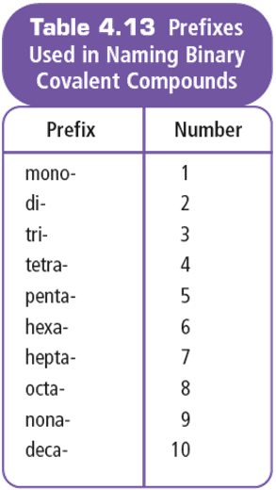
Covalent Compounds
Formulas show the actual number of atoms of each element in a molecule (e.g. H₂O₂)
Prefixes are used in naming simple covalent compounds
Notes:
Covalent compounds are composed of non-metal atoms
Covalent molecules share electrons
Formulas show the actual number of atoms of each element in a molecule (e.g. H₂O₂)
Rely on the chemical formula to reveal the components of the molecule

Slide 8
Part B: naming COVALENT compounds

Slide 9
Naming Rules:
Exceptions to rule:
Do not add a prefix if the first element has only one atom
Shorten mono- to mon- if it is placed before oxide
1st Element
Name the first element.
2nd Element
Name the second element and add the suffix “ide”
Prefix
Add a prefix to each element’s name to indicate the number of atoms.

Slide 10
Examples:
a) CO₂
oxide
Di
Carbon
b) CO
Carbon
Mon
oxide
Mono– EXCEPTION when Oxide!
c) P₄S₁₀
Tetra
phosphorous
Deca
sulphide
d) N₂O₄
Di
nitrogen
Tetra
oxide

Slide 11
Part B: WRITING FORMULAS OF COVALENT compounds

Slide 12
Rules for Writing Formulas For Covalent:
(i) Write the first element’s symbol.
(ii) Write the second element’s symbol.
(iii) Write subscripts to show the number of atoms as indicated by the prefix
Example:
carbon tetraiodide
C
I
4

Slide 13
Rules for Writing Formulas For Covalent:
Example:
dichlorine monoxide
(i) Write the first element’s symbol.
(ii) Write the second element’s symbol.
(iii) Write subscripts to show the number of atoms as indicated by the prefix
Cl
O
2

Slide 14
You try some:
sulphur dioxide
S
O
2
phosphorus tribromide
P
Br
3
arsenic pentachloride
As
Cl
5

Slide 15
IONIC VS COVALENT:
Examine the formula.
Ionic compounds start with a metal or the ammonium ion.
Covalent compounds start with a non-metal.

Slide 16
IONIC VS COVALENT:
2. If the compound is COVALENT:
Use the prefix system of naming if the compound is binary and does not start with hydrogen.
If there are more than two different elements, or it starts with H, there is probably a different, simpler (“common”) name for the covalent molecule.

Slide 17
IONIC VS COVALENT:
3. If the compound is IONIC:
Check the metal to see if it is multivalent (add a Roman Numeral if it is multivalent). Naming starts with the name of the metal atom.
If it ends with a single non-metal, naming will just end in -ide.
If it ends in a polyatomic ion, look up the name/formula.

