Slide 1
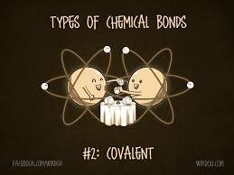
covalent Compounds

Slide 2
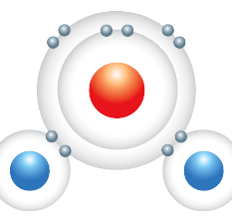
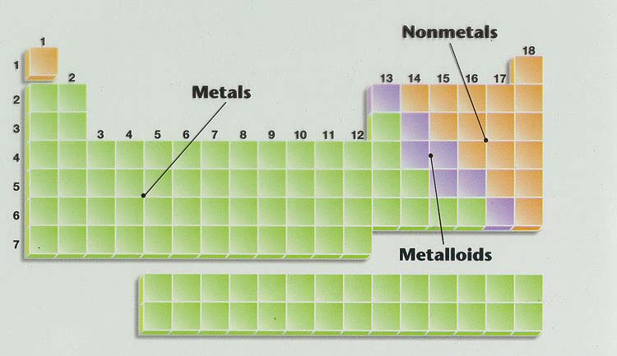
COVALENT COMPOUNDS
Covalent compounds are made up of two non-metals.
Covalent compounds share electrons to form molecules.
Example: water
Notes:
In covalent compounds, atoms combine by sharing electrons to form molecules. A molecule is a group of atoms in which the atoms are bound together by sharing one or more pairs of electrons. The shared pairs of electrons form covalent bonds that keep the atoms together. Carbon dioxide and water are examples of covalent compounds.
When a jar is filled with water, trillions and trillions of molecules bump into each other constantly, but the atoms in one molecule are not bonded to atoms in other water molecules. Each molecule is separate from the other. Liquid water flows because the water molecules can move past each other.

Slide 3
Example: H₂O
H O
H
Notes:
Don’t draw anything yet!
Hydrogen atom has one electron &
Oxygen’s atomic number is 8- 8 electrons

Slide 4
Example: H₂O
Let’s Share!
H O
H

Slide 5
Example: H₂O
H O
H
Let’s Share!
Notes:
Oxygen’s atomic number is 8- 8 electrons

Slide 6
Example: H₂O
Lone Pairs
H O
H
Let’s Share!
Bonding Pairs
Notes:
Oxygen’s atomic number is 8- 8 electrons
Pairs of valence electrons involved in the covalent bond are called bonding pairs
Pairs of valence electrons that aren’t
involved in the bond are called lone pairs
DON’T have charge because sharing!

Slide 7
Part B: naming COVALENT compounds

Slide 8
naming COVALENT compounds
BINARY COVALENT COMPOUNDS—covalent compounds that contain only two elements—are named using a procedure similar to that used for simple ionic compounds, but use a prefix method as well

Slide 9
naming COVALENT compounds
Step 1:
Place the elements in their proper order.
The first element farthest to the left in the periodic table is usually named first.
If both elements are in the same group, the element closer to the bottom of the column is named

Slide 10
naming COVALENT compounds
Step 2:
Name each element in the compound the same way we do with ionic compounds.
The 1st element name is unchanged
The 2nd element name has suffix “ide”

Slide 11
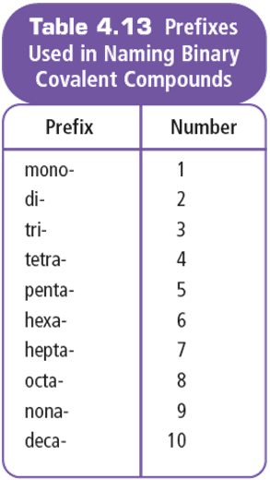
In Covalent Compounds…
Formulas show the actual number of atoms of each element in a molecule (e.g. H₂O₂)
NOT a ratio like ionic!
Prefixes are used to show this
Notes:
Covalent compounds are composed of non-metal atoms
Covalent molecules share electrons
Formulas show the actual number of atoms of each element in a molecule (e.g. H₂O₂)
Rely on the chemical formula to reveal the components of the molecule

Slide 12
Step 3:
Identify the number of each type of atom present.
Add the corresponding prefix to each element’s name to indicate the number of atoms.
Exceptions to rule:
Do not add a prefix if the first element has only 1 atom
Shorten mono- to mon- if it is placed before oxide

Slide 13
Examples:
a) CO₂
Carbon
di
oxide
b) CO
Carbon
mon
oxide
EXCEPTION when Oxide!

Slide 14
Try these two examples:
c) P₄S₁₀
Tetra
phosphorous
deca
sulphide
d) N₂O₄
Di
nitrogen
tetra
oxide
tetroxide

Slide 15
Part B: WRITING FORMULAS OF COVALENT compounds

Slide 16
Step 1:
Write each element’s symbol.
Step 2:
Write subscripts to show the number of atoms as indicated by the prefix.
Example:
dichlorine monoxide
Cl
O
2

Slide 17
disulphur decafluoride
You try some:
S
O
2
10
sulphur dioxide
S
O
2
phosphorus tribromide
P
Br
3
arsenic pentachloride
As
Cl
5

Slide 18
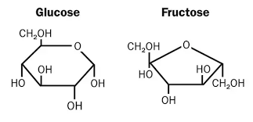
SOME EXCEPTIONS
There is often a common name used instead of the prefix system for many covalent molecules.
There are more than two different elements
Example: CH₃CH₂OH is called “ethanol”
Example: C₁₂H₂₂O₁₁ is called “sucrose” – it’s a sugar
Example: C₆H₁₂O₆ can be fructose or glucose – both simple sugars! They differ in their molecular structure!
If it starts with H
Example: H₂O is called “water”

Slide 19
Recap…
Ionic compounds:
Metal + non-metal
Suffix ”ide” on non-metal
Electrons transferred (atoms become ions)
Covalent compounds:
Non-metal + non-metal
Suffix ”ide” on non-metal
Prefix on both non-metals
Electrons shared (no ions)

Slide 20
IONIC VS COVALENT:
RE-CAP
Examine the formula.
Ionic compounds start with a metal or the ammonium ion.
Covalent compounds start with a non-metal.

Slide 21
IONIC VS COVALENT:
RE-CAP
2. If the compound is COVALENT:
Use the prefix system of naming if the compound is binary and does not start with hydrogen.
If there are more than two different elements, or it starts with H, there is probably a different, simpler (“common”) name for the covalent molecule.

Slide 22
IONIC VS COVALENT:
RE-CAP
3. If the compound is IONIC:
Check the metal to see if it is multivalent (add a Roman Numeral if it is multivalent). Naming starts with the name of the metal atom.
If it ends with a single non-metal, naming will just end in -ide.
If it ends in a polyatomic ion, look up the name/formula.

