Slide 1
Drawing COVALENT compounds + diatomic elements

Slide 2
Practice Drawing these “simple” molecules using a Bohr Model
1. Water: H₂O
2. Carbon dioxide: CO₂

Slide 3
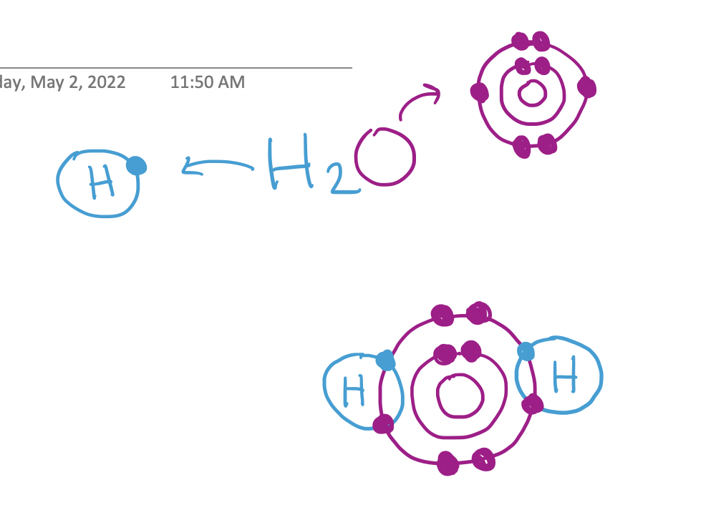
Practice Drawing these “simple” molecules using a Bohr Model
1. Water: H₂O

Slide 4
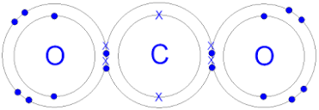
Practice Drawing these “simple” molecules using a Bohr Model
2. Carbon dioxide: CO₂

Slide 5
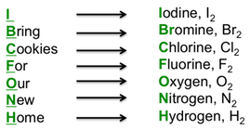
Diatomic Elements
Diatomic elements are pure elements that form molecules consisting of two of the same type of atoms bonded together.
There are seven diatomic elements: hydrogen, nitrogen, oxygen, fluorine, chlorine, iodine, bromine.

Slide 6
Diatomic Elements
Diatomic elements are pure elements that form molecules consisting of two of the same type of atom bonded together.
These elements can exist in pure form in other arrangements. For example, oxygen can exist as the triatomic molecule, ozone.

Slide 7
Practice Drawing a Few Diatomic molecules
O₂
F₂
N₂

Slide 8
STOP AT 1:40
Notes:
STOP AT 1:40

Slide 9
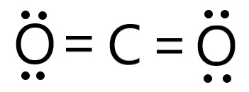
Let’s go back to example: CO₂
Draw the Lewis structure

Slide 10
Recap…
Ionic compounds:
Metal + non-metal
Suffix ”ide” on non-metal
Electrons transferred (atoms become ions)
Covalent compounds:
Non-metal + non-metal
Suffix ”ide” on non-metal
Prefix on both non-metals
Electrons shared (no ions)

