Slide 1
THE CELL

Slide 2
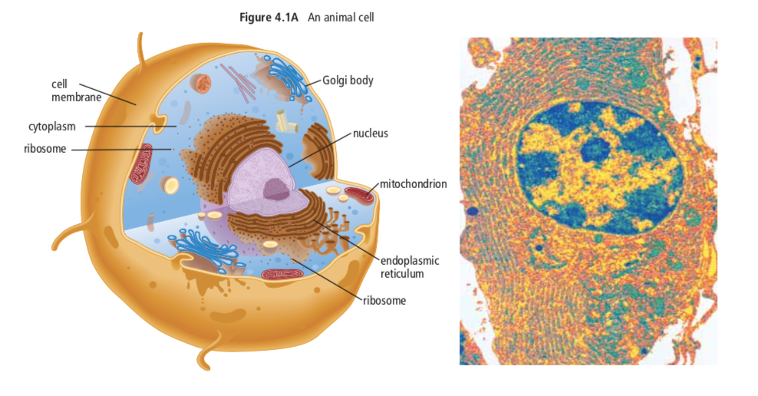
CELL STRUCTURE + FUNCTION
Review cell structure + function (text 4.1)
Notes:
***MATCHING GAME****

Slide 3
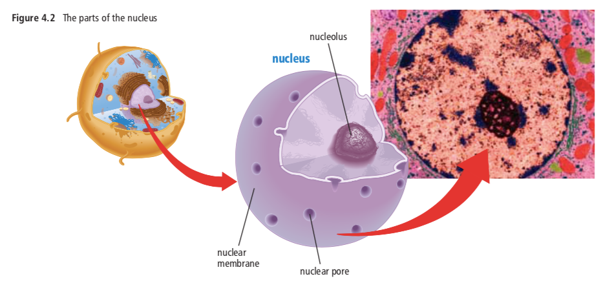
THE NUCLEUS

Slide 4
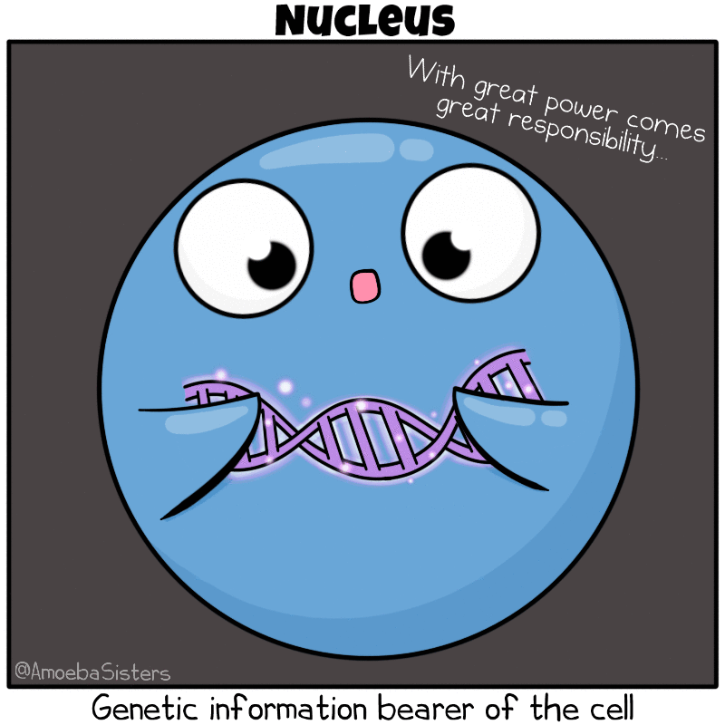
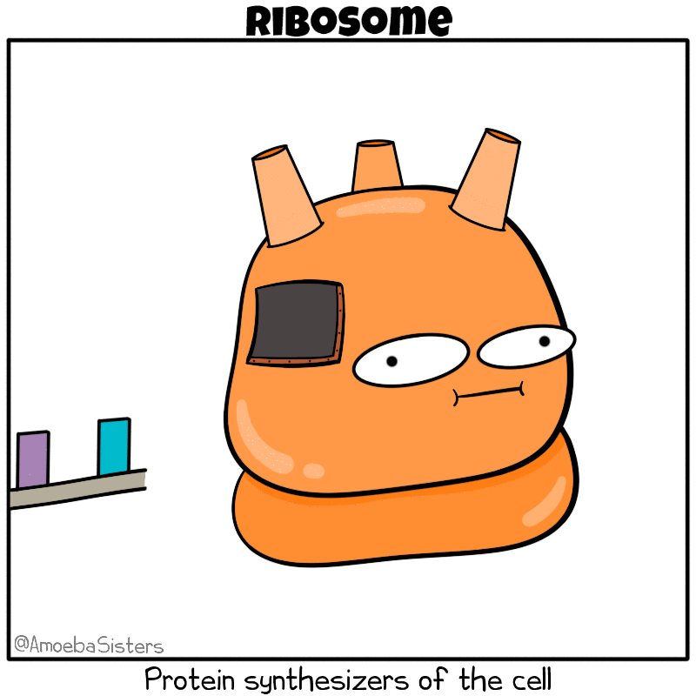
The Nucleus
The control centre of a living cell
Surrounded by nuclear membrane (kind of like cell membrane).
Function: Protects contents of nucleus
Inside is membrane-free nucleolus
Function: make ribosomes (whose job it is to make proteins)
Has small openings in nuclear membrane called nuclear pores
Function: Allow certain things in/out of nucleus (ex. ribosomes).

Slide 5
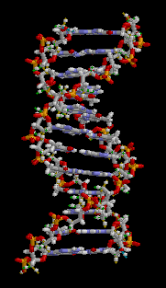
DNA

Slide 6
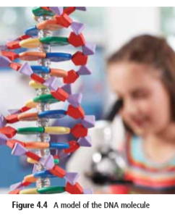
DNA
The nucleus contains the master set of instructions that determines what each cell will become, how it will function, when it will grow and divide, and when it will die
The instructions in the nucleus are carried in long, two-stranded molecules called deoxyribonucleic acid, or DNA.

Slide 7
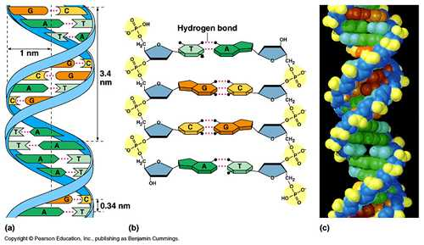
DNA
The DNA molecule looks like a twisted ladder
The two strands, or sides, of the DNA ladder wrap around each other in a spiral shape that scientists call a double helix.
The word “helix” comes from a Greek word meaning to wrap.
The sides of the DNA ladder are made of sugar and phosphate (often called the sugar-phosphate “backbone”.
The steps of the ladder are made of four nitrogen bases, which are represented by the letters:
A (adenine),
G (guanine),
C (cytosine), and
T (thymine)

Slide 9
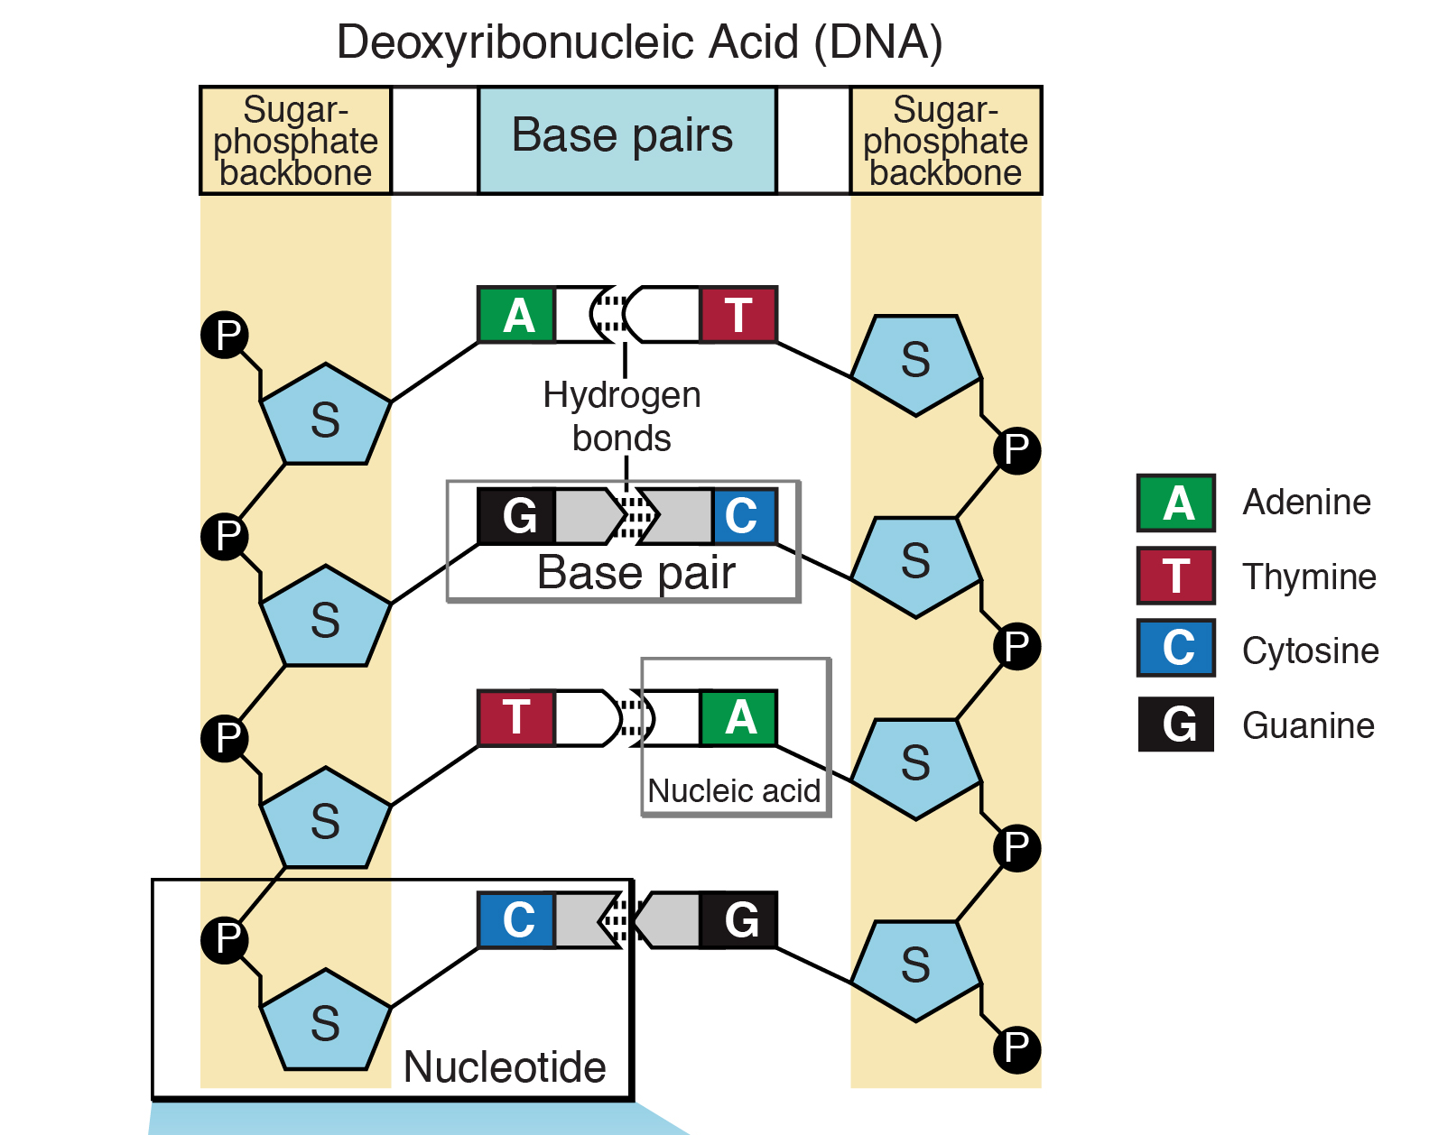

Slide 10
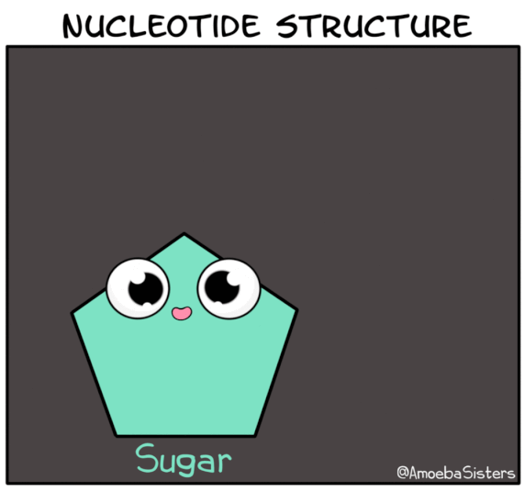

Slide 11
DNA ARRANGEMENT
Everything that occurs within a cell is the result of how the bases on the DNA molecule are arranged. This arrangement is known as the DNA message.
Bases in a DNA molecule always join in a specific way:
A always joins with T
G always joins with C
However, the order and number of these bases can vary greatly within the DNA molecule. In humans, a single DNA molecule can be several million base pairs in length.

Slide 12
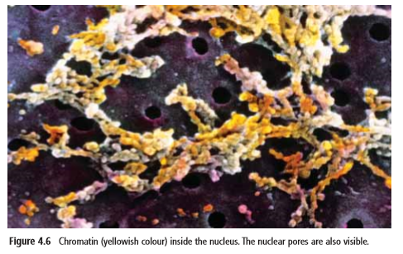
How is DNA stored?
DNA exists in the nucleus in the form of chromatin.
Chromatin is a substance that contains DNA and proteins
Within each strand of chromatin is one molecule of DNA

Slide 13
When a eukaryotic cells is ready to divide, each strand of chromatin coils up into a very compact, X-shaped structure called a chromosome

Slide 14
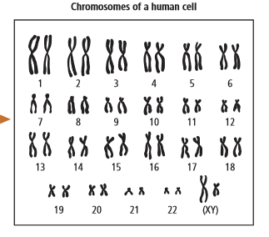
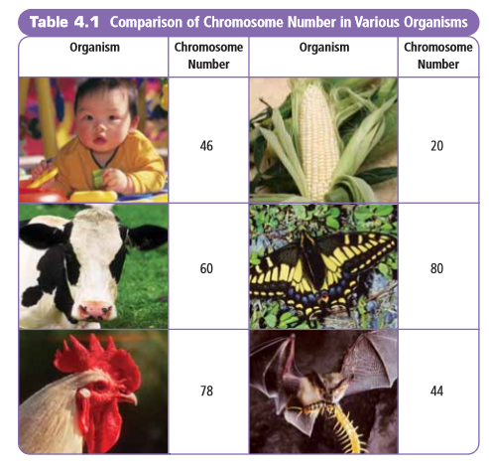
Chromosomes
Chromosomes within the nucleus are found in pairs.
Most human cells have 46 chromosomes arranged in 23 pairs, including one pair of chromosomes that help determine sex.
In biological males, the 23rd pair of chromosomes is the XY pair.
In biological females, it is the XX pair.
Every living thing has a characteristic number of chromosomes

Slide 15
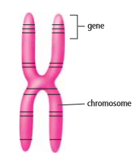
GENES ARE FOUND ON CHROMOSOMES
Genes are small segments of DNA located at specific places on a chromosome
Genes store the information needed to produce 90 000 to 100 000 different proteins used in the cells of your body.
The arrangement of bases in a gene will usually be used to produce a specific protein.
Genes can vary in length from hundreds to thousands of bases.
Every chromosome carries thousands of genes and therefore contains the information to make thousands of different proteins.

Slide 16
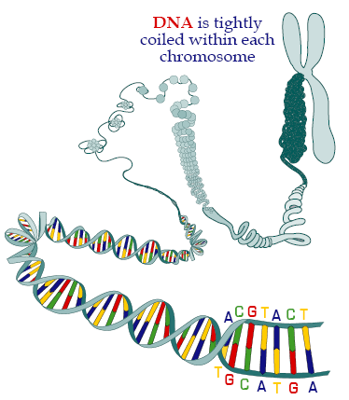

Slide 18
PROTEIN SYNTHESIS
You aren’t expected to know this by heart in Gr. 9 – but being familiar with the process will be helpful for next year

Slide 19
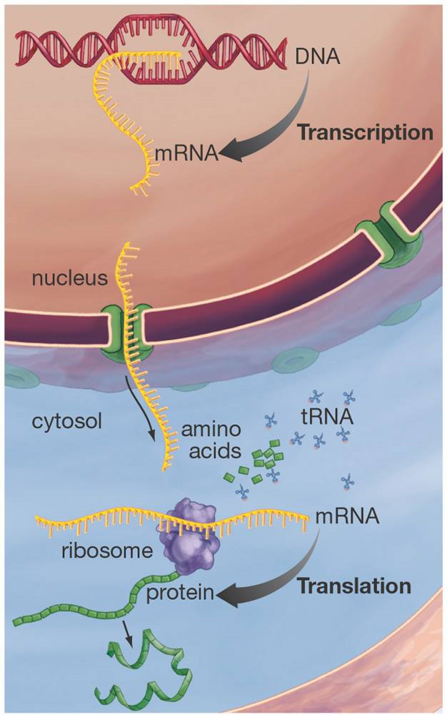
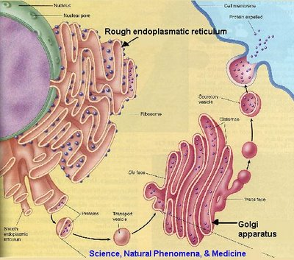
Protein Synthesis
Making protein
Exporting protein

Slide 20
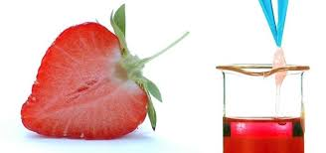
Lab
4-1D p. 133
Strawberry DNA
Create a Pre-Lab for next class. Include:
Research question
Hypothesis
Methods (reference the materials + procedure)
Data Table Skeleton(s)
You’ll be collecting data and then writing a conclusion and answering analysis questions

