Slide 1
Enrollment Instructions
Step 1: Go to https://www.explorelearning.com
Step 2: Click on the “Enroll in a Class” button in the upper right-hand corner of the web page.
Step 3: Type in your teacher’s class code: P5WVZQ
Click “Continue” and follow the directions on the site to complete your enrollment. Use your usual first & last name please.
Step 4: Record your username and password in your phone or somewhere that you won’t lose it.
Once you’ve enrolled, you can login anytime using just your username and password (no class code required).

Slide 2
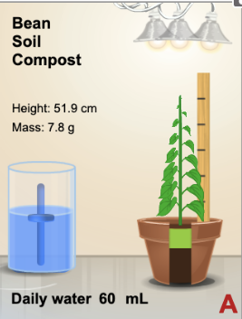
VIRTUAL LAB
Launch the gizmo that’s waiting for you:
Design and run an experiment using the parameters of this gizmo.
What could you investigate?
Work with the lab partner you’re sitting beside. Use the assignment in Teams to record your responses. You may complete one document together but each of you needs to turn it in on Teams.
Growing Plants

Slide 3
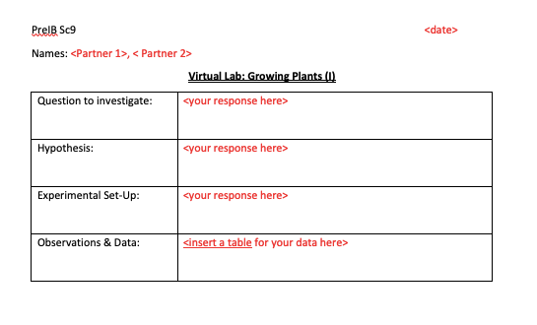
VIRTUAL LAB
Growing plants

Slide 4
The Question
What effect does _____ have on _____?
Measurable?
IV
DV
Qualitative (categorical)
Quantitative (numerical)
Bar graph
(good for preliminary research, not relationship)
Scatter graph (allows us to see relationship)

Slide 5
The Hypothesis
Remember this?
“I" “we”
Keep it to facts.

Slide 6
The Hypothesis
If ___________________________________,
then _______________________________,
because _________________________
what you are doing to IV
what you expect to happen to DV as a result
scientific rationale

Slide 7
Experimental Set-Up
What type of plant?
Soil additives?
How many lights (If not IV)?
Location of lights?
How much water (if not IV)?
Controlled Variables (CV)

Slide 8
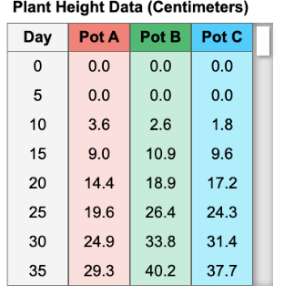
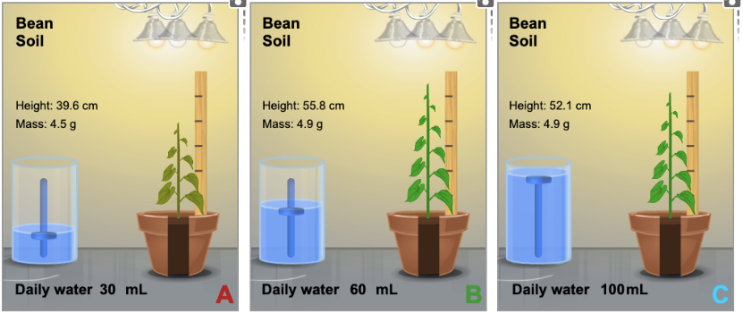
Data Collection
What type of qualitative data is relevant?
Is “Pot A” relevant? What do these represent?
Is “day” relevant?
If no, why?
If yes, how?
Include averages

Slide 9
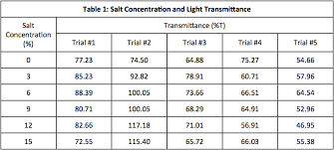
example
average

Slide 10
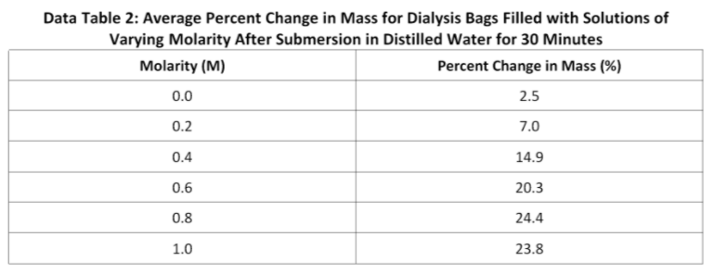
Consider this data set:
example

Slide 11
Consider this data set:
Percent Change in Mass(%)
Molarity (M)

Slide 12
We can use the line of best fit to estimate by EXTRAPOLATING or INTERPOLATING
Percent Change in Mass(%)
EX: estimating percent change in mass at a molarity of 0.5 M?
Molarity (M)

Slide 13
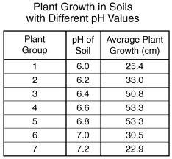
Consider this data set:
Plant growth (cm)
pH of soil

Slide 14
VIRTUAL LAB
EDIT
+ graph
Launch the gizmo that’s waiting for you:
Design and run an experiment using the parameters of this gizmo.
What could you investigate?
Work with the lab partner you’re sitting beside. Use the assignment in Teams to record your responses. You may complete one document together but each of you needs to turn it in on Teams.
Growing Plants

