Slide 1
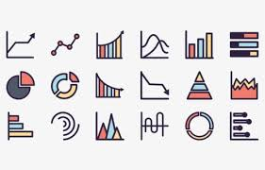
Graphing

Slide 2
Handout

Slide 3
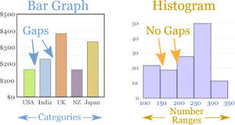

Bar Graphs vs Histograms

Slide 4
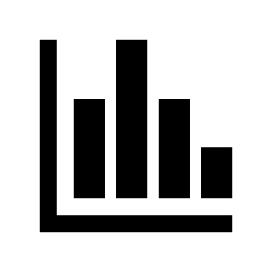
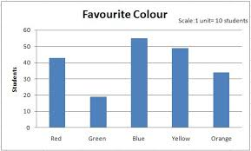
Bar Graphs
Used to represent QUALITATIVE data that is CATEGORICAL
Does NOT represent relationship between 2 variables
Can be used for PRELIMINARY data (why we chose the experimental set-up we did)
y-axis
DV
Quantitative
Increasing quantity
Consistent scale
x-axis
IV
Qualitative
Categories
Order likely irrelevant

Slide 5
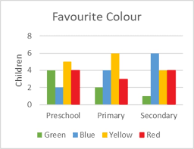
Bar Graphs
“multi-series” bar graph: categories within categories
Used to represent QUALITATIVE data that is CATEGORICAL
Does NOT represent relationship between 2 variables
Can be used for PRELIMINARY data (why we chose the experimental set-up we did)
y-axis
DV
Quantitative
Increasing quantity
Consistent scale
The big idea is that bar graphs are used in Science as a starting point to drive further experimentation. It’s not usually an end product for us!
x-axis
IV
Qualitative
Categories
Order likely irrelevant

Slide 6

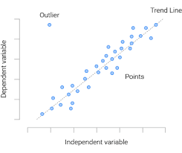
Scatter Graphs
Used to represent QUANTITATIVE data (i.e. NOT categorical)
Represents RELATIONSHIP between 2 variables
  What effect does _x_ have on _y_?
y-axis
DV
Quantitative
Increasing quantity
Consistent scale
x-axis
IV
Quantitative
Increasing quantity
Consistent scale

Slide 7

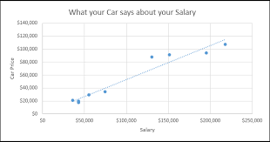
Scatter Graphs
Includes a line of best fit (aka “trendline”)
Used to represent QUANTITATIVE data (i.e. NOT categorical)
Represents RELATIONSHIP between 2 variables
  What effect does _x_ have on _y_?
y-axis
DV
Quantitative
Increasing quantity
Consistent scale
x-axis
IV
Quantitative
Increasing quantity
Consistent scale

Slide 8
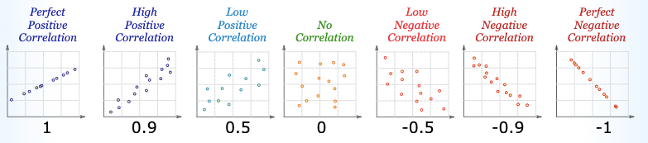
Analyzing scatter trendlines: Correlation
Slope →

Slide 9
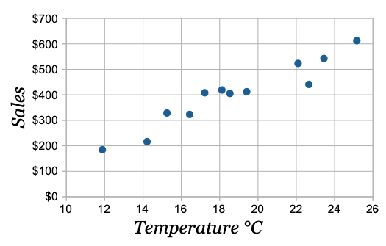
We can use the line of best fit to estimate by INTERPOLATING (estimating within data set), or EXTRAPOLATING (estimating outside of data set)
EX: estimate sales at a temperature of 21ºC?
EX: estimate temperature at sales of $150?

Slide 10
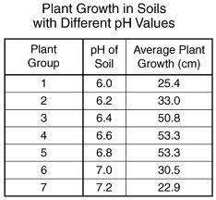
Sometimes our trendline isn’t linear.
Consider this data:
Plant growth (cm)
pH of soil

Slide 11
Sometimes our trendline isn’t linear.
Consider this data:
Plant growth (cm)
pH of soil

Slide 12
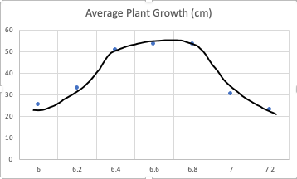
Sometimes our trendline isn’t linear.
Consider this data:
Plant growth (cm)
pH of soil

Slide 13
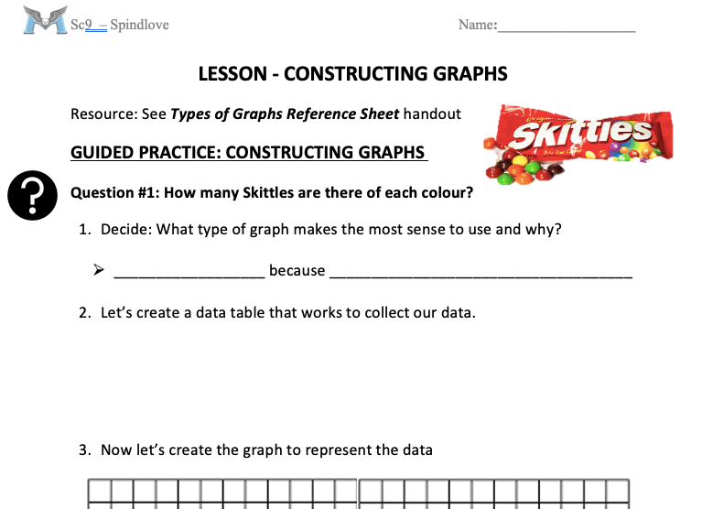
Let’s do some examples together
Use your Types of Graphs Reference Sheet handout and the Lesson- Constructing Graphs package
(switch to OneNote)

