Slide 1
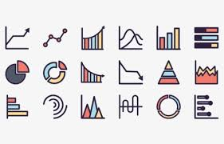
Graphing

Slide 2
Handout

Slide 3
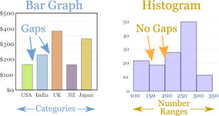

Bar Graphs vs Histograms

Slide 4
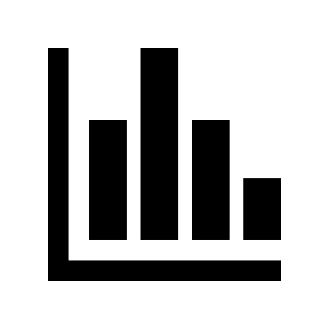
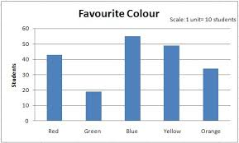
Bar Graphs
Used to represent QUALITATIVE data that is CATEGORICAL
Does NOT represent relationship between 2 variables
Can be used for PRELIMINARY data (why we chose the experimental set-up we did)
y-axis
DV
Quantitative
Increasing quantity
Consistent scale
x-axis
IV
Qualitative
Categories
Order likely irrelevant

Slide 5
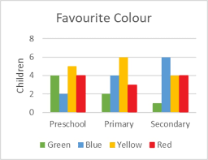
Bar Graphs
“multi-series” bar graph: categories within categories
Used to represent QUALITATIVE data that is CATEGORICAL
Does NOT represent relationship between 2 variables
Can be used for PRELIMINARY data (why we chose the experimental set-up we did)
y-axis
DV
Quantitative
Increasing quantity
Consistent scale
The big idea is that bar graphs are used in Science as a starting point to drive further experimentation. It’s not usually an end product for us!
x-axis
IV
Qualitative
Categories
Order likely irrelevant

Slide 6
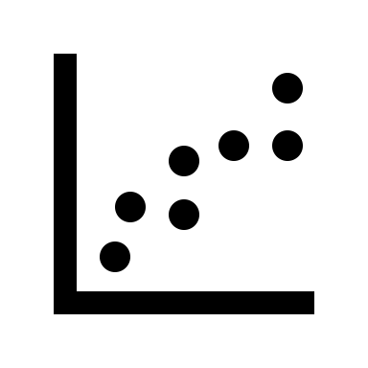
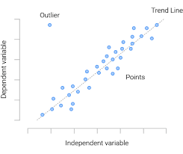

Scatter Graphs
Includes a line of best fit (aka “trendline”)
Used to represent QUANTITATIVE data (i.e. NOT categorical)
Represents RELATIONSHIP between 2 variables
  What effect does _x_ have on _y_?
y-axis
DV
Quantitative
Increasing quantity
Consistent scale
x-axis
IV
Quantitative
Increasing quantity
Consistent scale

Slide 7
Graphing Guidelines
Scatter Graphs
Need a title at the top. “Comparison of….” or “Relationship between…” are good ways to start. Mention both quantities (IV and DV) you are comparing. Try to avoid “vs”!
Label the axes with the quantity involved for each variable. Place units in brackets.
Look at data range (for each variable) and determine scales for the x- and y- axis. (The scale will probably not be the same for each axis!) Graph should fill most (at least 2/3) of the page. Scale must increase by regular increments for the entire axis. (i.e. increase by twos, by tens, by tenths, etc.) Your scale need not start at zero if it is not suitable for your data.
→Challenge yourself to find an efficient method of determining an appropriate scale from a given set of data!

Slide 8
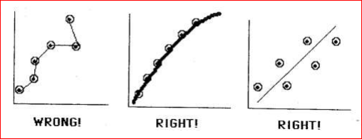
Graphing Guidelines
Scatter Graphs
Plot points in pencil. Draw dot for each point and then circle (like bullseye). If plotting >1 set of data on one graph, use different shapes or colors.
Don’t draw a line connecting one point to the next, draw a smooth line through all the points, called a “line of best fit”. (Should be as close to each point as possible, but can disregard extreme outliers.) **Usually is a straight line, but can be a curve!**

Slide 9
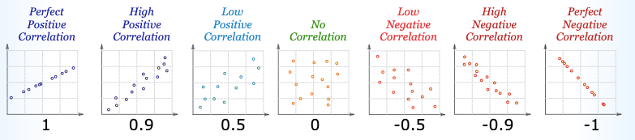
Analyzing scatter trendlines: Correlation
Slope →

Slide 10
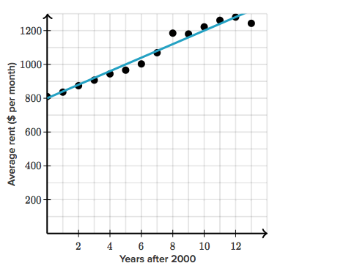

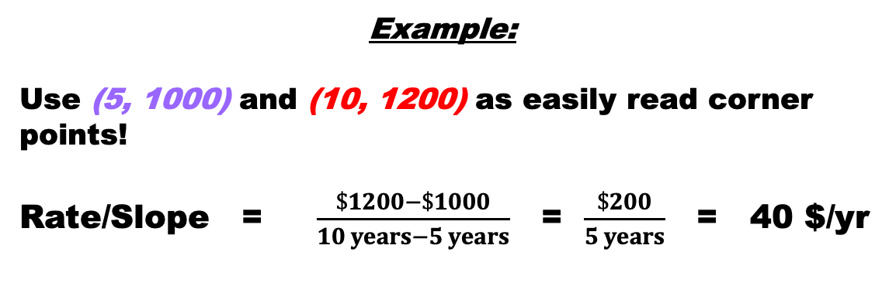
Relationship between Average Rent per Month and Years after 2000
Scatter Graphs
Calculate the RATE of increase or decrease in your line of best fit (aka SLOPE !) Choose two easily read data points on your graph (x₁, y₁) and (x₂, y₂),which are NOT part of your data set to avoid bias. Formula:
Rate/Slope = $\frac{change in dependent \left(y\right)variable}{change in independent \left(x\right)variable }$ = $\frac{y_{2}−y_{1}}{x_{2}−x_{1}}$ = answer (+ units)
→Challenge yourself to determine what the units for your rate will be!
Example:
Use (5, 1000) and (10, 1200) as easily read corner points!
Rate/Slope = $\frac{\$1200−\$1000}{10 years−5 years}$ = $\frac{\$200}{5 years}$ = 40 $/yr

Slide 11
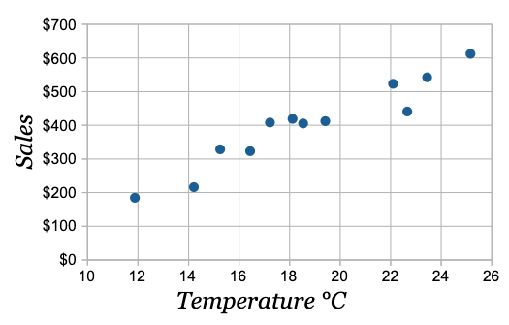
We can use the line of best fit to estimate by INTERPOLATING (estimating within data set), or EXTRAPOLATING (estimating outside of data set)
EX: estimate sales at a temperature of 21ºC?
EX: estimate temperature at sales of $150?

Slide 12
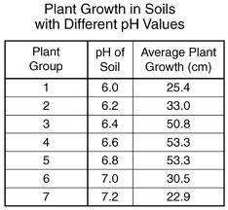
Sometimes our trendline isn’t linear.
Consider this data:
**Note: this data does not have enough significant digits!**
NO CORRELATION!
Plant growth (cm)
pH of soil

Slide 13
Sometimes our trendline isn’t linear.
Consider this data:
**Note: this data does not have enough significant digits!**
Plant growth (cm)
pH of soil

Slide 14
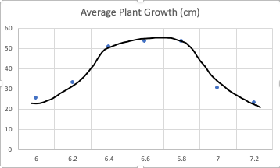
Sometimes our trendline isn’t linear.
Consider this data:
**Note: this data does not have enough significant digits!**
Plant growth (cm)
pH of soil

Slide 15
In-Class Practice: Let’s draw a graph ☺
The following data was collected by measuring the mass of given volumes of methanol. The MASS of methanol in (g) DEPENDS on the VOLUME of methanol (in mL).
Volume of methanol (mL) | 5.0 | 10.0 | 15.0 | 20.0 | 25.0 | 30.0 | 35.0 | 40.0 | 45.0
Mass of methanol (g) | 3.92 | 7.90 | 11.88 | 15.80 | 19.80 | 23.62 | 27.72 | 31.66 | 35.58

Slide 16

Enrollment Instructions
Step 1: Go to https://www.explorelearning.com
Step 2: Click on the “Enroll in a Class” button in the upper right-hand corner of the web page.
Step 3: Type in your class code: GPDC2H
Click “Continue” and follow the directions on the site to complete your enrollment. Use your usual first & last name please.
Step 4: Record your username and password in your phone or somewhere that you won’t lose it.
Once you’ve enrolled, you can login anytime using just your username and password (no class code required).

