Slide 1
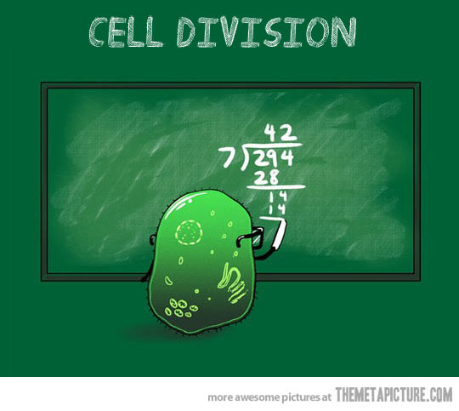
The cell cycle
Text section 5.1

Slide 2
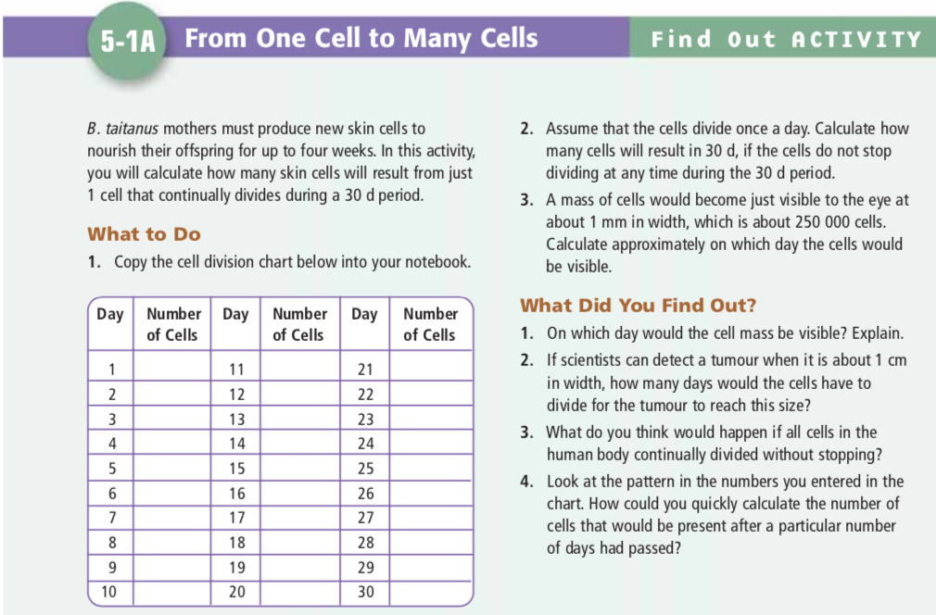
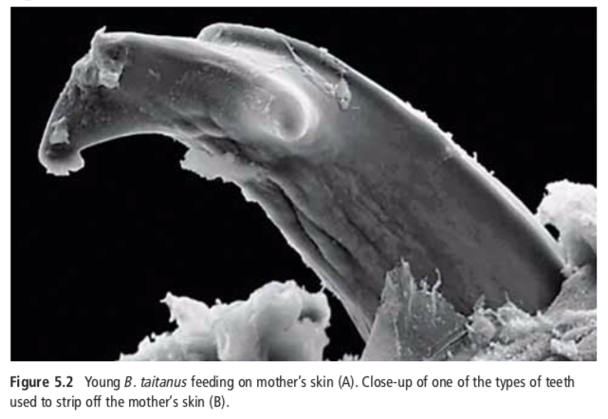

Slide 3
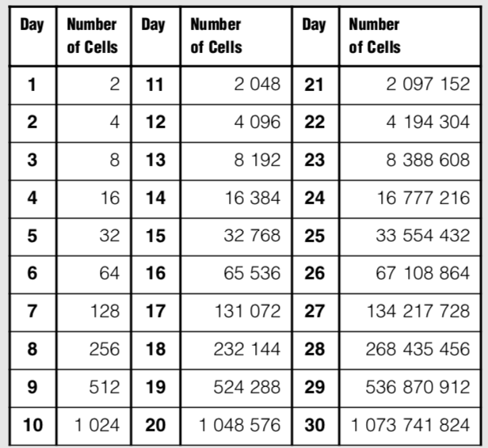
Notes:
To calculate the number of cells on a particular day, you could multiply 2 times the power of the number of days;

Slide 4
Why do cells divide?
Instead of dividing, why don’t cells just grow larger and larger?
If the cell grows too large, it will have trouble moving enough nutrients and wastes across the cell membrane.
As the cell grows, the volume of the cell increases much more rapidly than the surface area of the cell membrane.
The larger a cell becomes, the more demands the cell places on its DNA.

Slide 5
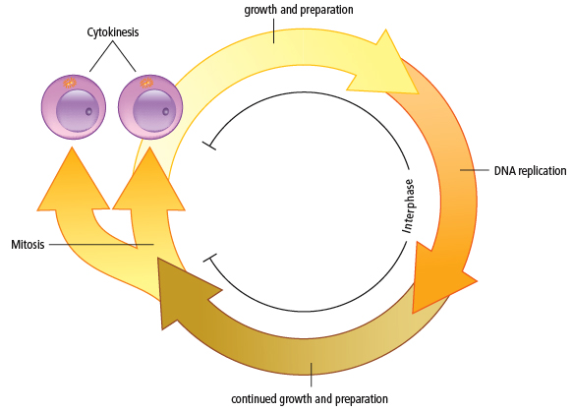
THE CELL CYCLE AND MITOSIS
Due to the loss and death of cells, the body must replace them.
A good example of this is human skin cells: Each day millions are shed.
The life of a cell is divided into three stages known as the cell cycle

Slide 6
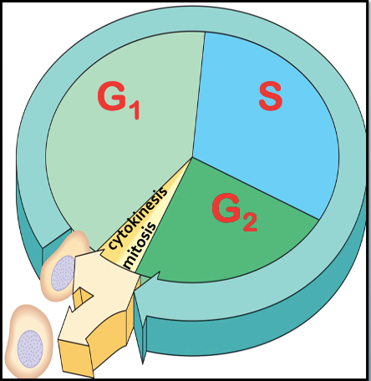
The cell cycle consists of three major phases, but often represented as five, since the first phase (interphase) is long:
1. Interphase is normal cell function and growth
i. G₁ (first gap)
ii. S (synthesis)
iii. G₂ (second gap)
2. Mitosis is the division of the nucleus.
3. Cytokinesis is the division of the cytoplasm.
End result: 2 new, identical cells are produced.

Slide 7
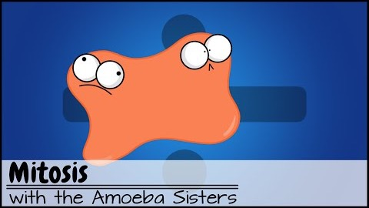
Again… let it sink in now

Slide 8
1. Interphase
G₁, S, G₂

Slide 9
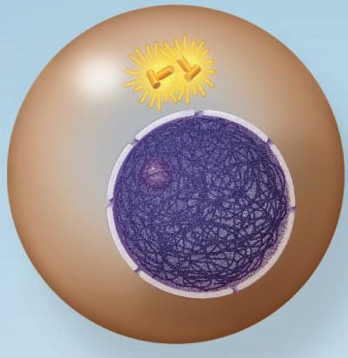
Interphase
Nucleus is well-defined and bounded by the nuclear membrane.
Outside of the nucleus are two centrioles.
Their function is to organize the microtubules into a spindle. They will begin to move apart as spindle microtubules grow out of them.
centrioles
nuclear membrane
nucleolus
chromosomes

Slide 10
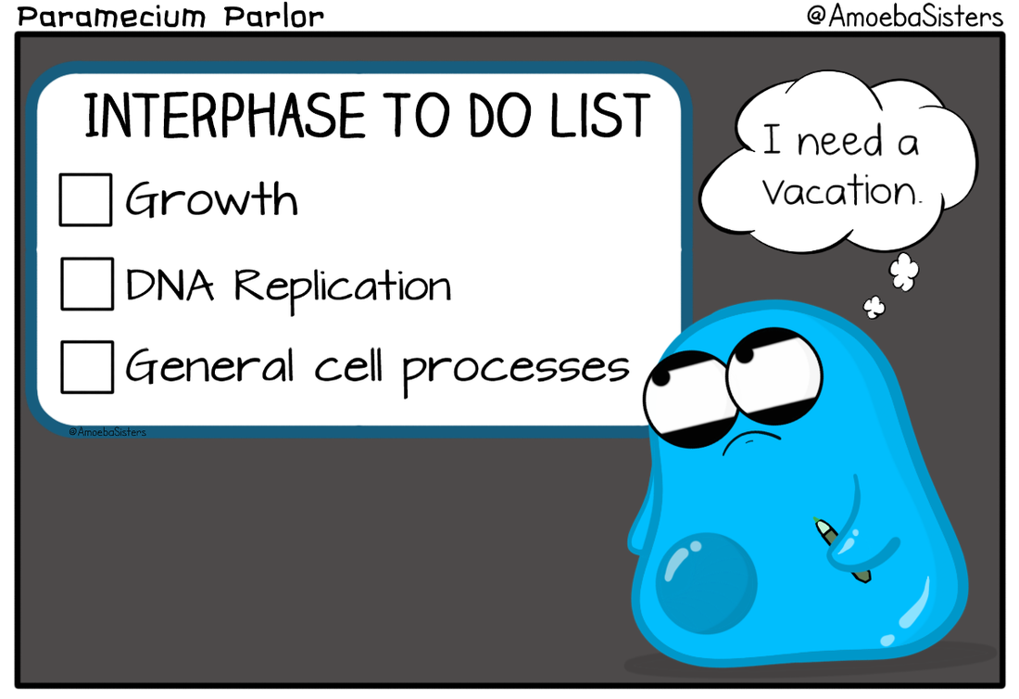

Slide 11
G1 – 1st Gap (Interphase)
Cell increases in size and makes the proteins and molecules necessary for the cell to function.
Some organelles begin to duplicate.

Slide 12
S – synthesis (Interphase)
Replication of DNA occurs.
The DNA molecule unwinds with the help of an enzyme.
New bases pair with the bases on the original DNA.
Two new identical DNA molecules are produced.

Slide 13
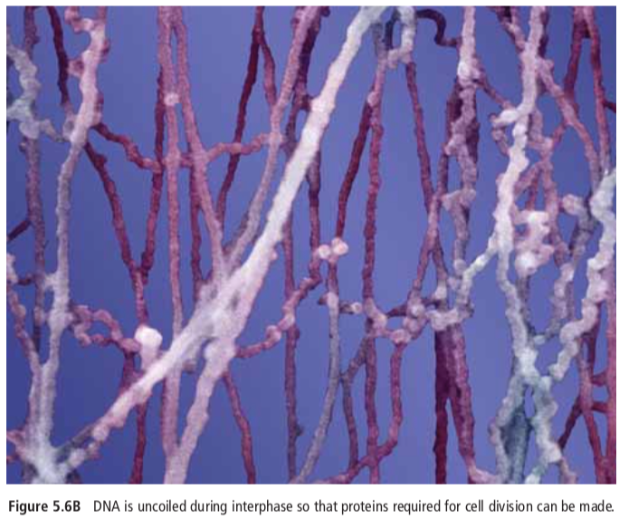
S – synthesis (Interphase)
The chromosomes have duplicated and appear as a jumbled mass of fibers.
They have not yet condensed.

Slide 14
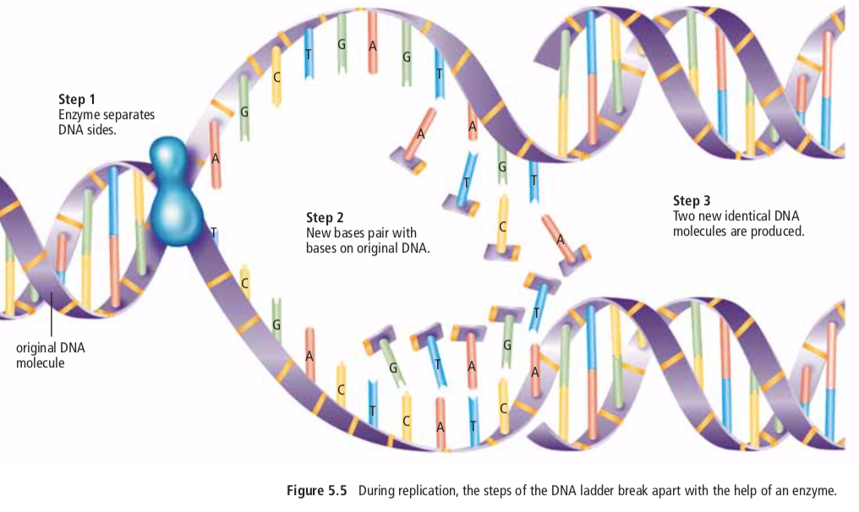

Slide 15
G₂ – 2nd Gap (Interphase)
Cell continues to grow and make materials such as proteins
The chromatin, which contains the replicated DNA, is in its loosely coiled form
Remaining organelles (such as mitochondria and chloroplasts) are duplicated.
Now the cell is ready to divide!

