Slide 1
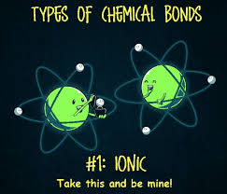

Slide 2
Ionic Compounds

Slide 3
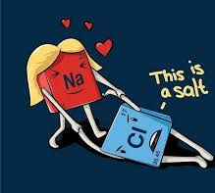
IONIC COMPOUNDS
Atoms gain or lose electrons to form ions
An ionic compound forms when electrons on metal atoms transfer to non-metal atoms, creating oppositely charged ions
Example: table salt: Na + Cl vid

Slide 4
Na + Cl
When sodium and chlorine atoms come together, they are electrically neutral.
When they get close enough, an electron transfers from the sodium TO the chlorine (recall that sodium has an extra electron in its valence shell and chlorine is short one)
This makes a positive sodium ion, Na⁺, and a negative chlorine ion, Cl⁻. animation

Slide 5
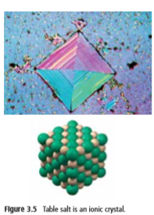
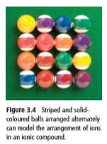
IONIC COMPOUNDS
Ionic compounds exist as a solid in the form of an ionic lattice
-A repeating pattern of positive and negative ions
Animation
So is a single grain of salt a pair of sodium and chlorine ions??
No! In a single grain of salt there are billions of trillions of sodium and chloride ions.

Slide 6
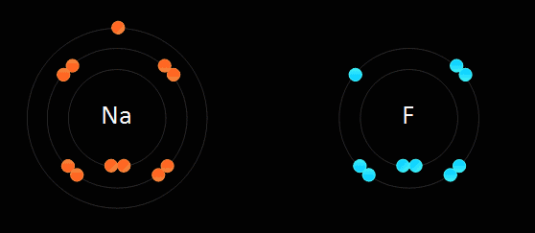
IONIC COMPOUNDS - Example NaF

Slide 7
IONIC COMPOUNDS – Example NaCl
Note: In order to simplify the model of ionic bonding, a single atom of sodium and chlorine are shown. In reality, the chlorine atom would be bonded to another chlorine atom as part of the gas Cl₂. The sodium atom would be one of billions of trillions of sodium atoms bonded together as a solid. The combination of these substances is a complex reaction between the atoms of the two substances. The animation shows single separated atoms to illustrate the idea of how ions and ionic bonds are formed . © Middleschoolchemistry.com

Slide 9
Use the whiteboards to practice drawing a few ionic compounds
Start by drawing the Bohr models of the atoms of each. Then draw the ionic compound.
Beryllium Oxide (BeO)
Potassium sulphide (how many of each makes sense?)

Slide 10
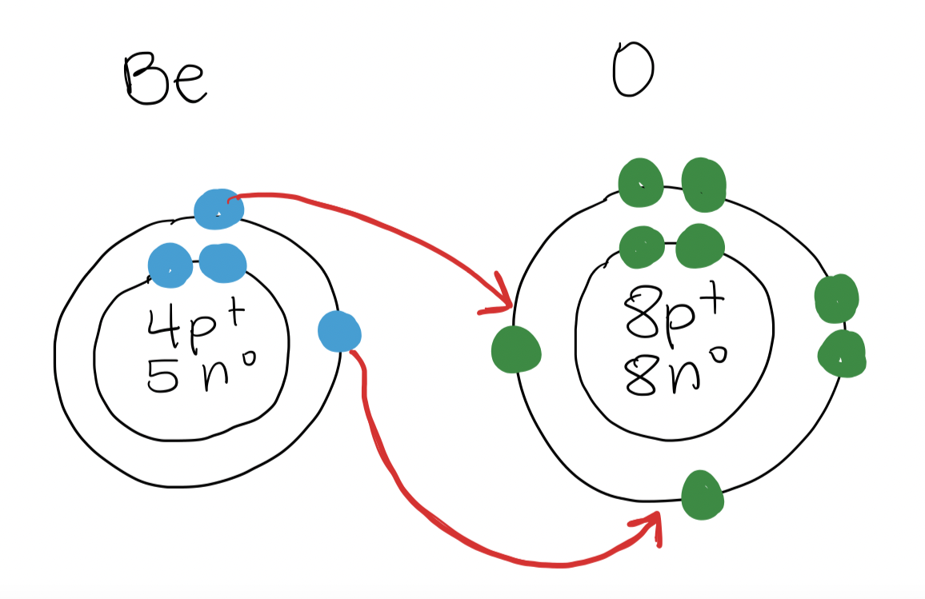
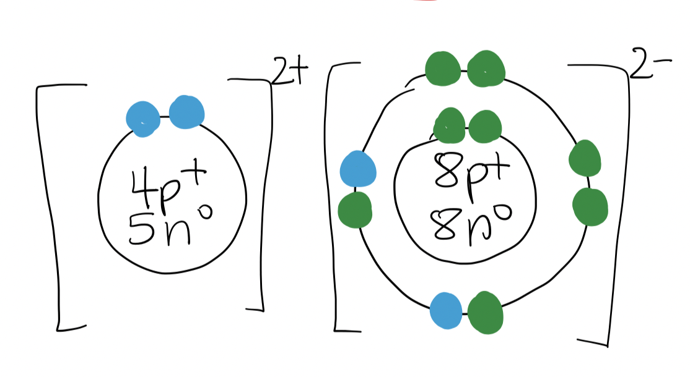
beryllium oxide
BeO
The ratio of 1:1 makes sense… 1 Be atom is required to “fill the holes” in the O atom

Slide 11
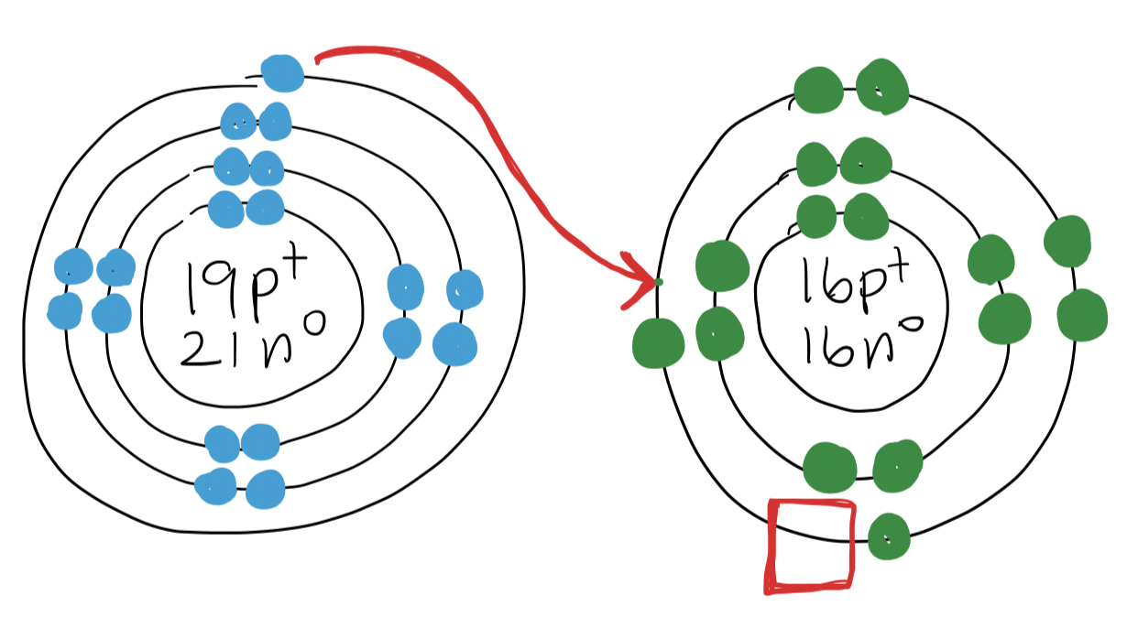
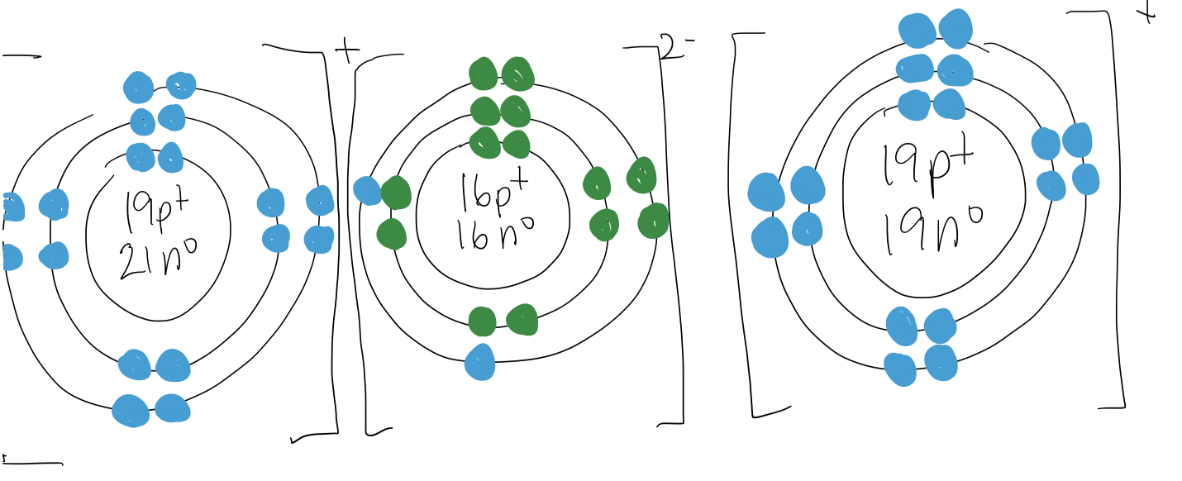
potassium sulphide
K₂S
The ratio of 2:1 makes sense… 2 K atoms is required to “fill the holes” in the S atom

Slide 12
PART A: Naming ionic Compounds

Slide 13
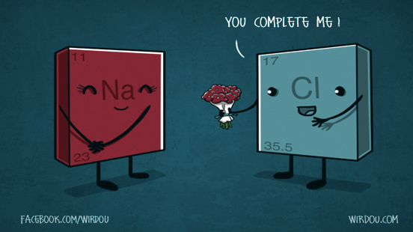
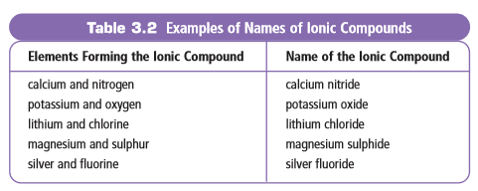
CHEMICAL NAME
A chemical name indicates the elements present in the compound.
Name has two parts: one for each type (+,-) of ion
1st part names the positive ion (called the cation)
The positive ion is always a metal in a compound containing 2 elements

Slide 14
CHEMICAL NAME
The 2nd part names the negative ion (called the anion)
The negative ion is always a non-metal in a compound containing 2 elements
The non-metal ion’s name always ends with the suffix “-ide”

Slide 15
NAMING IONIC COMPOUNDS A couple of examples:
MgBr₂
magnesium bromide
Ag₃N
silver nitride
Sr₃P₂
strontium phosphide
Na₂O
sodium oxide

Slide 16
Practice a few…

Slide 17
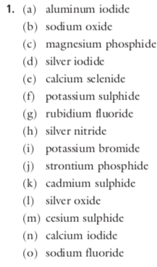
SOLUTIONS

Slide 18
PART B: WRITING FORMULAS
Naming Ionic Compounds

Slide 19
Ionic Formulas
Formulas:
contain symbols to identify each ion
show the relative number of ions in the compound (i.e. ratio)
shown as a subscript to the right of the element symbol
magnesium
bromine
MgBr₂
This means there’s 2 bromine ions
No number means there’s 1 magnesium ion

Slide 20
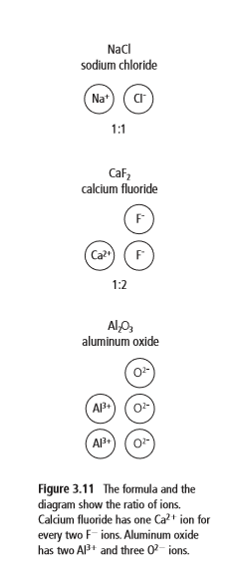
Ionic Formulas
In an ionic compound the positive charges balance the negative charges
Example Al₂O₃
2-
2-
2-
----
2
It takes ___ aluminums to
balance ___ oxygens
3+
3+
----
3
6+
6-

Slide 21
How to Write Chemical Formulas
First, WATCH the example of zinc nitride.
Then, there’ll step-by-step instructions with the example to record into can record into your notes.

Slide 22
Writing Ionic Formulas: Example 1
Example: zinc nitride
Zinc has a charge of 2+
2+
2+ 2+ 2+
Nitrogen has a charge of 3-
3-
3- 3-
6
It takes 3 zincs to balance 2 nitrogens
Zn₃N₂

Slide 23
Example: Zinc nitride
Step 1: Put symbols of each element together. Leave a tiny space between for any subscripts
Step 2: Figure out ratio needed to balance the charges on the metal and non-metal (how many of each do you need?)
Step 3: Include subscripts to the right of each element. If there is “1”, do not include that.
Note: NO charges should appear in a compound. Compounds are neutral!!
2+
3-
2+
2+
3-
Zn N
6-
6+
3
2
It takes 3 zincs to balance 2 nitrogens

Slide 24
Writing Ionic Formulas: Example 2
Example: magnesium chloride
Mg has a charge of 2+
2+
2+
Cl has a charge of 1-
1-
1- 1-
2
It takes 1 magnesium to balance 2 chlorines
MgCl₂

Slide 25
Practice a few…
Solutions:

Slide 26
But wait, a shortcut exists!
Example:
Zinc nitride
Zn ²⁺
N ³⁻
Zn N
³
²
Zn₃N₂

Slide 27
One more example:
Calcium oxide
Ca ²⁺
O ²⁻
Ca O
²
²
BUT… for ionic compounds we SIMPLIFY because it’s a ratio
(just like in math)
Ca₂O₂
→ CaO

Slide 28
Practice a few…

Slide 29
SOLUTIONS

Slide 30
Compounds with multivalent metals

Slide 31
Multi-Valent Metal Compounds
Many important metals are multivalent
“multi” means many
“valent” refers to the capacity to bond (think about the valence shell…)
So it means that the element has many ways to bond
Multivalent metals can form 2 or more different positive ions with different ion charges

Slide 32
Example:
Iron has two ion charges: 3⁺ and 2⁺. It can exist as either.
-The periodic table shows the most common ion charge first
--> Fe³⁺ is more common than Fe²⁺
Recall: metals are the blue ones here. In an ionic compound, we name the metal first.

Slide 33
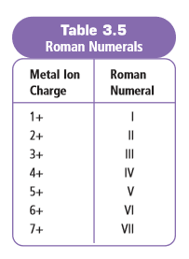
So how do we know which one??
When we’re talking about multivalent metals, we need make sure we’re clear which ion form we’re talking about. To do this, we use Roman Numerals
We would use Roman Numerals for copper (Cu) because it can have a charge of either 2+ or 1+ as an ion, and we’d need to specify which one
We wouldn’t use Roman Numerals for calcium (Ca) because it always has a charge of 2+ as an ion

Slide 34
How to Write and Say Them…
 | Examples
Fe³⁺ | Written: iron(III) | Pronounced “iron three”
Fe²⁺ | Written: iron(II) | Pronounced “iron two”
Pb⁴⁺ | Written: lead(IV) | Pronounced “lead four”
Cu⁺ | Written: copper(I) | Pronounced “copper one”

Slide 35
Part A: Writing Formulas with Multivalent Metals

Slide 36
Writing Chemical Formulas w/ Multivalent Metals
The Roman Numeral after the metal will tell you which ion charge to use
Example: Chromium fluoride
Cr⁺³
or Cr⁺² ??
F⁻¹
Example: Chromium(III) fluoride
Cr⁺³
F⁻¹
CrF₃

Slide 37
Writing Formulas of Multivalent Ionic Compounds Try some examples:
copper(I) iodide
CuI
tin(II) nitride
Sn₃N₂
iron(II) phosphide
Fe₃P₂
tin(IV) nitride
Sn₃N₄

Slide 38
Practice a few…

Slide 39
Solutions

Slide 40
Part B: Naming Compounds with Multivalent Metals

Slide 41
Naming Compounds with Multivalent Metals
It’s important EVERY time you write the metal in the compound, you stop to CHECK if it’s multivalent!!
If it IS, you need to include the Roman Numeral
If it IS NOT multivalent, do NOT include Roman Numeral!

Slide 42
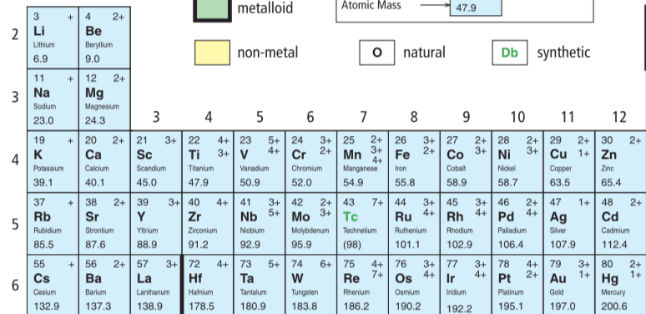
No
Likely

Slide 43
Examples
Cu₃P
copper(I) phosphide
Why??
Mn⁺⁴ and O²⁻ → Mn₂O₄ which simplifies to MnO₂
MnO₂
manganese(IV) oxide
It’s not Mn⁺² and O²⁻ → Mn₂O₂ which simplifies to MnO

Slide 44
Practice a few…

Slide 45
Solutions

