Slide 1
Ions

Slide 2
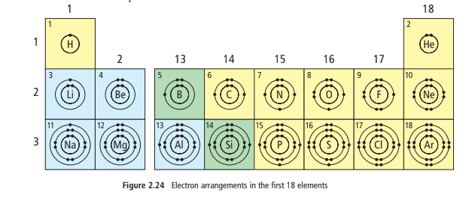
Valence Electrons and Chemical Families
What do you notice??

Slide 3
Valence Electrons and Chemical Families
Look at the Elements in the same GROUP (column).
Most elements in the same FAMILY have the same number of valence electrons
Ex: halogens have 7 valence electrons

Slide 4
Valence Electrons and Chemical Families
Look at the Elements in the same PERIOD (row).
They have valence electrons in the same shell
What does the period number indicate?
The period number indicated the number of shells that have electrons

Slide 5
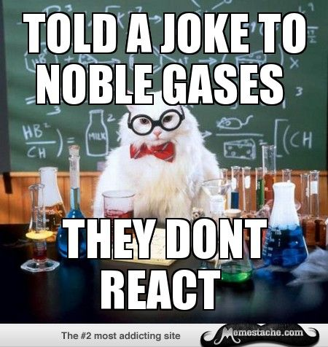
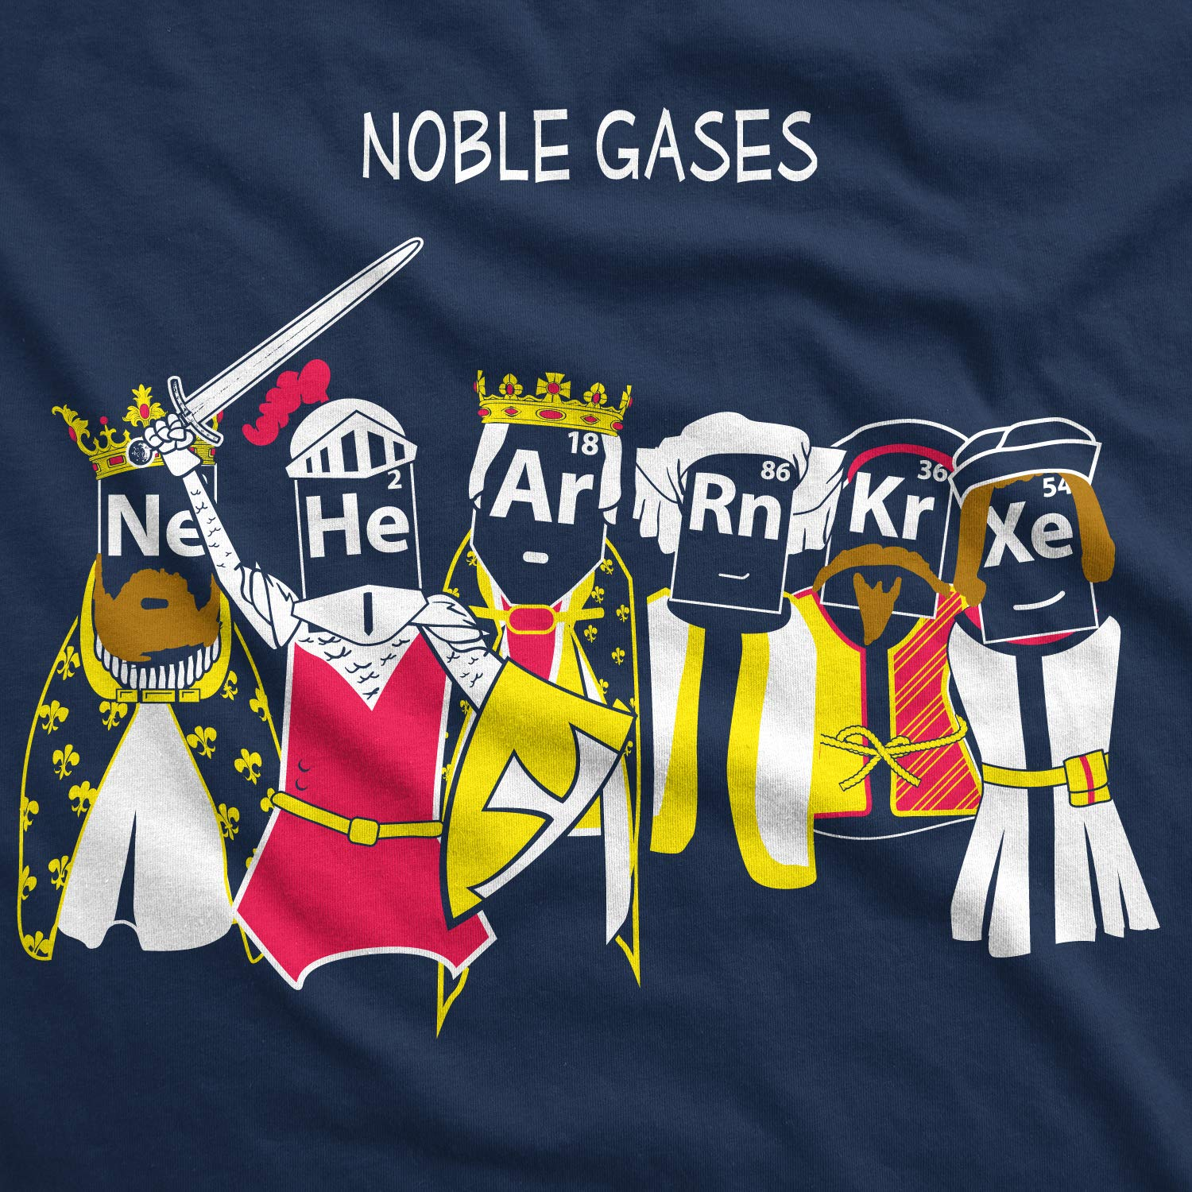
Noble Gas Stability
The noble gases are normally unreactive, which means the atoms do not form new substances with other atoms.
Why? Because their atoms have filled valence shells – the max number of electrons in their outer shells. That makes them stable.
For two atoms to join together to make a new substance, atoms must lose, gain or share electrons. But atoms with filled valence shells will not easily trade or share electrons. They have what is called noble gas stability.

Slide 6
Gaining/Losing Electrons
Atoms from other families often try to achieve a kind of stability similar to the noble gases. To do this they will gain or lose electrons.
METALS:
How many valence electrons do Metals usually have?
1, 2 or 3
They will often lose them all
When metals lose their valence electrons, their remaining electrons will have the same arrangement as the nearest noble gas

Slide 7
Gaining/Losing Electrons
Atoms from other families often try to achieve a kind of stability similar to the noble gases. To do this they will gain or lose electrons.
NON-METALS:
How many valence electrons do non-metals usually have?
They gain 1, 2 or 3 extra electrons in order to achieve noble gas stability
They gain exactly enough to achieve the same electron arrangement as the noble gas in their period

Slide 8
IONS!
When they gain or lose electrons, they are called…

Slide 9
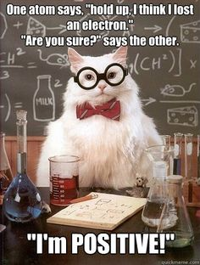
What Are Ions?
The ion charge is an electric charge that forms on an atom when it gains or loses electrons.
An atom that has gained electrons is a negative ion because the extra electrons make it negative.
An atom that has lost electrons is a positive ion because the loss of electrons removes negative charge

Slide 10
Some elements have a multiple ion charge, meaning they form ions in multiple ways (example: Copper)
What pattern do you notice on the table?
Elements on left tend to form positive ions
Elements on right tend to form negative ions
Elements in same column form ions with same charge as other elements in that column

Slide 11
NOBLE GASES DO NOT FORM IONS. WHY?
What do you notice about the arrangement of the ions relative to the noble gases?
Ions have the same electron arrangement as the nearest noble gas

Slide 12
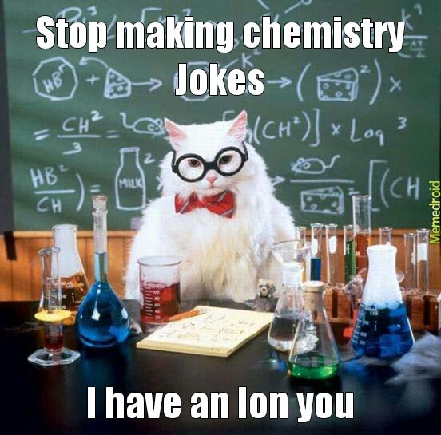
How Atoms Become Ions
Now that we get that an atom that has gained or lost electrons is called an ion and ions carry an electrical charge…
An atom of any metal can lose electrons and form positive ions
An atom of any non-metal (except a noble gas) can gain electrons and form negative ions
Ions have the same electron arrangement as the nearest noble gas
The charge on an ion is equal to the sum of the charges on its protons and electrons

Slide 13
Let’s practice drawing Bohr models of ions
First, WATCH the example of Nitrogen.
Then, there’ll be second example for you to try and see done for you – you can record that into your notes.

Slide 14
It may want to gain 3 electrons to fill its valence shell.
Gaining electrons makes it more negative, so it has a negative ion charge
P = 7
N = 7

Slide 15
Draw the Bohr model of NITROGEN’S ION
3-
Start with drawing the Bohr model of the atom
Decide whether it will lose or gain electrons.
add/subtract electrons so that the valence shell is full
Insert square brackets around Bohr diagram
Include the number of electrons you added/subtracted as a superscript outside of the brackets
+ = if subtracted electrons (making it “less negative”)
- = if added electrons (making it “more negative”)
P = 7
N = 7
Check the sum of protons and electrons…
P + E → (+7) + (-10) = (-3)

Slide 16
Draw the Bohr model of MAGNESIUM’S ION
2+
Start with drawing the Bohr model of the atom
Decide whether it will lose or gain electrons.
add/subtract electrons so that the valence shell is full
Insert square brackets around Bohr diagram
Include the number of electrons you added/subtracted as a superscript outside of the brackets
+ = if subtracted electrons (making it “less negative”)
- = if added electrons (making it “more negative”)
P=12
N=12

