Slide 1
Mass

Slide 2
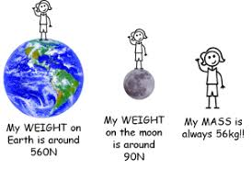
MASS
The mass of an object is the amount of matter in a substance or object.
Mass is measured in milligrams, grams, kilograms
Mass ≠ Weight
Weight is the force of gravity on an object. It changes depending on where in the universe the object is
Video: Mass vs Weight

Slide 3
Triple Beam balance

Slide 4
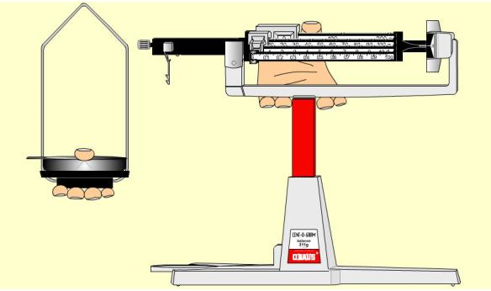
Transporting a Balance

Slide 5
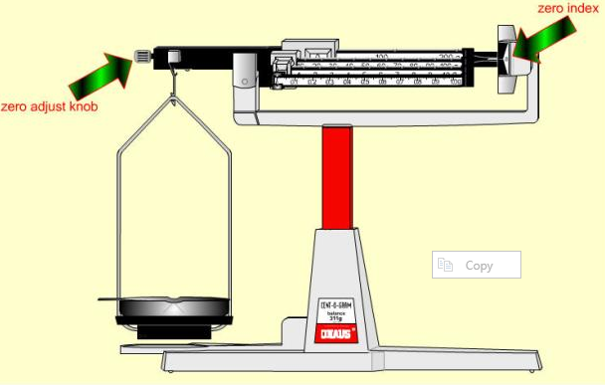
Zeroing the Balance

Slide 6
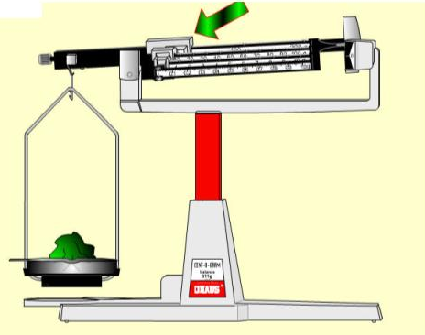
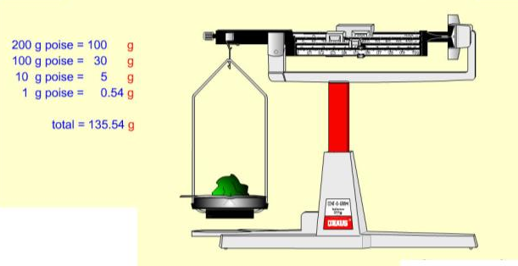
Determining the mass of an object
Start with the larger sliders/riders then work smaller

Slide 7
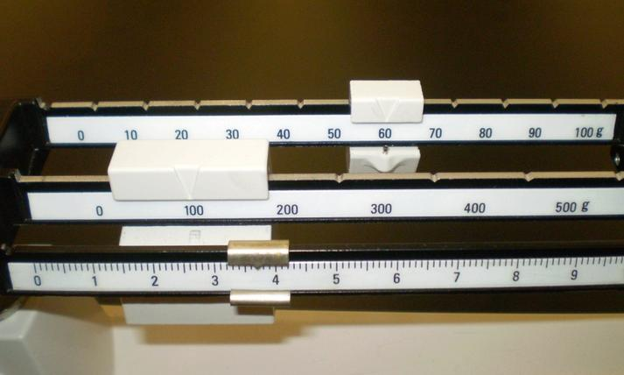
Example:
Smallest graduation lines represent 0.1 so we must estimate to 0.01!
60 g
100 g
3.70 g
163.70 g

Slide 8
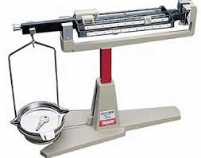
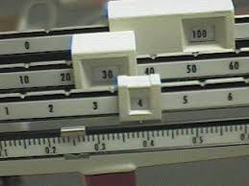
The accuracy you use (how many numbers after decimal) depends on the specific tool, so pay attention to that!!
The balances we’ll be using here are centigram balances and give us accuracy to the nearest centigram (or, hundredth of a gram).
i.e. there should be one estimated digit added to this!!
134.249 g

Slide 9
Create a Pre-Lab for upcoming lab. Include:
Title (given)
Question (given)
Hypothesis (you generate, based on question and reading through procedure)
Methods
Materials (list)
IV - incl unit
DV - incl unit
CV(s) - incl how controlled
Procedure – reference it like this: See “Measuring Mass” handout, Kovacevic +Spindlove, 2021
Data table skeleton (you generate, based on the procedure). Pre-load what you can.
Lab
Measuring Mass

Slide 10
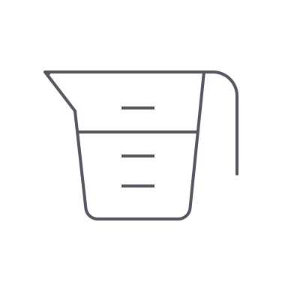
Volume

Slide 11
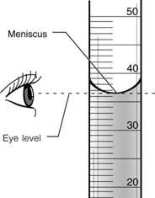
Volume is the amount of space taken up by an object or substance.
Liquids:
Volume is commonly measured with a graduated cylinder
Units for liquid volume is litres (L), typically mL
When reading from a graduated cylinder, we read from the bottom of the curved water line. This is called the meniscus.
Be sure to be eye level with the meniscus to obtain an accurate measurement.
A graduated cylinder can have numerous scales so be sure to determine the value of each of the gridlines prior to taking your measurement.

Slide 12
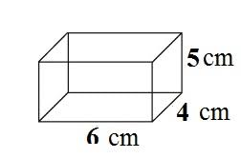
Solids (“regularly” shaped):
Volume is measured with a ruler and calculated (l x w x h)
Units for solid volume are cubic units, typically cm³
Example:
Vol = 6 cm x 4 cm x 5 cm
Vol = 120 cm³
Note: the significant digits for this example are insufficient. We measure to tenth and estimate to hundredth for metric length.

Slide 13
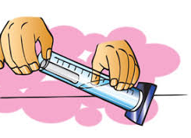
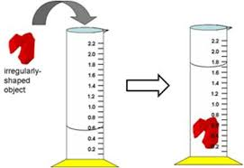
Volume of Solids (“irregularly” shaped):
Volume is measured by displacement method
Steps:
Add water to graduated cylinder and record volume of water (must be enough to completely cover object).
Add item to the cylinder. The water level will rise.
Record the new water level.
Subtract the two volumes. This is the volume of the object.
Be sure to think through the size of the object you are using and ensure you have an appropriately sized cylinder so it does not become stuck!
Solids are typically measured in cm³. You will be measuring the water level in mL…
Conversions to note:
1000 mL = 1 L
1 cm³ = 1 mL

Slide 14
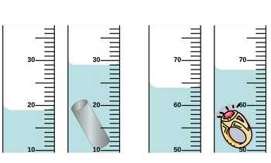
Practice
vol = 29.0mL – 19.0mL
vol = 10.0 mL → 10.0 cm³
vol = 68.0 mL – 64.0 mL
vol = 4.0 mL → 4.0 cm³

Slide 15
When reading a graduated cylinder, you need to
keep the graduated cylinder level on the desk
determine the value of the graduations [minor grids]
ensure that you are reading it at eye level of the meniscus
read from the bottom of concave meniscus
record measures with the correct number of significant digits: include one digit of estimation beyond smallest tick lines
12.4 mL

Slide 16
Each tick = 1 mL
Each tick = 2 mL
Each tick = 0.2 mL
Each tick = 0.5 mL
Determining scale
Step 1: Determine the value for the graduations [minor grids] on the cylinder.
what is the smallest “tick line” worth? [assume mL units]

Slide 17
Each tick = 1 mL
Each tick = 2 mL
Each tick = 0.2 mL
Each tick = 0.5 mL
Reading the volume
Step 2: record measures with the correct number of significant digits: include one digit of estimation beyond smallest tick lines

Slide 18
Each tick = 1 mL
Each tick = 2 mL
Each tick = 0.2 mL
Each tick = 0.5 mL
Each tick is a whole number, so we need one digit PAST that (i.e. to the TENTH)
Each tick is some tenth (2/10, 5/10) of a whole number, we need one digit PAST that (i.e. to the HUNDREDTH)

Slide 19
Each tick = 1 mL
Each tick = 2 mL
Each tick = 0.2 mL
Each tick = 0.5 mL
x.x mL
x.x mL
x.xx mL
x.xx mL
Each tick is a whole number, so we need one digit PAST that (i.e. to the TENTH)
Each tick is some tenth (2/10, 5/10) of a whole number, we need one digit PAST that (i.e. to the HUNDREDTH)

Slide 20
Measuring Volume
Create a Pre-Lab for upcoming lab. Include:
Title
Question
Hypothesis
Objectives (this is a lab whose purpose serves to strengthen skill)
Methods:
Materials (reference)
Controls
Procedure (reference)
Data table skeleton (you generate, based on the procedure). Pre-load what you can.
Lab

