Slide 1
Investigating Matter
Describing Matter
Chemical Change vs Physical Change

Slide 2
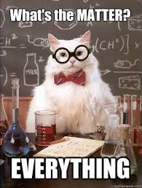
Investigating matter
Matter is anything that has MASS and VOLUME
Mass is the amount of matter in an object
Volume is the amount of space the matter occupies
Matter can be described by its properties

Slide 3
What are properties?
PHYSICAL PROPERTIES: is a characteristic of a substance that can be observed or measured without changing the identity of the substance
CHEMICAL PROPERTIES: describe a substances ability to react chemically with other substances to form new products.

Slide 4
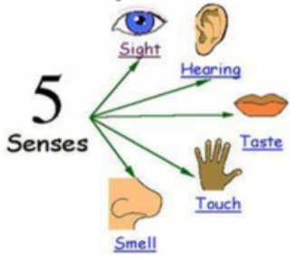
PHYSICAL PROPERTIES used to describe matter
Qualitative
Quantitative
measured numerically
described but not measured
categorical
Two categories:

Slide 5
PHYSICAL PROPERTIES
Qualitative
Quantitative
QuaLitative
QuaNtitative
K
U
M
B
E
R
Two categories:

Slide 6
Observing Physical Properties
We’re going to start an ongoing list that will be helpful for future labs to give you some ideas for how to set-up your data table skeletons (remember, all labs are not the same and the procedure drives the table, not the other way around!)
Property | Qualitative or Quantitative? | Definition/ Description

Slide 7
Notes:
What properties do you see? Record on your list?

Slide 8
Notes:
What properties do you see? Record on your list?

Slide 9
Sorting Activity
Physical vs Chemical Properties

Slide 10
Changes in Matter
Matter can undergo two types of changes:
physical change
chemical change

Slide 11
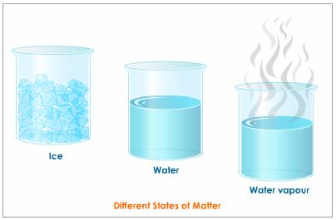
Physical changes
A physical change is a change in which the appearance of matter may change but no chemical bonds are broken or made and no new substance is formed
A change of state is a physical change

Slide 12
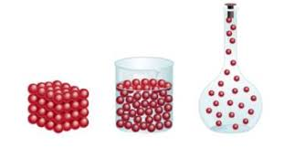
SOLID
Definite shape and volume.
KMT: particles packed together tightly and vibrating
LIQUID
Definite volume; shape determined by surroundings
KMT : particles in contact with each other and can move past each other (slip/slide)
GAS
shape and volume determined by surroundings
KMT : particles have very large spaces between them and move freely
States of Matter

Slide 13
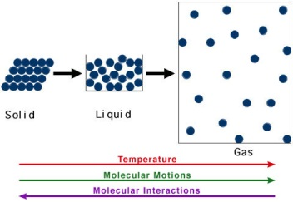
Kinetic Molecular Theory (KMT)
Describes what happens to matter when the kinetic energy of particles changes.
The main points in the theory are:
Matter is made of small particles.
There is empty space between particles.
Particles are constantly moving.
Energy makes particles move.

Slide 14
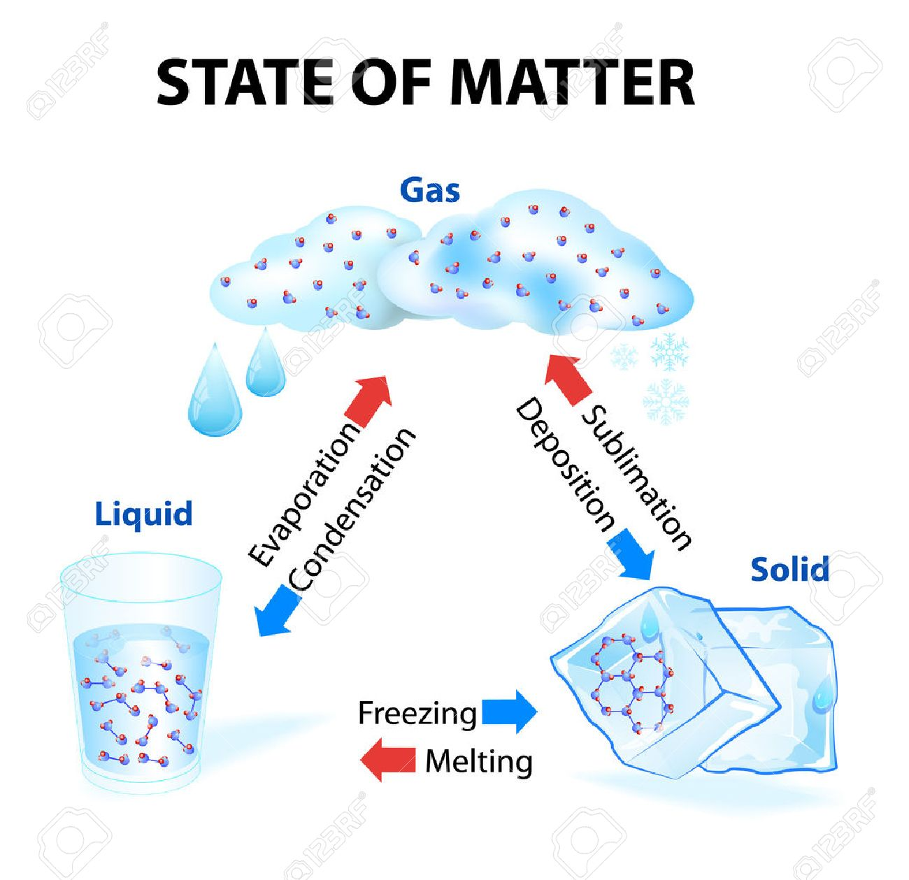
Changes of state depend on factors such as temperature
When heat is added to a substance, its particles gain kinetic energy and move faster, causing them to move farther apart

Slide 15
Chemical Changes
A chemical change is a change that occurs when substances combine to form new substances

Slide 17
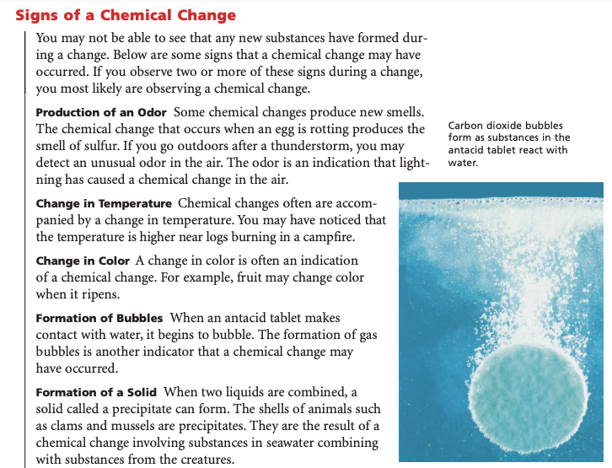

Slide 18
Kahoot.it
Chemical Changes
vs
Physical Changes

Slide 19
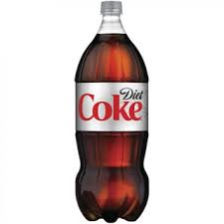
Demo

Slide 20
Demo
Calcium + Water
Ca(s) + 2H₂O → Ca(OH)₂(s) + H₂(g)
What is the evidence that it was a chemical change?
Chemical Changes

Slide 21
Demo
Elephant
Toothpaste
What kind of qualitative observations can we make regarding the following demo?
Materials:
30% H₂O₂
Dish soap
Catalyst, such as KI (or yeast + warm water)
Observing Chemical Changes

Slide 22
Labs
For each lab:
Title
Question
Hypothesis
Materials
Procedure: See <title of lab>, p. __, BC Science 9, 2007
Observations & Data: make data table skeleton(s)
Bag of Change
Slivers of Silver
Observing Matter

Slide 25
Slivers of Silver Lab:
Bag of Change Lab:

Slide 27
Hydrogen Lab:

