Slide 1
Mass

Slide 2
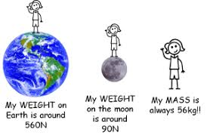
MASS
The mass of an object is the amount of matter in a substance or object.
Mass is measured in milligrams, grams, kilograms
Mass ≠ Weight
Weight is the force of GRAVITY on an object. It changes depending on where in the universe the object is
Video: Mass vs Weight

Slide 3
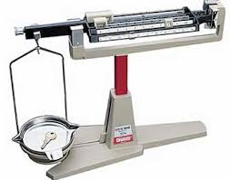
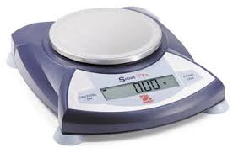
Measuring Mass
Measuring tool = BALANCE
It can be __________ or ___________
What about measuring masses of liquids or granular/powder substances?
With a digital scale, you can use an empty beaker or dish and hit the “tare” or “zero” button to reset the balance to zero, and then add your substance. The scale automatically subtracts the mass of the beaker or dish before the contents are added, so it reports only the mass of the contents.
With a manual balance, you have to do this yourself. First find the mass of the beaker or dish and record its mass. Then add your substance and record the resulting mass. Finally, subtract the two masses and your result will be the mass of the substance.
MANUAL
DIGITAL

Slide 4
Triple Beam balance

Slide 5
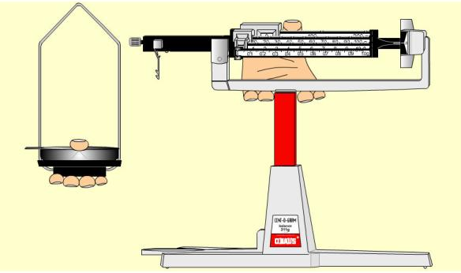
Transporting a Balance

Slide 6
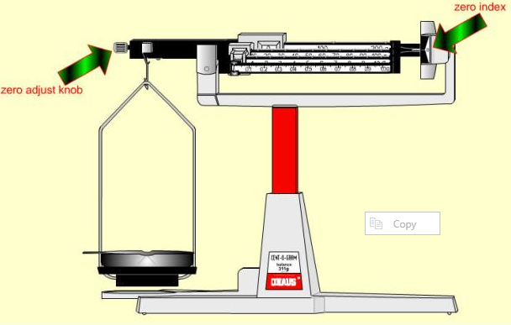
Zeroing the Balance

Slide 7
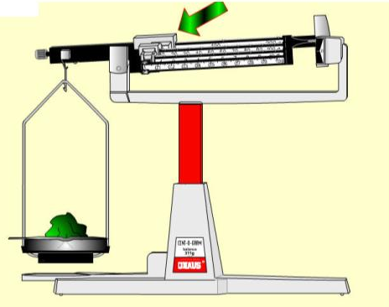
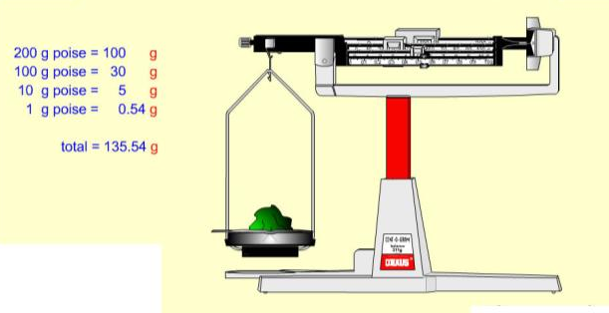
Determining the mass of an object
Start with the larger sliders/riders then work smaller

Slide 8
Example:
60 g
100 g
3.7 g
163.7 g

Slide 9
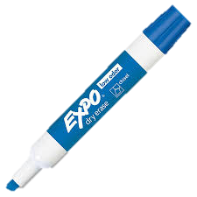
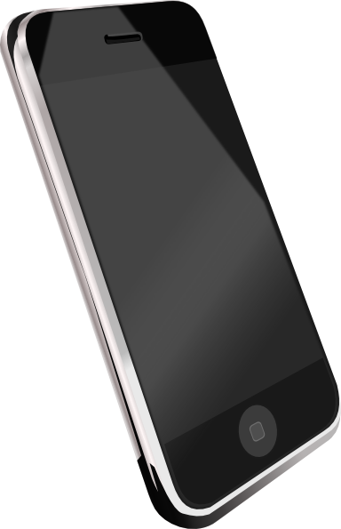
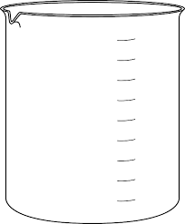
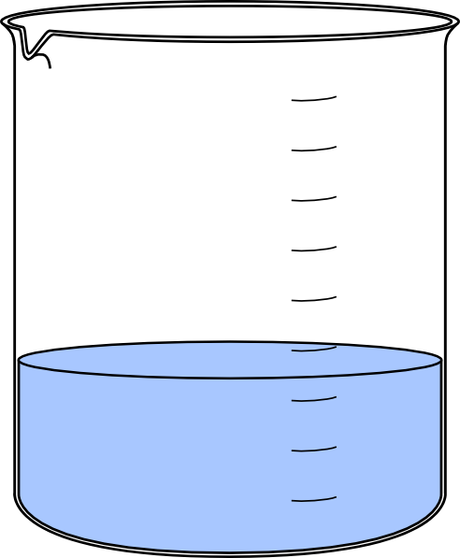
Practice: Obtaining Mass Measurements
Use the triple beam balance to measure the mass of the following objects:
1. A dry erase marker
2. A cell phone
4. A beaker with ~100mL of water
3. A beaker

Slide 10
Lab
Create a Pre-Lab for tomorrow’s lab. Include:
Title
Question (given) Hypothesis (you generate, based on question and reading through procedure)
Data table skeleton (you generate, based on the procedure)
Measuring Mass

Slide 11
Volume

Slide 12
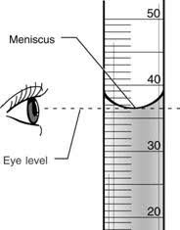
Volume is the amount of space taken up by an object or substance.
Liquids:
Volume is commonly measured with a graduated cylinder
Units for liquid volume is litres (L), typically mL
When reading from a graduated cylinder, we read from the bottom of the curved water line. This is called the meniscus.
Be sure to be eye level with the meniscus to obtain an accurate measurement.
A graduated cylinder can have numerous scales so be sure to determine the value of each of the gridlines prior to taking your measurement.

Slide 13
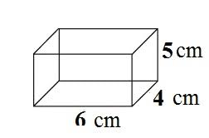
Solids (“regularly” shaped):
Volume is measured with a ruler and calculated (l x w x h)
Units for solid volume are cubic units, typically cm³
Example:
Vol = 6 cm x 4 cm x 5 cm
Vol = 120 cm³

Slide 14
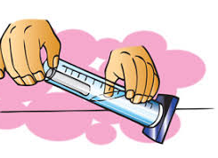
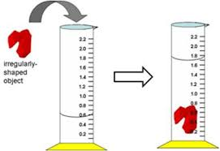
Volume of Solids (“irregularly” shaped):
Volume is measured by displacement method
Steps:
Add water to graduated cylinder and record volume of water (must be enough to completely cover object).
Add item to the cylinder. The water level will rise.
Record the new water level.
Subtract the two volumes. This is the volume of the object.
Be sure to think through the size of the object you are using and ensure you have an appropriately sized cylinder so it does not become stuck!
Solids are typically measured in cm³. You will be measuring the water level in mL…
Conversions to note:
1000 mL = 1 L
1 cm³ = 1 mL

Slide 15
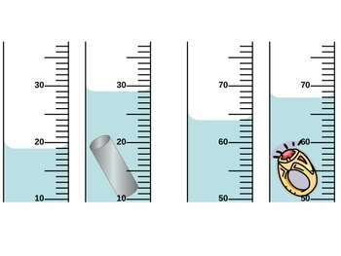
Practice
vol = 29mL – 19mL
vol = 10 mL → 10 cm³
vol = 68 mL – 64 mL
vol = 4 mL → 4 cm³

Slide 16
Lab
Create a Pre-Lab for tomorrow’s lab. Include:
Title
Question
Hypothesis
Objectives (this is a lab whose purpose serves to strengthen technique & following directions)
Procedure (copy)
Data table skeleton (you generate, based on the procedure)
Measuring Volume

Slide 17
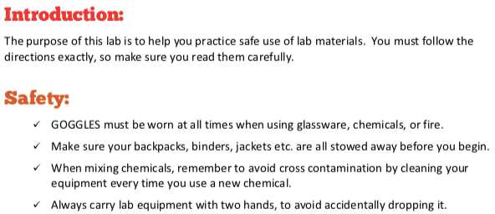
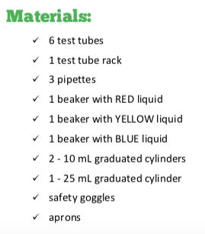

Slide 18
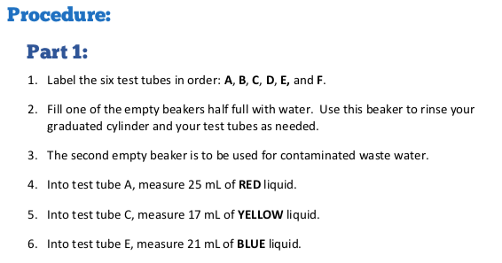
Procedure

