Slide 1
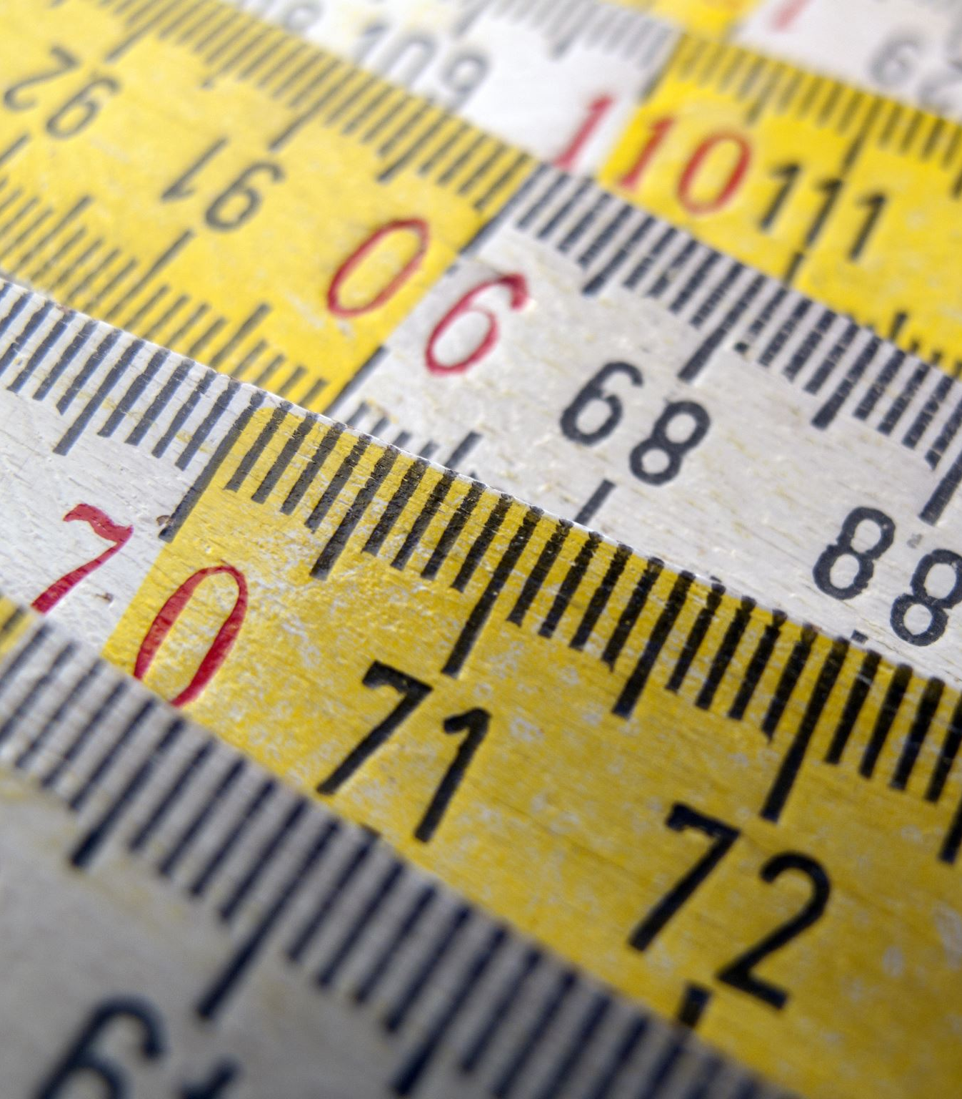
Measurements + Significant Digits

Slide 2
Measured Values
There are two types of quantities, those that include exact values and those that include measured values.
Exact values can either be counting numbers or defined values, both of which are perfect and exact.
Counting numbers: If Johnny has 5 loonies, he has exactly 5 and not 5.7 loonies.
Defined values: Values that have been created by scientists, such as 1 dozen = 12, are also said to be perfect and exact. Another example is that 1 cm = 10 mm.
Measured values are created by reading a measurement instrument, such as a centigram balance, a graduated cylinder or a ruler. Measured values are NOT perfect or exact.

Slide 3
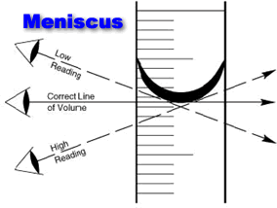
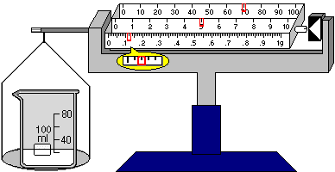
Some tools of measurement
Graduated Cylinder (measures volume)
Centigram Balance (measures mass)
Ruler (measures length)
All measured values obtained from these instruments have limited precision, and those quantities must be recorded to the correct number of digits, or significant digits (aka “sig figs” in your future science courses).

Slide 4
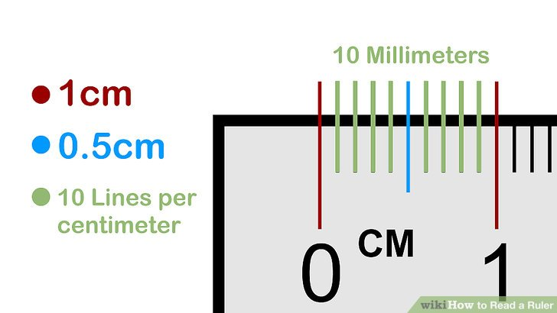
Let’s look at a ruler and study the markings:

Slide 5
When reading measured values on an instrument in the laboratory, one must decide upon how many significant digits (or decimal places + the whole number) these quantities should include, which reflects the precision of the instrument used. These values are recorded to be as accurate as possible, as well as precise.

Slide 6
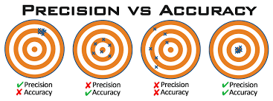
When reading measured values on an instrument in the laboratory, one must decide upon how many significant digits (or decimal places + the whole number) these quantities should include, which reflects the precision of the instrument used. These values are recorded to be as accurate as possible, as well as precise.
Note: Accuracy refers to how close a value is to its true value, whereas precision refers to how repeatable a measurement is.

Slide 7
Example:
The pin is measured as 0.66 cm
When reading measured values on an instrument, we obtain a measurement reading by using the markings (division lines, graduations, “tick lines”, partition lines, etc.) as seen on the instrument. Our measurement readings will always involve some degree of uncertainty, however, because the item being measured doesn’t always exactly line up with the marking/division lines on the measuring device – this is why the measurement readings must contain one more reasonably estimated place value than what we are certain of, called the estimated digit.

Slide 8
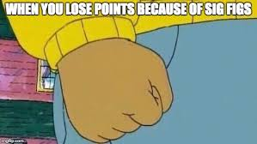
Significant Digits
Your measured values with the correct number of significant digits are thus:
measurement readings that contain the digits you are sure of (that correspond to the markings/division lines on the measuring device) and
one estimated digit (the estimated number will be one more place value than the value of the smallest marking/division line on the measuring device and needs to be reasonable!).

Slide 9
Example #1
We need to have 2 decimal places (or 3 significant digits) since the ruler gives us accuracy to the nearest tenth, and we estimate reasonably to the next decimal place
2._ _ cm
32

Slide 10
Example #2
We need to have 2 decimal places (or 3 significant digits) since the ruler gives us accuracy to the nearest tenth, and we estimate reasonably to the next decimal place
1._ _ cm
87

Slide 11
Example #3
30
4._ _ cm

Slide 12
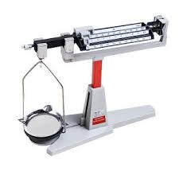
Measuring Mass
Our balances for measuring mass here at REMSS are centigram balances, meaning they provide measurement to the nearest centigram (1/100 of a gram, or 0.01 g).
3
measured values
estimated value
How many decimal places should our mass measurements have?
___ . _ _ _ g

