Slide 1
the Metric System
Based on multiples of 10​
The basic unit of length is the metre ​
Larger units are based on metres multiplied by 10, 100, 1000 etc​
Smaller units are based on metres divided by 10, 100, 1000 etc​
Each multiple has its own prefix (syllable joined to the beginning of a word)​
Base units:
mass → g
length → m
volume → L
energy → W

Slide 2
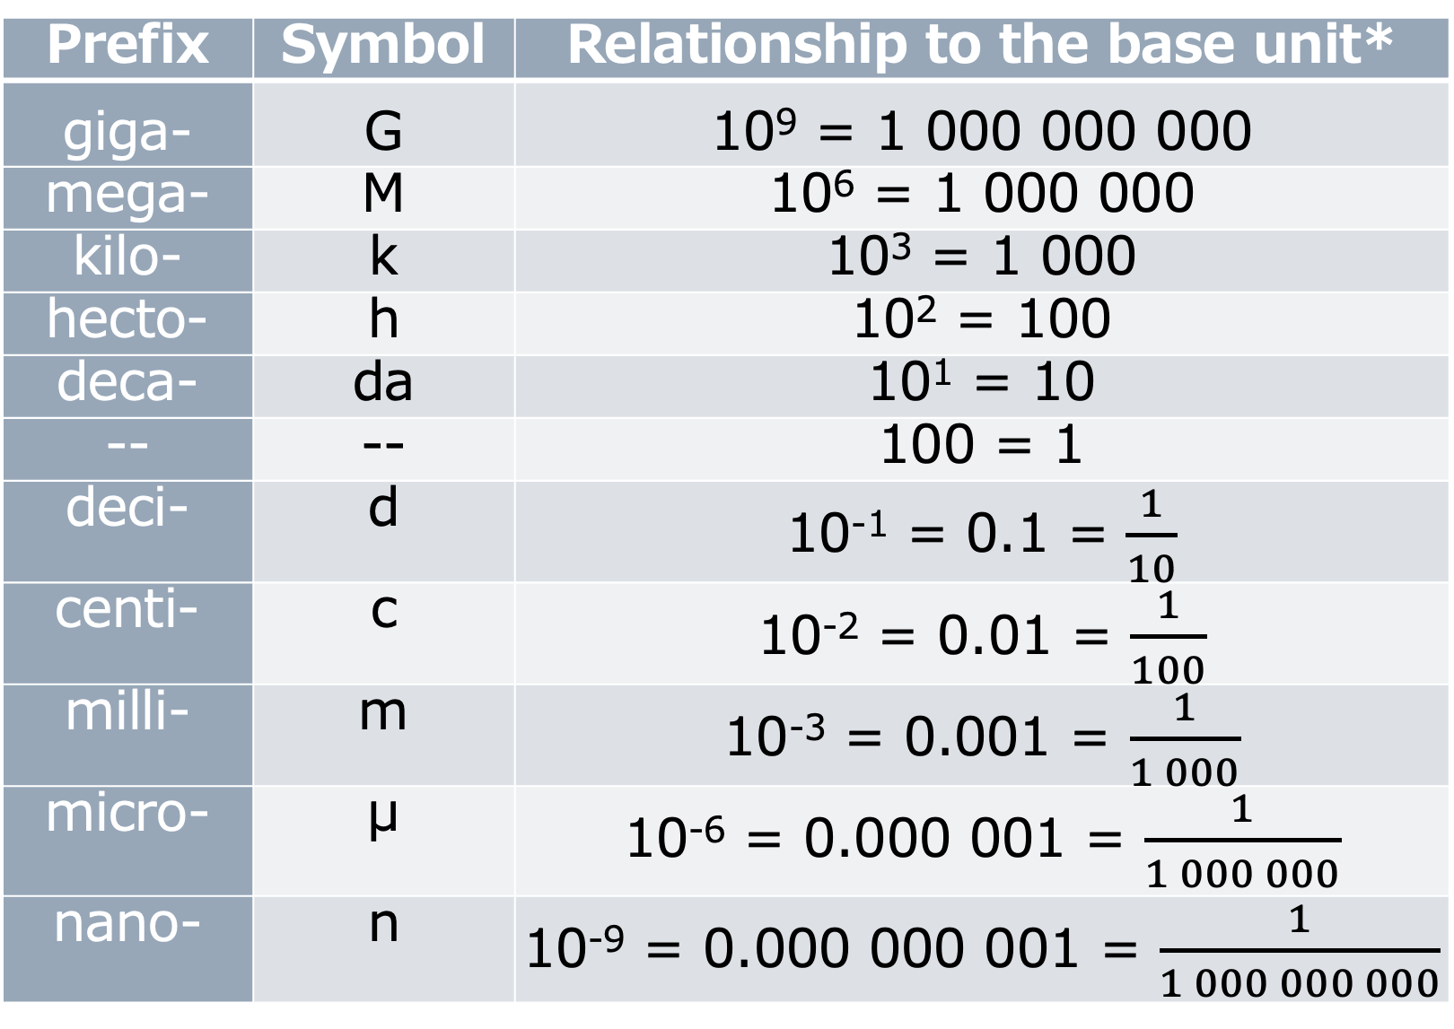
Prefix | Symbol | Relationship to the base unit*
giga- | G | 10⁹ = 1 000 000 000
mega- | M | 10⁶ = 1 000 000
kilo- | k | 10³ = 1 000
hecto- | h | 10² = 100
deca- | da | 10¹ = 10
-- | -- | 100 = 1
deci- | d | 10⁻¹ = 0.1 = $\frac{1}{10}$
centi- | c | 10⁻² = 0.01 = $\frac{1}{100}$
milli- | m | 10⁻³ = 0.001 = $\frac{1}{1 000}$
micro- | μ | 10⁻⁶ = 0.000 001 = $\frac{1}{1 000 000}$
nano- | n | 10⁻⁹ = 0.000 000 001 = $\frac{1}{1 000 000 000}$
*base units:
mass → g
length → m
volume → L
energy → W

Slide 3
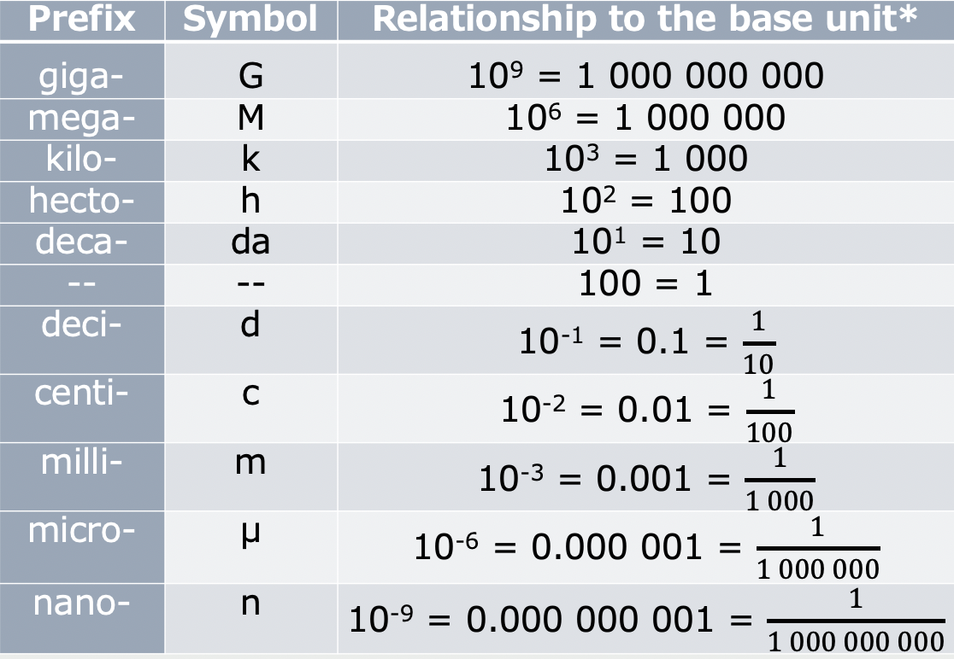



1 L = 1000 mL
Strategy Plan: we want to be able to cancel out like units vertically, so decide what unit factor to use:
$\frac{1000 mL}{1 L}$ or $\frac{1 L }{1000 mL}$
459 mL x
0.459 L
Example #1:
A student measures 459 ml of water.
Express this value in L.
$\frac{1 L }{1000 mL}$
$\frac{ }{1 }$
$\frac{ }{ mL}$
459 x 1 ➗ 1000

Slide 4


Example #2 :
A student needs to measure 0.4 kg of salt.
Express this mass in g.
1000 g = 1 kg
Strategy Plan: we want to be able to cancel out like units vertically, so decide what unit factor to use:
$\frac{1000 g}{1 kg}$ or $\frac{1 kg }{1000 g}$
0.4 kg x
400 g
$\frac{1000 g }{1 kg}$
$\frac{ }{1 }$
$\frac{ }{ kg}$
0.4 x 1000 ➗ 1

Slide 5
PRACTICE COMPLETE THE FOLLOWING, SHOWING YOUR WORK. BE SURE TO INCLUDE THE UNIT IN YOUR ANSWER.
The amount of energy used by an appliance is 250 W.
- Express this in kW
The volume of water that is needed to fill a holding tank is 357 L.
-Express this in mL
The atomic radius of an atom of an element is 0.112 nm.
-Express this in m

Slide 6


PRACTICE COMPLETE THE FOLLOWING, SHOWING YOUR WORK. BE SURE TO INCLUDE THE UNIT IN YOUR ANSWER.
The amount of energy used by an appliance is 250 W.
- Express this in kW
The volume of water that is needed to fill a holding tank is 357 L.
-Express this in mL
The atomic radius of an atom of an element is 0.112 nm.
-Express this in m
250 W x $\frac{1 kw }{1000 W}$
= 0.25 kw (or 2.5x10⁻¹ kW)
357 L x $\frac{1000 mL }{1 L}$
= 337,000 (or 3.37x10⁵ mL)
0.112 nm x $\frac{1 m }{1,000,000,000 nm}$
= 1.12x10⁻¹⁰ m

