Slide 1
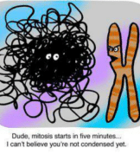
2. MITOSIS

Slide 2
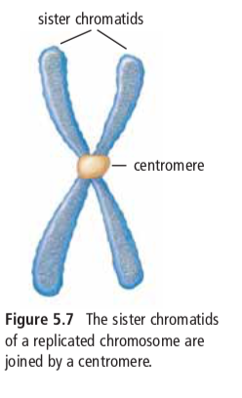
MITOSIS
The shortest stage of the cell cycle where the nuclear contents divide, and two daughter nuclei are formed.
As the nucleus prepares to divide, replicated DNA in interphase joins to form sister chromatids, joined by a centromere.

Slide 3
Early
Prophase
Late
Prophase
Prophase
Metaphase
Anaphase
Telophase
Mitosis occurs in 4 (well, kind of 5) stages

Slide 4
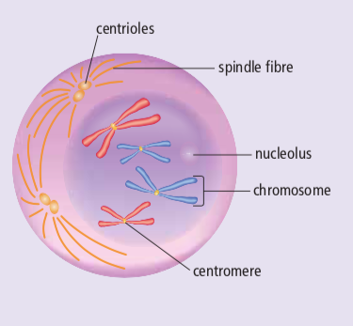
EARLY PROPHASE
PMAT
The chromosomes coil and thicken and become distinct from one another. The chromosomes are now visible.
The nucleolus disappears
The chromosomes are doubled throughout their length.
The centrioles separate and start moving to opposite ends of the cell. A spindle made of microtubules begins to form.

Slide 5
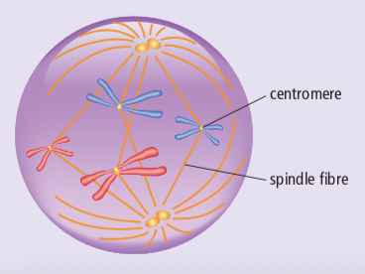
LATE PROPHASE
PMAT
The nuclear membrane disappears
The centrioles move to the opposite poles, completing spindle (microtubules form spindle)
The chromosomes attach to the spindle fibres at their centromeres

Slide 6
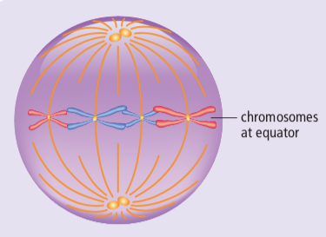
METAPHASE
PMAT
Each chromosome is connected to a spindle fiber at its centromere.
The centrioles are now at opposite sides of the cell.
The spindle fibers will push and pull the chromosomes.
The chromosomes line up at the center of the cell.
meta = middle = chromos at the middle of the cell

Slide 7
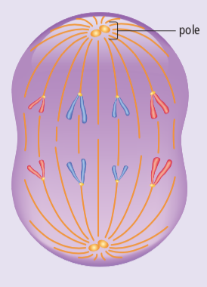
ANAPHASE
PMAT
The microtubules begin to shorten and this pulls the chromatids apart to opposite sides of the cell
Once they separate, each sister chromatid is considered to be a chromosome.
By the end of anaphase, the two ends of the cell have equivalent and complete sets of chromosomes.
look at the shape of the chromos.. Little A’s?

Slide 8
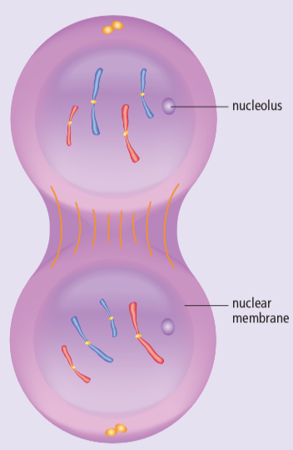
TELOPHASE
PMAT
One complete set of chromosomes is now at each pole of the cell
Spindle fibres begin to disappear
Nuclear membrane forms around each set of chromosomes
A nucleolus appears within each nucleus
Now there are two nuclei in one cell, and the cell is ready to divide

Slide 9
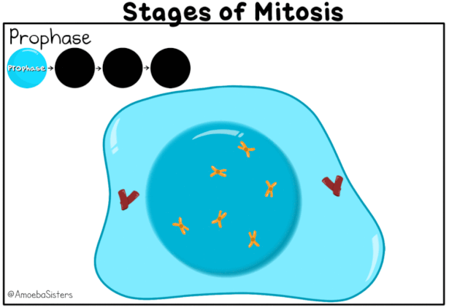

Slide 11
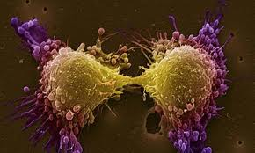
CYTOKINESIS
The final stage in the cell cycle, and happens in conjunction with telophase
The two nuclei are separated into two daughter cells
These new cells are identical to the original parent cell

Slide 12
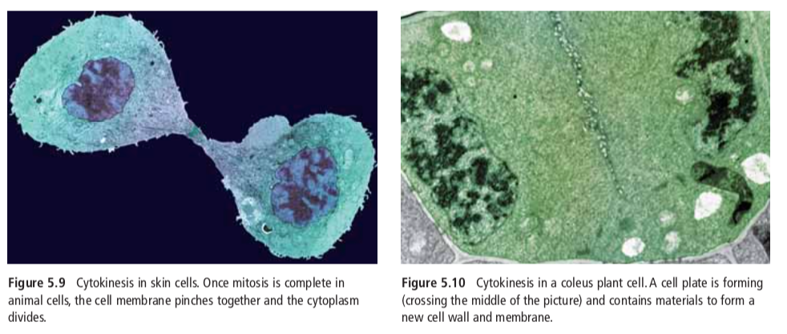
Cytokinesis in ANIMAL cells
Cytokinesis in ANIMAL cells

Slide 13
Check out short video: Amoeba Sisters Mitosis HERE

Slide 14
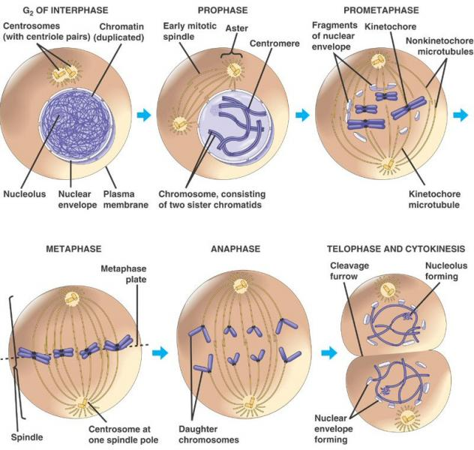

Slide 15
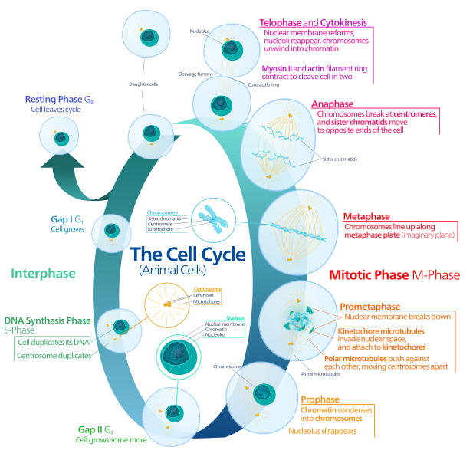

Slide 16
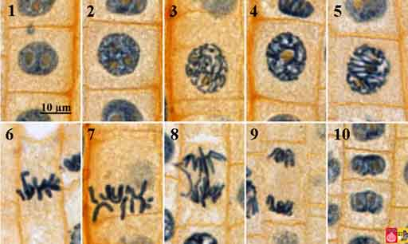
Notes:
Mitosis in Onion Root Tip

Slide 17
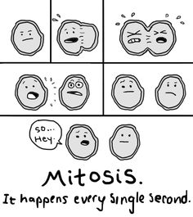
Mitosis in Animal Cells

Slide 18
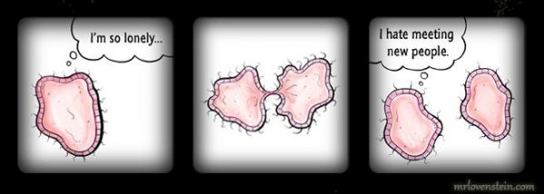
Cell Division in Plant Cells

Slide 19
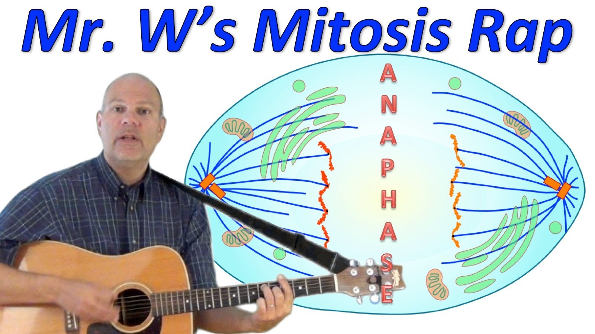
Mitosis Rap
Ok so you can see he’s, um, not a rapper, but this is a good little review ☺

Slide 20
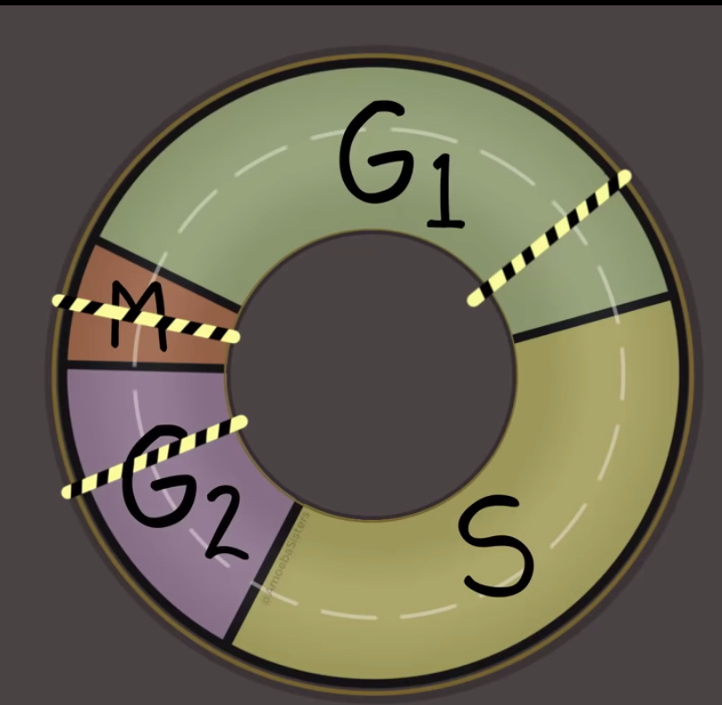
Cell cycle Checkpoints
©Amoeba Sisters

Slide 21
Cell Cycle Problems
Checkpoints in the cell cycle will prevent division if:
If the cell is short of nutrients
If the DNA within the nucleus has not been replicated
If the DNA is damaged
Mutations in genes involving checkpoints can result in an
out-of-control cell cycle.
The result can be uncontrolled cell division: cancer.

Slide 22
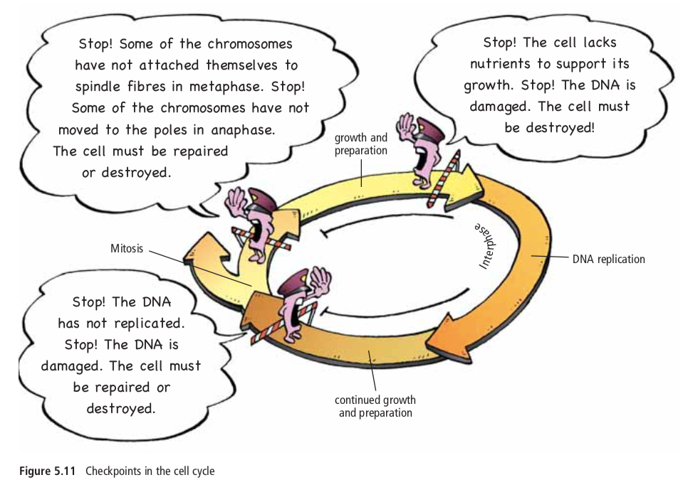

Slide 23
Check out short video: Amoeba Sisters Cell Cycle HERE

Slide 24
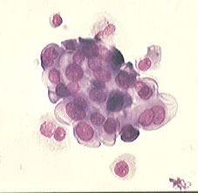
CANCER
Cancer is a loss of a cell’s ability to control its own rate of mitosis.
Typically results from a mutation in the genetic control mechanism.
Cancer isn’t a disease in the conventional sense because:
-It isn’t caused by a specific pathogen
(although viruses are suspect in some)
-Cancer isn’t characterized by one set
of symptoms.
In its simplest sense, cancer is rapid and uncontrolled cell growth.

Slide 25
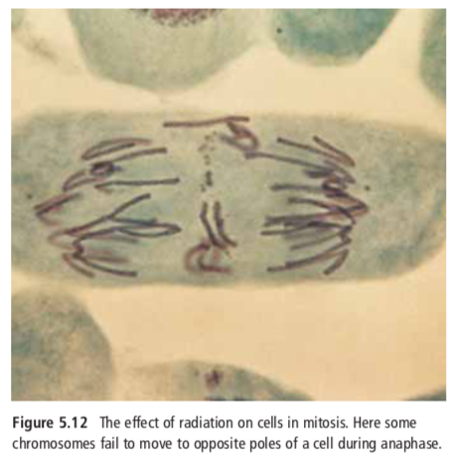

Slide 26
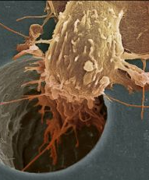
Characteristics of Cancer Cells:
1. They lack differentiation
2. Have abnormal shaped nuclei
3. Form tumors
4. Lack contact inhibition
5. Don’t stick to each other
6. Can migrate
7. Can stimulate vascularization

Slide 27
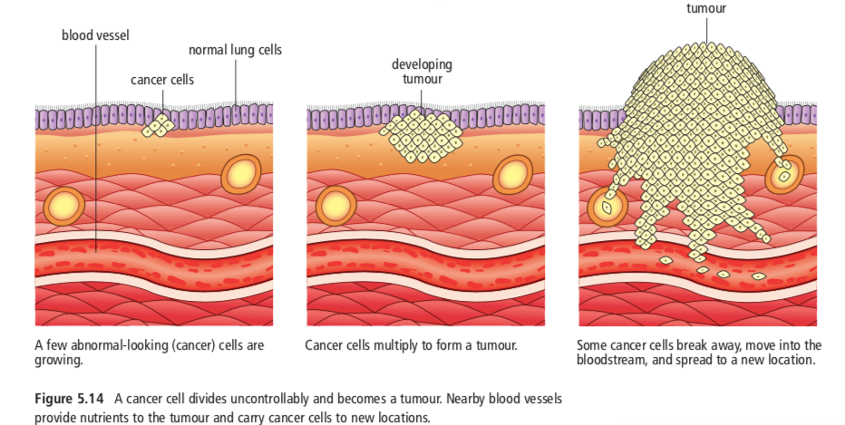

Slide 28
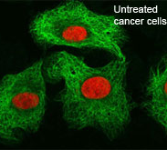
Why is it problematic?
These cells are reproducing so rapidly (up to once every 3 hours) that they do not have a chance to differentiate and become useful.
Despite being useless, they still must be fed and provided with the metabolites of life. They survive at the expense of normal cells that do have a function.
This ultimately can lead to the death of the individual as so many normal cells become sacrificed to satisfy the voracious appetite of the cancer cells.

Slide 29
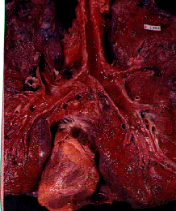
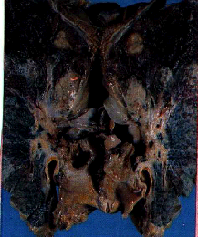
Lung Cancer

