Slide 1
Compounds with multivalent metals

Slide 2
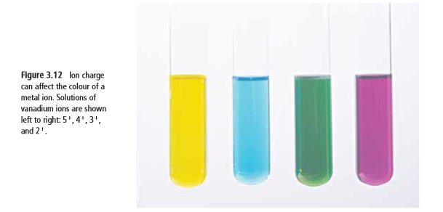
Multi-Valent Metal Compounds
Many important metals are multivalent
“multi” means many
“valent” refers to the capacity to bond (think about the valence shell…)
So it means that the element has many ways to bond
Multivalent metals can form 2 or more different positive ions with different ion charges

Slide 3
Example:
Iron has two ion charges: 3⁺ and 2⁺. It can exist as either.
-The periodic table shows the most common ion charge first
--> Fe³⁺ is more common than Fe²⁺
Recall: metals are the blue ones here. In an ionic compound, we name the metal first.

Slide 4
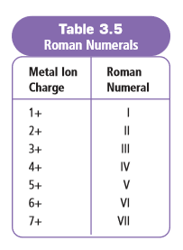
So how do we know which one??
When we’re talking about multivalent metals, we need make sure we’re clear which ion form we’re talking about. To do this, we use Roman Numerals
We would use Roman Numerals for copper (Cu) because it can have a charge of either 2+ or 1+ as an ion, and we’d need to specify which one
We wouldn’t use Roman Numerals for calcium (Ca) because it always has a charge of 2+ as an ion

Slide 5
How to Write and Say Them…
 | Examples
Fe³⁺ | Written: iron(III) | Pronounced “iron three”
Fe²⁺ | Written: iron(II) | Pronounced “iron two”
Pb⁴⁺ | Written: lead(IV) | Pronounced “lead four”
Cu⁺ | Written: copper(I) | Pronounced “copper one”

Slide 6
Part A: Writing Formulas with Multivalent Metals

Slide 7
Writing Chemical Formulas w/ Multivalent Metals
The Roman Numeral after the metal will tell you which ion charge to use
Example: Chromium fluoride
Cr⁺³
or Cr⁺² ??
F⁻¹
Example: Chromium(III) fluoride
Cr⁺³
F⁻¹
CrF₃

Slide 8
Writing Formulas of Multivalent Ionic Compounds Try some examples:
copper(I) iodide
CuI
tin(II) nitride
Sn₃N₂
iron(II) phosphide
Fe₃P₂
tin(IV) nitride
Sn₃N₄

Slide 9
Practice a few…

Slide 10
Solutions

Slide 11
Part B: Naming Compounds with Multivalent Metals

Slide 12
Naming Compounds with Multivalent Metals
It’s important EVERY time you write the metal in the compound, you stop to CHECK if it’s multivalent!!
If it IS, you need to include the Roman Numeral
If it IS NOT multivalent, do NOT include Roman Numeral!

Slide 13
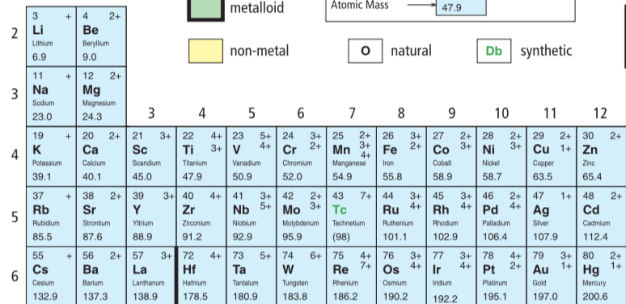
No
Likely

Slide 14
Examples
Cu₃P
copper(I) phosphide
Why??
Mn⁺⁴ and O²⁻ → Mn₂O₄ which simplifies to MnO₂
MnO₂
manganese(IV) oxide
It’s not Mn⁺² and O²⁻ → Mn₂O₂ which simplifies to MnO

Slide 15
Practice a few…

Slide 16
Solutions

Slide 17
Compounds with polyatomic ions

Slide 18
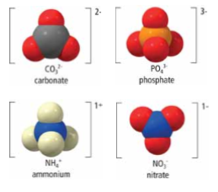
MOLECULAR IONS // POLYATOMIC IONS
Covalent & ionic bonds can be found in the same compound!
It is possible for some molecules (i.e. compounds) to gain or lose electrons (ionic bonding) as their atoms combine to form a molecule (covalent bonding)
In doing so, they become a molecular ion, called a polyatomic ion.

Slide 19
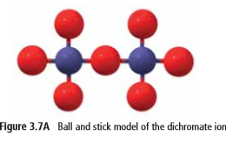
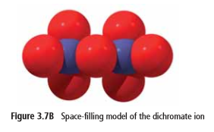
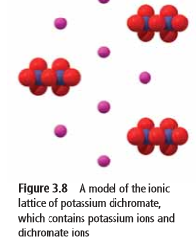
Polyatomic Ions Example: Breathalyzer Test
In one type of Breathalyzer test, an orange liquid (potassium dichromate) turns green in the presence of alcohol.
Potassium dichromate contains potassium ions and dichromate ions
Dichromate ion has the formula Cr₂O₇²⁻
___ atoms of chromium and ___ atoms of oxygen; has a charge of ____
The atoms oxygen and chromium are connected by covalent bonds to make dichromate
The negatively charged dichromate ion is connected by ionic bonds to positive potassium ions in the potassium dichromate.
2
7
2-

Slide 20
Part A: Writing Formulas of compounds with polyatomic ions

Slide 21
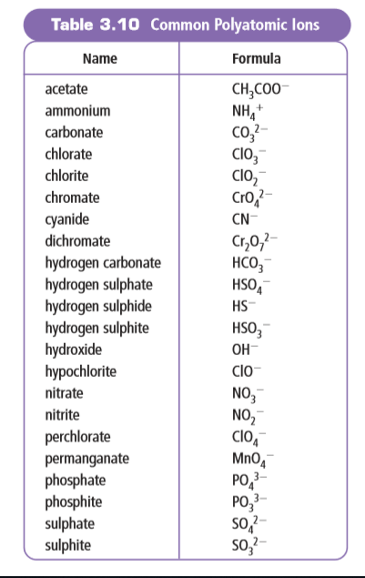
FORMULAS OF POLYATOMIC IONS
We already learned that some molecules can gain or lose electrons to become polyatomic ions
Because a polyatomic ion carries an electric charge, it cannot exist on its own. It is always paired up with ions that carry an opposite charge.

Slide 22
FORMULAS OF POLYATOMIC IONS
Polyatomic ions often have common names, so if you do not see the word listed as an element on the periodic table, chances are it is a polyatomic ion so refer to the table of common polyatomic ions

Slide 23
Example:
sodium chromate
Na ⁺
CrO₄ ²⁻
We don’t need to put the “1”
Na CrO₄
2
Answer: Na₂CrO₄

Slide 24
Example:
tin(II) hydroxide
Sn ²⁺
OH ⁻
NEED brackets to ensure it’s two of the whole hydroxide molecule, not just the “H”
( )
Sn OH
2
Answer: Sn(OH)₂

Slide 25
Practice a few…

Slide 26
Solutions

Slide 27
Part B: naming compounds with polyatomic ions

Slide 28
Example:
NaCH₃COO
NaCH₃COO
sodium
acetate
That’s it!

Slide 29
Example:
Cr(OH)₃
chromium
(III)
hydroxide
WAIT!!
Don’t forget to check if you’re using a multivalent metal. Is chromium multivalent?
YES!! So we need a Roman Numeral to indicate which ion we’re talking about
Answer: chromium(III) hydroxide

Slide 30
Example:
Ba₃(PO3)₂
barium
phosphite
Check: is the metal (barium) multivalent?
Nope!
Answer: barium phosphite

Slide 31
Part B: Practice a few…

Slide 32
Part B: Solutions

