Slide 1
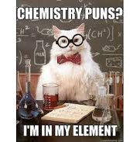
The Periodic Table Of Elements

Slide 5
METALS AND NON-METALS
Metals are typically hard, shiny, malleable, ductile, and good conductors of heat and electricity
Non-metals tend not to have these properties and are usually gases or brittle solids at room temperature
Metals and non-metals vary in their reactivity.

Slide 6
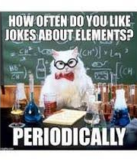
THE PERIODIC TABLE OF ELEMENTS
Chart containing information about the atoms that make up all matter
An element is a substance made up of only ONE type of atom.
There are currently 118 identified elements
The table is organized based on their properties

Slide 7
Reminder that PROPERTIES are…
PHYSICAL PROPERTIES: include characteristics such as state and colour
CHEMICAL PROPERTIES: describe a substance’s ability to react chemically with other substances to form new products

Slide 8
THE PERIODIC TABLE OF ELEMENTS
The chemical symbol for each element consists of 1 or 2 letters (or the newer ones have 3)– the symbol is international
If the symbol is only 1 letter, that letter is capitalized
If it is 2 or 3 letters, the 1st letter is capitalized, and the 2nd (& 3rd) letter is not capitalized.

Slide 9
Interactive Periodic Table
Notes:
https://elements.wlonk.com/ElementsTable.htm

Slide 11
Some cool and common elements

Slide 12
Some cool and common elements

Slide 13
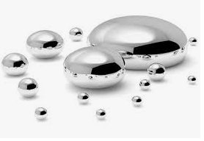
Some cool and common elements

Slide 14
So how did the table as we know it come to be?

Slide 15
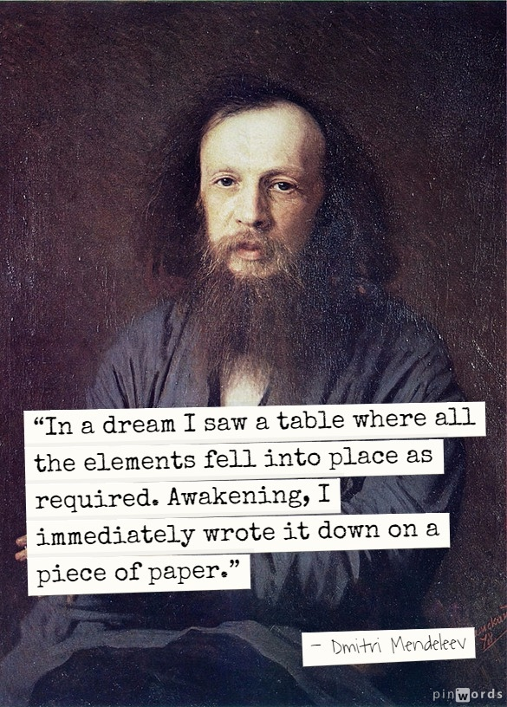
In 1867, Russian chemist & teacher, Dmitri Mendeleev, wrote down the name of every known element on a separate card & included its known properties
Then he sorted and re-sorted the cards into rows and columns until he found a pattern.
Mendeleev’s special insight was that there needed to be HOLES in the table—places left for elements that had yet to be discovered.
From the placement of the holes and the properties of the surrounding elements, Mendeleev was able to predict the properties of elements that were later discovered.
Notes:
In the 19th century, chemists began looking for a way to organize their observations of the elements. Could elements having similar properties be grouped together? What sort of properties could be used?

Slide 16
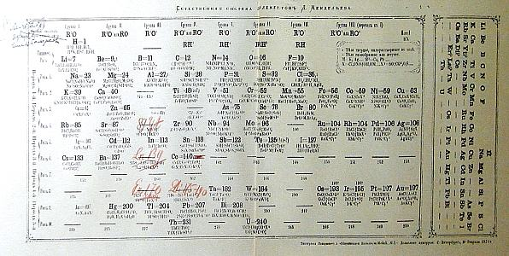
Notice the spaces
he left

Slide 17
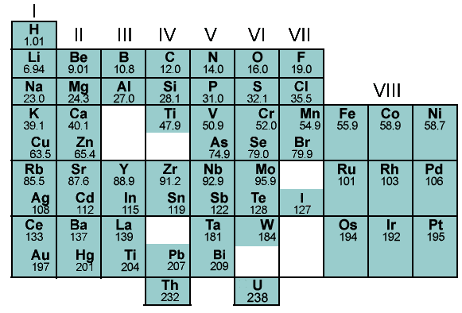
ORIGIN OF THE PERIODIC TABLE

Slide 18
1ST PERIOD
2ND PERIOD
3RD PERIOD
PERIOD

Slide 19
GROUP

Slide 20
Table organization
metals
non-metals
metalloids (semi-metals)
non-metals
*gases @ room temp

Slide 22
Chemical families are organized vertically

Slide 23
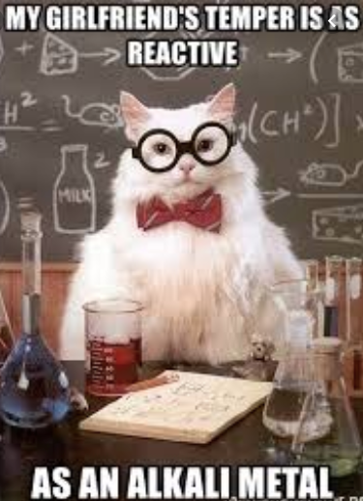
Chemical Family: ALKALI METALS
(Group 1, excluding hydrogen)
Highly reactive
Reactivity increases as you go down the table
React with both oxygen and water
Low melting points (all below 200˚C)
Soft and can be cut with knife

Slide 24
Chemical Family: ALKALINE EARTH METALS
(Group 2)
Less reactive than alkali but will burn in air if heated
Produce bright flames and are used in fireworks
React with water but less vigorously than alkali
Low melting points (all below 200˚C)
Soft and can be cut with knife

Slide 25
Chemical Family: HALOGENS
(Group 17)
Non-metals
Highly reactive
States at room temp:
Fluorine and chlorine = gases
Bromine = liquid
Iodine = solid
Astatine is v. rare (no one has collected enough to determine its physical properties)

Slide 26
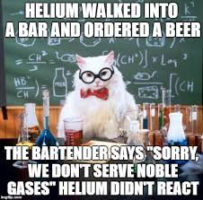
Chemical Family: NOBLE GASES
(Group 18)
Most stable
Unreactive
At room temp:
colourless
odorless
gases
Some glow (use electricity to ‘excite’ atom)

Slide 27
READING SYMBOLS
Atomic Number: the number of protons in the nucleus of each atom. It is always a whole number.
Pattern: atomic numbers increase one by one through the periodic table
Atomic Mass: the mass of an average atom of an element. It is written as a decimal. Mass is a combo of protons & neutrons
Pattern: atomic mass tends to increase along with atomic number
*There are some exceptions, i.e. Co and Ni
Notes:
The atomic mass of an element is based on the mass of the protons, neutrons, and electrons of the atoms of that element. The mass of the proton and neutron are about the same, but the mass of the electron is much smaller (about 1/2000 the mass of the proton or neutron). The majority of the atomic mass is contributed by the protons and neutrons.

Slide 28
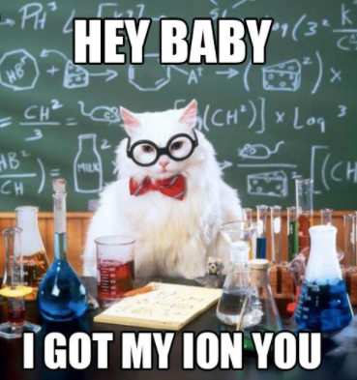
READING SYMBOLS
Ionic Charge: electric charge that forms on an atom when it gains or loses electrons.
An electrically charged atom is called an ion.
The can be positive (lose electrons) or negative (gain electrons)
Some elements have a multiple ion charge – these elements can form ions in more than one way.
Pattern: elements on the left side of the table generally form positive ions. Elements on the right side (except for the last column) generally form negative ions. Elements that are in the same column often form ions with the same charge as other elements in that column
Notes:
The atomic mass of an element is based on the mass of the protons, neutrons, and electrons of the atoms of that element. The mass of the proton and neutron are about the same, but the mass of the electron is much smaller (about 1/2000 the mass of the proton or neutron). The majority of the atomic mass is contributed by the protons and neutrons.

Slide 29
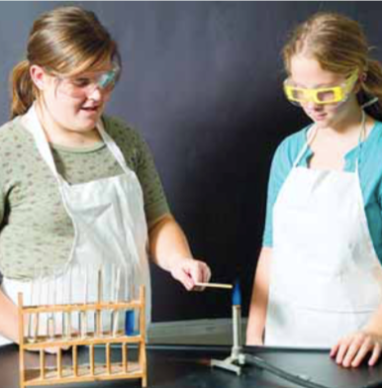
Lab
Flaming Metal Ions

Slide 30
Flaming Metal Ions
Background info
Copy/paste from WORD doc file
Question
Copy/paste from pdf file of textbook
Hypothesis
You create. Use if…then…because format. Note: no IV or DV in this one. Use the background info as scientific rationale (“because…”)
Experimental Set-up
Bullet list CVs
Materials
Copy/paste from WORD doc file
Procedure
Do not copy it all out, reference it
Observations & Data
Make data table skeleton with table title. Pre-load what you can.

