Slide 1
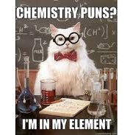
The Periodic Table Of Elements

Slide 4
Interactive Periodic Table
Start with the 9 elements you discovered yesterday – are the properties consistent with your data?
Look at other elements. Do you notice a trend in the table anywhere?
Notes:
https://elements.wlonk.com/ElementsTable.htm

Slide 5
Metals, Nonmetals & Metalloids

Slide 7
METALS AND NON-METALS
Metals are typically hard, shiny, malleable, ductile, and good conductors of heat and electricity
Non-metals tend not to have these properties and are usually gases or brittle solids at room temperature
Metals and non-metals vary in their reactivity.

Slide 8
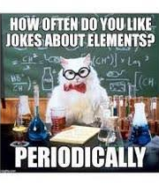
THE PERIODIC TABLE OF ELEMENTS
Chart containing information about the atoms that make up all matter
An element is a substance made up of only ONE type of atom.
There are currently 118 identified elements
The table is organized based on their properties

Slide 9
Reminder that PROPERTIES are…
PHYSICAL PROPERTIES: include characteristics such as state and colour
CHEMICAL PROPERTIES: describe a substance’s ability to react chemically with other substances to form new products

Slide 10
THE PERIODIC TABLE OF ELEMENTS
The chemical symbol for each element consists of 1 or 2 letters– the symbol is international
If the symbol is only 1 letter, that letter is capitalized
If it is 2 letters, the 1st letter is capitalized, and the 2nd letter is not capitalized.

Slide 12
Some cool and common elements

Slide 13
Some cool and common elements

Slide 14
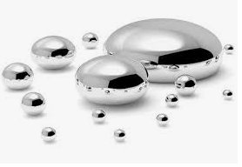
Some cool and common elements

Slide 15
So how did the table as we know it come to be?

Slide 16
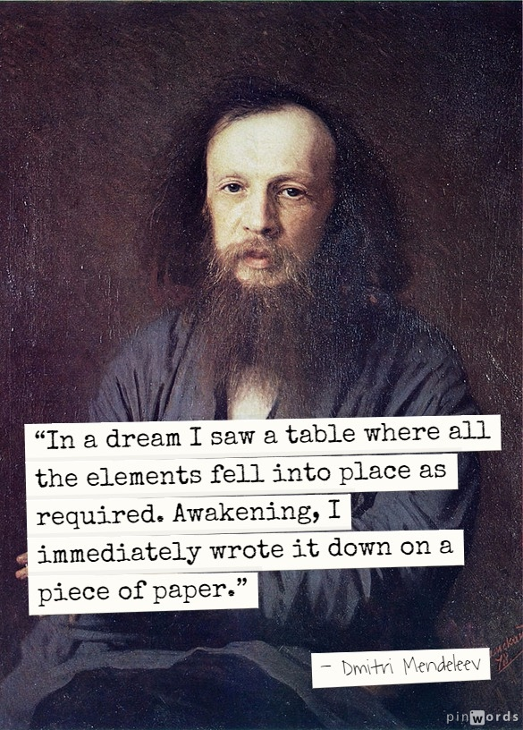
In 1867, Russian chemist & teacher, Dmitri Mendeleev, wrote down the name of every known element on a separate card & included its known properties
Then he sorted and re-sorted the cards into rows and columns until he found a pattern.
Mendeleev’s special insight was that there needed to be HOLES in the table—places left for elements that had yet to be discovered.
From the placement of the holes and the properties of the surrounding elements, Mendeleev was able to predict the properties of elements that were later discovered.
Notes:
In the 19th century, chemists began looking for a way to organize their observations of the elements. Could elements having similar properties be grouped together? What sort of properties could be used?

Slide 17
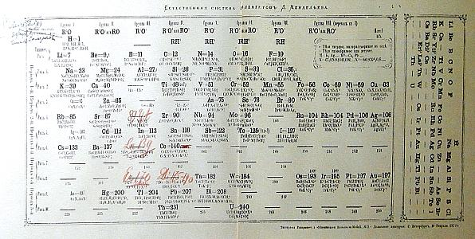
Notice the spaces
he left

Slide 18
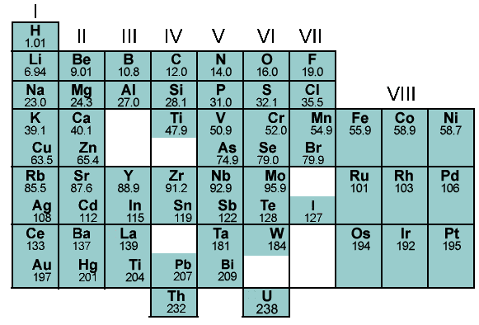
ORIGIN OF THE PERIODIC TABLE

Slide 19
1ST PERIOD
2ND PERIOD
3RD PERIOD
PERIOD

Slide 20
GROUP

Slide 21
Table organization
metals
non-metals
metalloids (semi-metals)
non-metals
*gases @ room temp

Slide 23
Chemical families are organized vertically

Slide 24
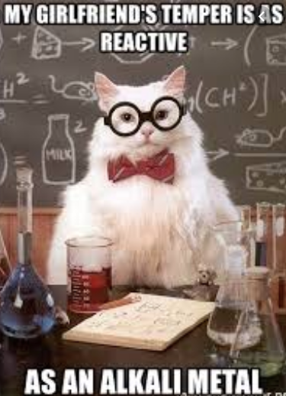
Chemical Family: ALKALI METALS
(Group 1, excluding hydrogen)
Highly reactive
Reactivity increases as you go down the table
React with both oxygen and water
Low melting points (all below 200˚C)
Soft and can be cut with knife

Slide 25
Chemical Family: ALKALINE EARTH METALS
(Group 2)
Less reactive than alkali but will burn in air if heated
Produce bright flames and are used in fireworks
React with water but less vigorously than alkali
Low melting points (all below 200˚C)
Soft and can be cut with knife

Slide 26
Chemical Family: HALOGENS
(Group 17)
Non-metals
Highly reactive
States at room temp:
Fluorine and chlorine = gases
Bromine = liquid
Iodine = solid
Astatine is v. rare (no one has collected enough to determine its physical properties)

Slide 27
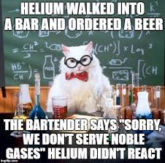
Chemical Family: NOBLE GASES
(Group 18)
Most stable
Unreactive
At room temp:
colourless
odorless
gases
Some glow (use electricity to ‘excite’ atom)

Slide 28
Periodic Table
Notes:
The atomic mass of an element is based on the mass of the protons, neutrons, and electrons of the atoms of that element. The mass of the proton and neutron are about the same, but the mass of the electron is much smaller (about 1/2000 the mass of the proton or neutron). The majority of the atomic mass is contributed by the protons and neutrons.

