Slide 1
The Effect of Mass on Flight Distance of a Paper Airplane
An example of a proficiency

Slide 2
The QUESTION
Relationship = scatter plot
Criteria
Example
Includes measurable DV and quantifiable IV.
Wording is specific, yet concise.
What effect does mass of a paper airplane have on it's flight distance?

Slide 3
The hypothesis
Criteria
Example
Includes measurable DV and quantifiable IV in the form of "if...,then..., because...".
Rationale is scientific.
Wording is specific, yet concise.
If the mass of a paper airplane is increased, then the distance at which it travels will decrease as a result, because more mass means more weight which increases gravity's pull to the ground
Do some research!

Slide 4
EXPERIMENT SET-UP
Example
The same type of paper used (A4).
The same folding technique (Extending: include a photo with the label Fig 1. Airplane design)
5 planes with varying masses:
Plane A is a single piece of A4 paper
Plane B is two pieces of A4 paper, glued together
Plane C is three pieces of A4 paper, glued together
Plane D is four pieces of A4 paper, glued together
Plane E is five pieces of A4 paper, glued together
Planes will be thrown by one person as consistently as possible.
Measurement of where plane stops on the ground will be recorded from the farthest point from the thrower.
Criteria
CV clear and all accounted for.
Well-organized and clear

Slide 5
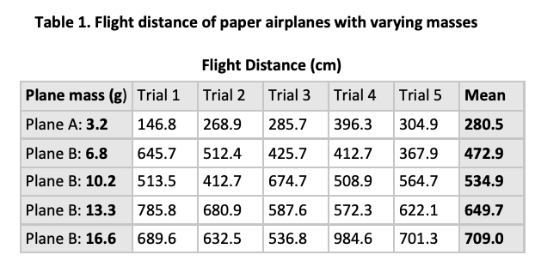
THE DATA
Data is well organized in table.
Both raw data and averages/means included (averages bolded).
Variables and their units are clearly labeled.
Table has title, incl table number
Criteria
Example
notice how there are NO units in the table next to the numbers?

Slide 6
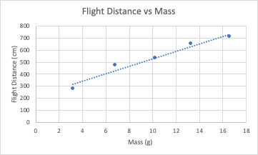
THE GRAPH
Example
Criteria
in form “DV vs IV”
Averages are graphed.
IV = x-axis and DV = y-axis.
Both axes are labeled with units.
Title included.
Best fit line

Slide 7
CONCLUSION
Example
This experiment served to address the question: What effect does mass of a paper airplane have on it's flight distance? It was hypothesized that if the mass of a paper airplane is increased, then the distance at which it travels will decrease as a result, because more mass means more weight which increases gravity's pull to the ground. The data reflects that as mass of the paper airplane increased, the flight distance also increased. The hypothesis was not supported.
Criteria
Includes clear and concise analysis of the graph as it pertains to the question & hypothesis.
Includes whether hypothesis was accepted or rejected

