Slide 1
Lab Safety

Slide 2
Lab Safety
Today’s Topics:
NFPA labels
HHPS labels
WHMIS pictograms
Lab safety – how to conduct yourself safety in a lab
Safety contract – signed by you + a parent/guardian
Homework: pg.15 #1a-f, #4, #6

Slide 3
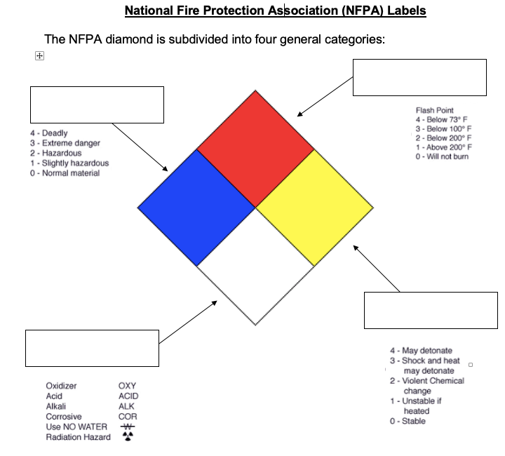
FIRE
HEALTH
REACTIVITY
SPECIFIC

Slide 4
HAZARDOUS HOUSEHOLD PRODUCT SYMBOLS
There are 4 different types of hazards.
poisonous
explosive
corrosive
flammable

Slide 5
HAZARDOUS HOUSEHOLD PRODUCT SYMBOLS
There are 3 levels of hazards,
each more harmful than the previous.
more harmful
caution
danger
extreme danger
The shape tells us what part of the product is dangerous
Container
Contents

Slide 6
HAZARDOUS HOUSEHOLD PRODUCT SYMBOLS
Combining the type, level and shape creates a HHPS
Danger
Caution
Extreme Danger
Danger: contents
poisonous
Caution: container
explosive
Extreme danger:
contents flammable

Slide 7
WHMIS
WORKPLACE HAZARDOUS MATERIALS INFORMATION SYSTEMS
There are 10 WHMIS symbols
Use the link below to add the 10 WHMIS symbols/pictograms to your notes.
Not sure what some of the vocab you come across means? Look it up!
https://eversafetraining.com/whmis-2015-pictograms/

Slide 8
LAB RULES - Dua Lipa "New Rules" Parody
Notes:
Hand out lab safety rules and contract

Slide 9
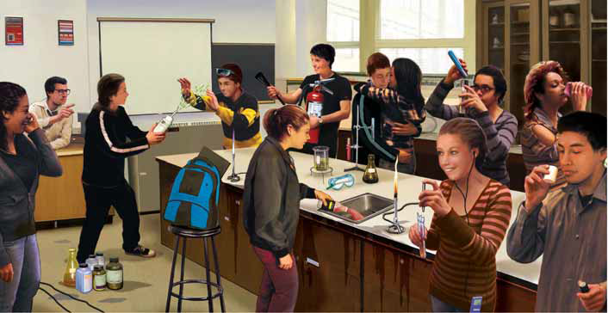
What is wrong here?
Notes:
Open pic and answer key

Slide 10
To do:
WHMIS pictograms
Add the 10 WHMIS pictograms with descriptions to notes. Look up any words you aren’t familiar with (ex. oxidizer)
Study Safety Rules (handout)
Prepare for Safety Test Friday
Safety only, not cumulative
Get Safety Contract signed
Needs to be signed for Monday’s lab
5. Homework: text pg.15 #1a-f, #4, #6

Slide 11
