Slide 1
The Scientific Method
Lesson notes and PowerPoint lessons are linked to website. You can choose to download and edit if preferred.

Slide 2
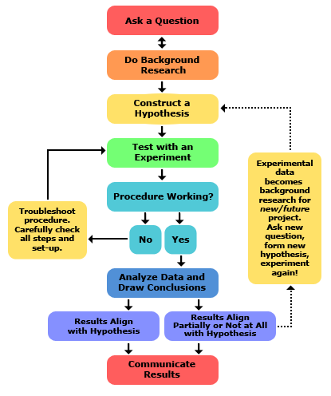
The Scientific Method
A process used to find answers to questions.

Slide 3
The Scientific Method
A process used to find answers to questions.

Slide 4
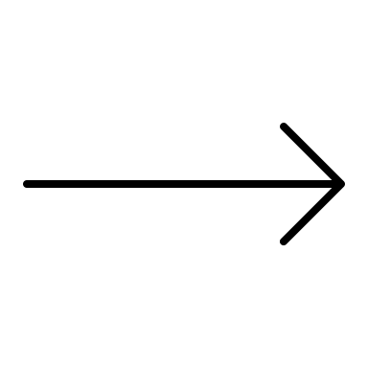
The question + variables
Needs to be testable
What effect does have on ?
(IV)
(DV)
Independent Variable
Dependent Variable
What you will be manipulating
What you will be measuring (the “results”)
After data is collected, this is graphed on the x-axis (horizontal)
After data is collected, this is graphed on the y-axis (vertical)
The Dependent Variable depends on the Independent Variable

Slide 5
Mnemonic device
“DRY MIX”
Dependent variable (DV)
Results
Y-axis on the graph
Manipulated (changed)
Independent variable (IV)
X-axis on the graph

Slide 6
Example
I’m curious to know what the relationship is between the temperature outside and
ice cream sales revenue.
What are variables?
Which is the IV and which is the DV?
The DV depends on the IV
Ice cream sales revenue depends on the temperature outside
The temperature outside depends on ice cream sales revenue

Slide 7
IV & DV Practice
Work with your group to create a:
Question
Testable hypothesis
Suggest a data table skeleton for data collection
What type of graph would this yield (bar or scatter)? Sketch and label the axes of a graph that would be used to represent the data for analysis.
If a bar graph is yielded, how could a further experiment be carried out from this that would yield a scatter graph? Suggest a new experiment (i.e. question)
Around the room are examples of observations and related wonderings.

Slide 8
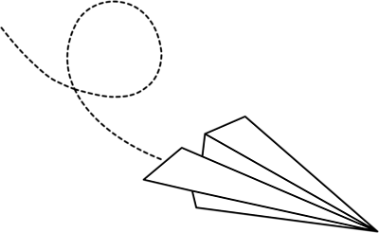
Let’s talk about that Paper Airplane Lab, one more time to make this come full circle ☺

Slide 9
Required components:
Question
Hypothesis
Materials
Procedure
Observations & Data
Analysis
Concluding statement
Measurable & testable. Has both IV & DV.
What effect does _(IV)_have on (DV)_?
Measurable & testable. Has both IV & DV. Basically rewords the question into a prediction.
Specific (incl type and quantity). List. Relevant items only (i.e. “pencil” not required)
Numbered step-by-step. SUPER clear and concise. Like a recipe. Someone else should be able to follow it and get similar results.
In a table. Pre-make the table ahead of time. What data are you planning to collect? Have a spot for averages. Make sure measurement units are in there.
Scatter graph! Both axes are labelled with units. IV (what you’re changing) is on the x-axis/horizontal and DV (what you’re measuring as a result) is on the y-axis/vertical
Two-liner. What does the shape of your graph tell you? Is your hypothesis accepted or rejected? (note: not right or wrong!)

Slide 10
Links for Practice (optional)
Quiz Friday
Click to visit KHAN ACADEMY
Click to visit QUIA
Click to try a SCI METHOD PRACTICE QUIZ

