Slide 1
sexual Reproduction
Section 6.2

Slide 2
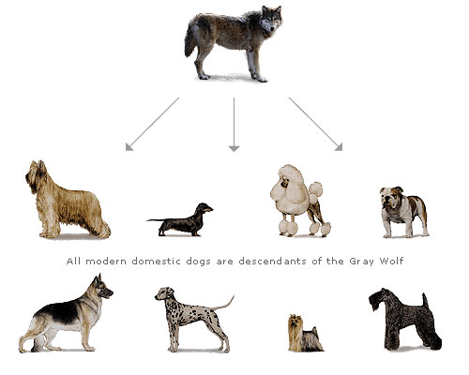
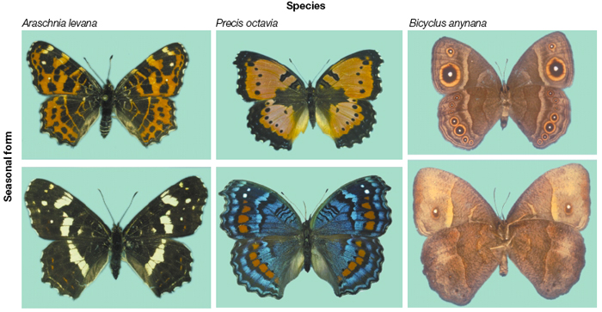
MEIOSIS IS THE BASIS OF SEXUAL REPRODUCTION
Sexual reproduction, through the shuffling of DNA, produces genetic diversity.
This variation offspring produces individuals that may have advantages over one another.

Slide 3
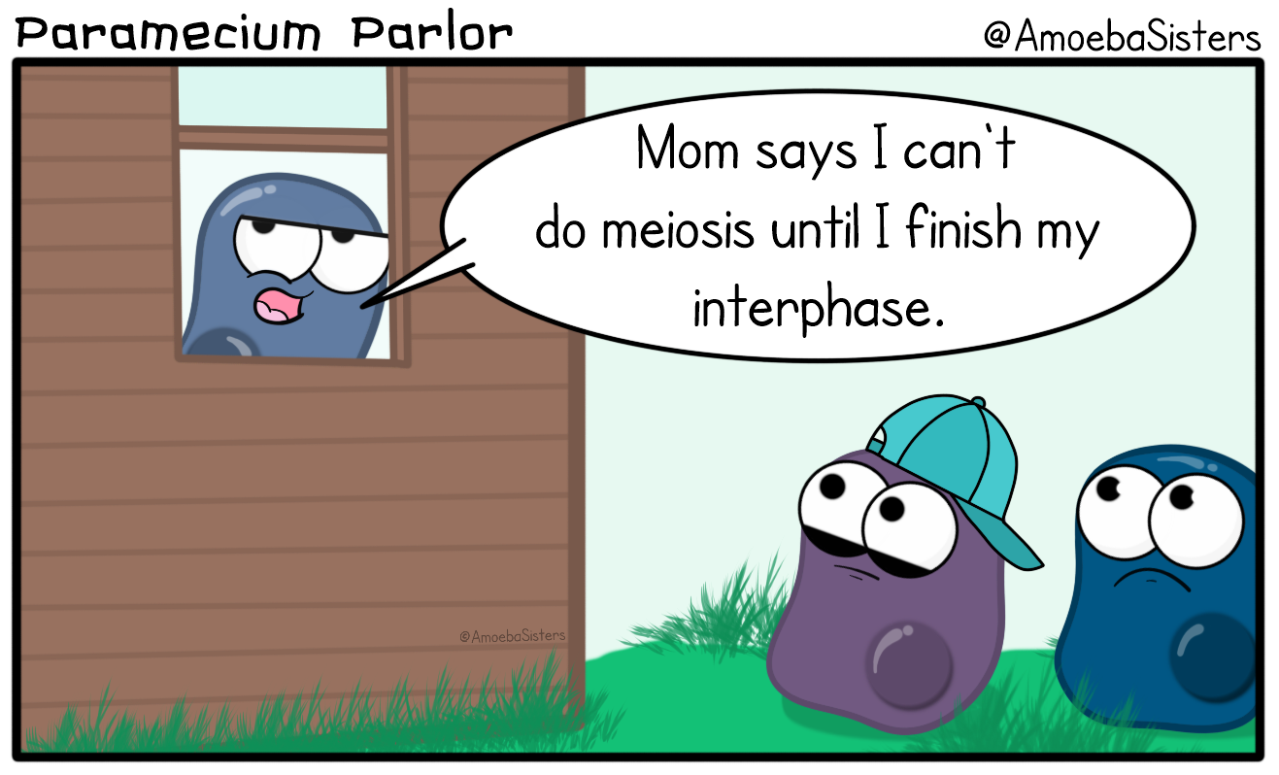
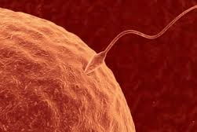
MEIOSIS IS THE BASIS OF SEXUAL REPRODUCTION
Sexual reproduction requires two parents.
Each parent passes on HALF its genes to its offspring.
Must have male and female: male to produce sperm and female to produce eggs.

Slide 4
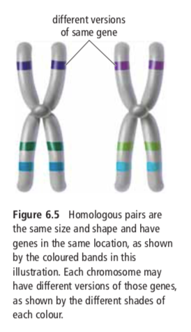
Cell Division and Chromosome Number
If an organism is the result of sexual reproduction, it will have 2 sets of chromosomes.
One set comes from the mother and one set comes from the father.
These two sets are called homologous chromosomes.
Homologous chromosomes carry the same genes, but they may have different expressions of that gene.

Slide 5
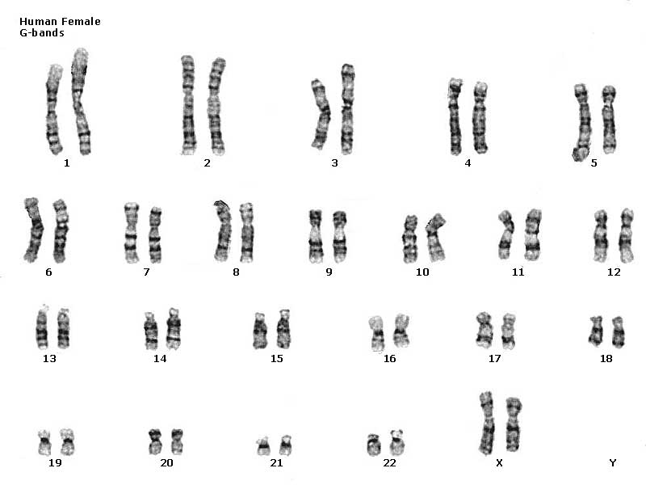
Chromosome Number
Normal body cells have a diploid chromosome number
Diploid means there are two of each kind of chromosome in each cell
They occur in pairs
“n” is the number of different chromosomes an organism has, so diploid is represented as 2n
Humans are 2n (aka diploid) because we have 2 of each kind of chromosome.
Prefix “di” → 2
Sex determining chromosomes in humans are the 23rd pair:
XX = biologically born female (X from mother, X from father)
XY = biologically born male (X from mother, Y from father)

Slide 6
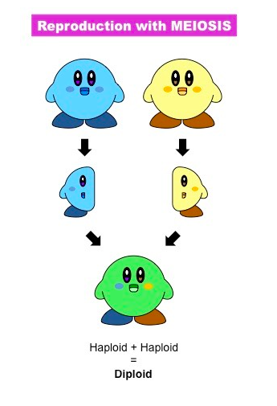

Slide 7
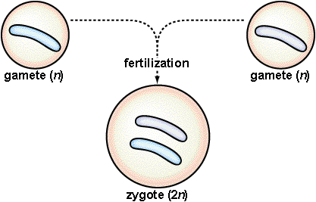
Role of Gametes
In humans, the male and female each contribute 23 chromosomes.
When fertilization takes place:
egg (23) + sperm (23) → zygote (46)
n + n → 2n
The zygote goes on to develop into an embryo, and on into a complete individual. When the time comes, the cycle repeats.

Slide 8
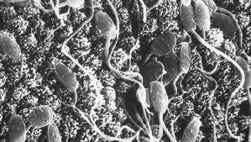
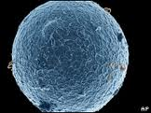
Gametes
23 chromosomes
23 chromosomes
46 chromosomes
Gametes are said to be haploid (or n) because they contain only one of each kind of chromosome.

Slide 9
Big idea: The cells which produce eggs and the cells which produce sperm are diploid (or 2n)…
So how do the egg and sperm
cells get to be haploid (or n)?
Meiosis!!
Meiosis is a process of reduction division in which the number of chromosomes per cell is cut in half through the separation of homologous chromosomes.

Slide 10
MEIOSIS
Occurs in the sex cells only: the egg and sperm.
Purpose is to reduce the chromosome number of the egg and sperm by half.
Like mitosis, meiosis is preceded by the replication of chromosomes.
Unlike mitosis, this replication is then followed by two divisions: meiosis I and meiosis II.
Notes:
“The process that produces gametes with half the number of chromosomes as body cells is called meiosis. Without meiosis, the joining of a sperm cell and an egg cell during fertilization would produce an offspring with two times the original number of chromosomes as its parents.”
**** PIC: shows how meiosis produces gametes with half the number of chromosomes of the parent cells. As you look at the figure, notice that DNA replicates only once in the process, even though two cell divisions occur.
*******DNA replicates only once, in interphase, before meiosis begins. Two complete cell divisions occur, once after meiosis I and again after meiosis II. CREATES HAPLOID GAMETES
2 DIVISIONS- 4 sister chromosomes become 2 sister chromosomes, 2 sister chromatids become 1 individual

Slide 11
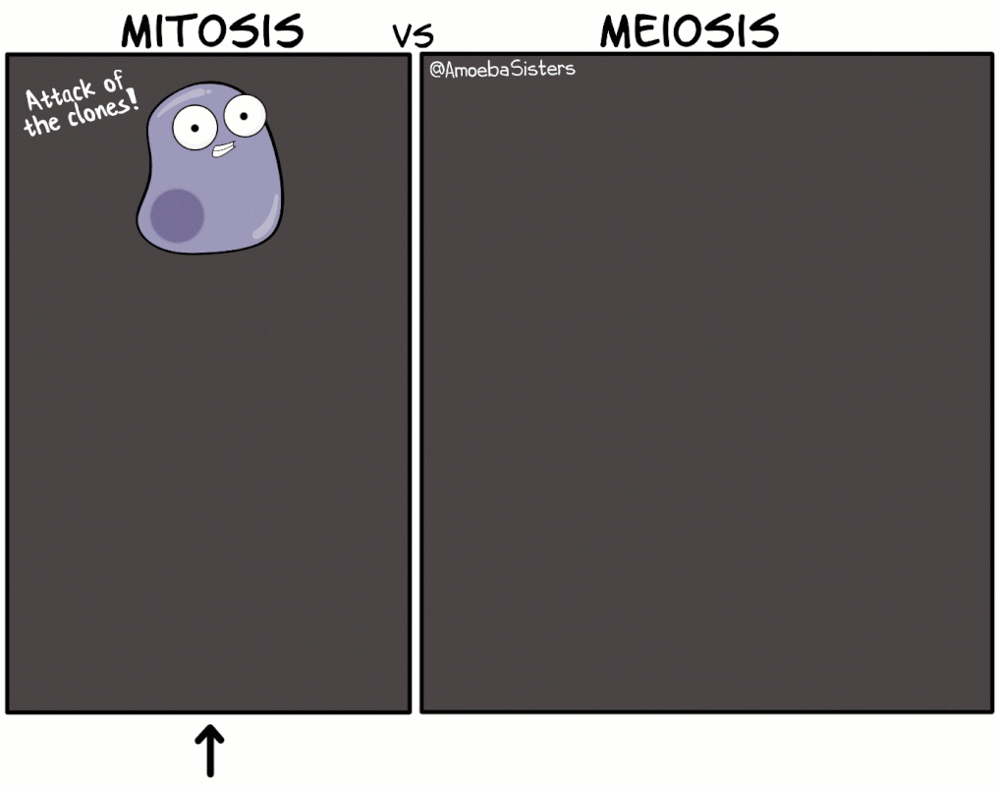

Slide 13
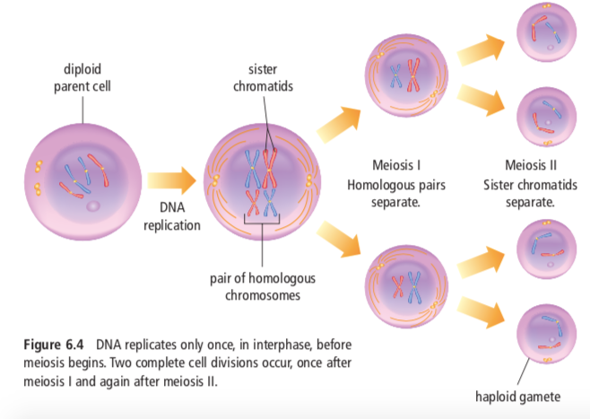

Slide 14
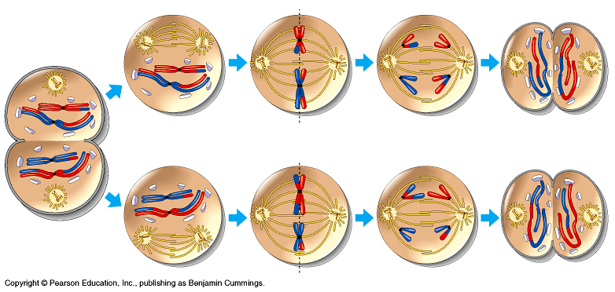
MEIOSIS
Meiosis II
Interphase
Meiosis I
P
M
A
T
P
M
A
T

Slide 15
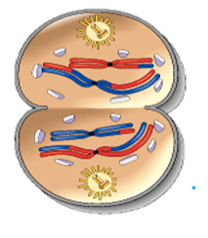
Meiosis: Interphase
The chromosomes replicate. It is similar to chromosome replication of mitosis. Two identical sister chromatids are held together by a centromere.

Slide 16
Meiosis: Prophase I
Chromosomes shorten and thicken. Each chromosome pairs with its corresponding homologous chromosome to form a tetrad.
A tetrad consists of 4 chromatids

Slide 17
“tetrad”
homologous chromosome
homologous chromosome
Crossing over
the exchange of genetic information (genes) between segments of homologous chromosomes during meiosis.

Slide 19
Meiosis: Metaphase I
Tetrads line up at the center of the cell.

Slide 20
Meiosis: Anaphase I
The tetrads break apart and the pairs move to opposite sides of the cell. Sister chromatids remain attached at their centromeres.

Slide 21
Meiosis: Telephase I
The cell separates into two cells
Meiosis I results in 2 haploid (1N) daughter cells
Each daughter cell has half the number of chromosomes as the original cell.

Slide 22
Meiosis: Telophase I
The cell separates into two cells
Meiosis I results in 2 haploid (1N) daughter cells
Each daughter cell has half the number of chromosomes as the original cell.

Slide 23
MEIOSIS
Meiosis II
Interphase
Meiosis I
P
M
A
T
P
M
A
T

Slide 24
Meiosis: Prophase II
The pairs of sister chromatids start toward the center.
There’s NO crossing-over here!!

Slide 25
Meiosis: Metaphase II
Pairs of sister chromatids line up at the center.

Slide 26
Meiosis: Anaphase II
The pairs of sister chromatids separate and move to opposite sides of the cell.

Slide 27
Meiosis: Telophase II (& cytokinesis)
Results in 4 new cells that are haploid (1N) and all different from each other.

Slide 28
The Importance of Meiosis
1 (2n) cell -------> 4 (1n) cells
The offspring will receive a new combination of genetic information. This leads to variation (called independent assortment) in the offspring.
Evolution!!

Slide 29
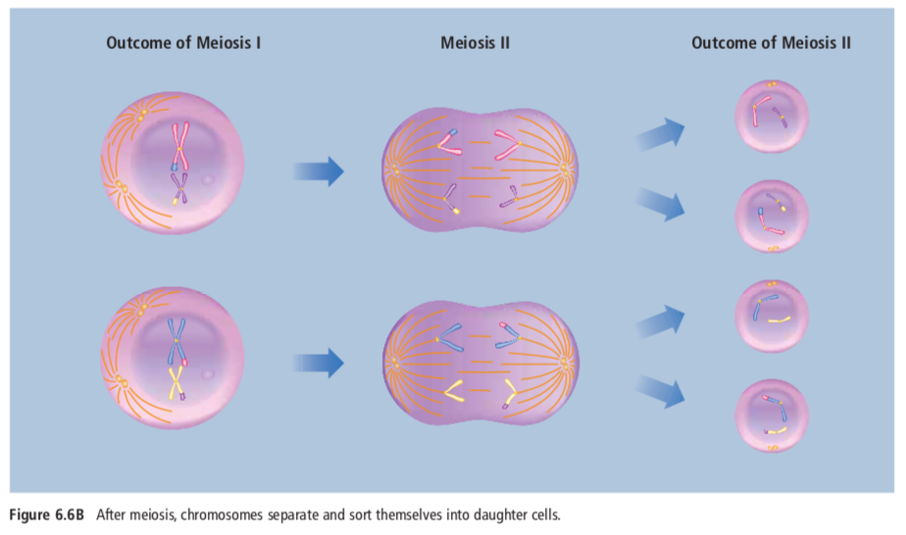

Slide 31
MITOSIS
Mitosis occurs in all cells of the body except egg & sperm
In mitosis each diploid cell divides once to form 2 cells.
In mitosis, each new cell contains the same number of chromosomes as the original cell.
In mitosis, the homologous pairs do not come together to form tetrads. There is no crossing over.
In mitosis, the new cells contain identical copies.
MEIOSIS
Meiosis only occurs in the formation of egg & sperm
In meiosis, each diploid cell divides twice to produce a total of 4 cells.
In meiosis, each of the four cells contains half the number of chromosomes as the parent cell.
In meiosis, the homologous pairs do come together to form tetrads. While the chromosomes are in tetrads, crossing over may occur.
In meiosis, the four haploid cells contain different combinations of chromosomes from each other.

Slide 32
Your turn to be “the expert”
Become an expert on one type of sexual reproduction.
Work with a small group to strengthen your understanding.
Then, you’ll be responsible for teaching a small group about your topic and learning from them about theirs.
Notes:
Choose to jigsaw this or traditionally teach with the following slides

Slide 33
Expert Topics
Explain, give examples, provide advantage(s) and disadvantage(s) specific to your topic (not just sexual reproduction in general)
Group 1+4: External Fertilization
Group 2+5: Internal Fertilization
Group 3+6: Pollination
Notes:
* If extra students add to these groups as more content

Slide 34
Pop Quiz!

Slide 35
Sexual Reproduction
Text 6.2

Slide 36
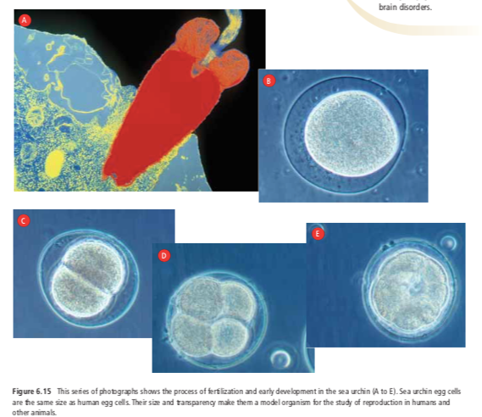
Sexual Reproduction
In sexual reproduction, a male gamete (sperm cell) must fertilize a female gamete (egg cell).
As a result of meiosis and the union of sperm and egg cells, no two individuals will have the same DNA, except identical twins
Following fertilization, the zygote and embryo start to divide by mitosis, and cells will differentiate

Slide 37
Types of Sexual Reproduction
External
Internal
Includes pollination

Slide 38
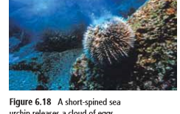
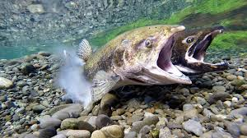
External fertilization
Sperm cell and egg cells unite outside parents’ bodies
Common in animals that live in the water.
The males and females of both species release their gametes into the water in a process called spawning.
Examples: Both sea urchins and fish such as salmon use this method.
Can also occur in plants such as mosses and ferns.
Since many of these plants live in moist environments, water transports their gametes, enabling sperm cells and egg cells to meet.

Slide 39
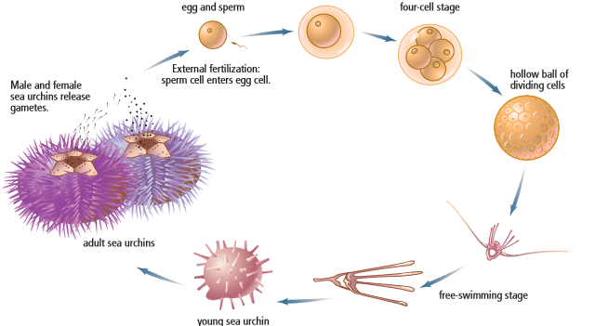

Slide 40
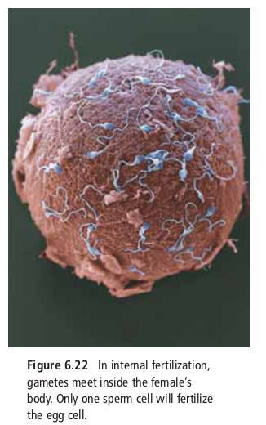
Internal Fertilization
Sperm cells are deposited inside the female’s body where they meet an egg cell
Ex: Water-dwelling orcas and most land-dwelling animals, such as mountain goats and humans, reproduce by internal fertilization.
Once a single sperm has penetrated an egg cell, the egg cell membrane changes its electrical charge, which produces chemical reactions that prevent any more sperm from entering the egg.
Preventing the entrance of more than one sperm ensures that only one set of male chromosomes can unite with chromosomes in the nucleus of the egg cell.

Slide 41
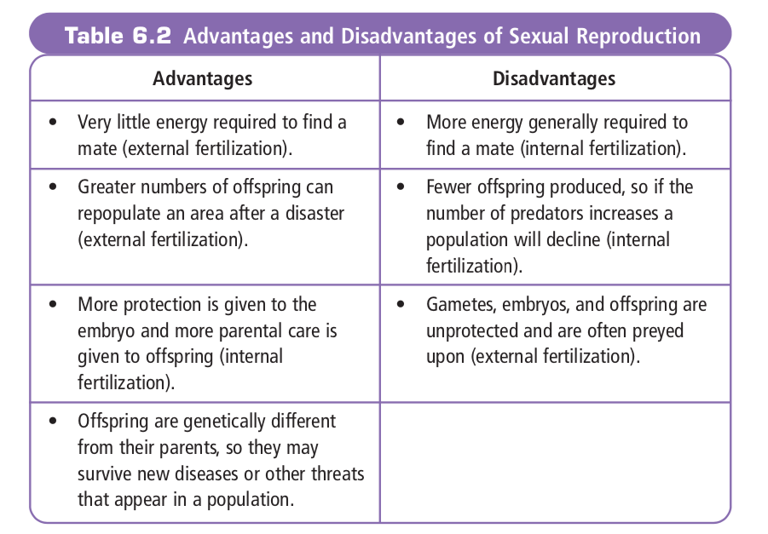

Slide 42
Sexual Reproduction in Plants

Slide 43
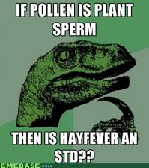
Pollination
Pollination is the transfer of male gametes in structures called pollen from the male reproductive part of a plant to the female reproductive part of a plant.
Pollen grains carry the sperm cells in a protective case to the ovules, which are the female plant structures that contain the egg cells.
The reproductive organ of the male is the stamen.
The reproductive organ of the female is the pistil

Slide 44
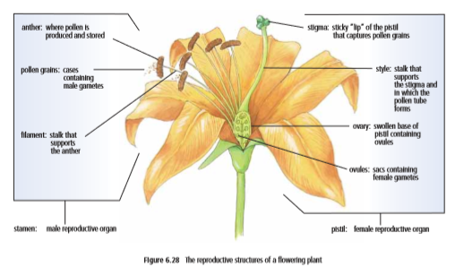
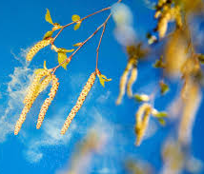
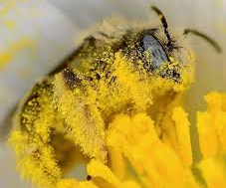

Slide 45
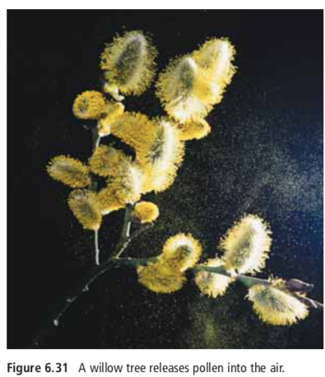
Pollen Transport
Some flowering plants (ex willow, hazelnut) have flowers that do not have petals. Plants like these release their pollen into the air so that the wind can carry the pollen to the female reproductive parts of other flowers
Genetic variation is maintained because seeds are often enclosed in a fruit that can be transported away from the parent plant by animals who eat the fruit. Since many seeds have a tough outer coat, they are often not digested by animals. As a result, the embryo may survive, grow, and reproduce away from the parent.

Slide 46
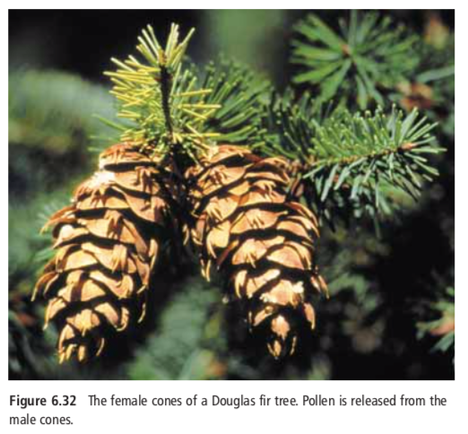
Pollen Transport
Some plants (ex Douglas fir) don’t have flowers. Sperm and egg cells are produced in male & female cones.
Such cone-bearing plants are called conifers.
Pollen is released from the male cones and is carried by the wind to the female cones.
The embryo is protected within seeds in the female cone and completes its development there. The winged seeds that are eventually released are often transported by birds and small animals to new locations
Since genes are reshuffled in meiosis during the production of egg and sperm cells, new Douglas fir trees may be resistant to disease or insect infestation. As a result, trees that survive with these favourable characteristics can pass them on to their offspring.

Slide 47
We aren’t studying embryonic development

