Slide 1
Enrollment Instructions
Step 1: Go to https://www.explorelearning.com
Step 2: Click on the “Enroll in a Class” button in the upper right-hand corner of the web page.
Step 3: Type in your teacher’s class code: XDZQGV
Click “Continue” and follow the directions on the site to complete your enrollment. Use your usual first & last name please.
Step 4: Record your username and password in your phone or somewhere that you won’t lose it. If you lose/forget it, do NOT make a new account, dm me & I’ll retrieve it for you.
Once you’ve enrolled, you can login anytime using just your username and password (no class code required).

Slide 2
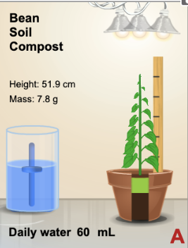
VIRTUAL LAB
Launch the gizmo that’s waiting for you:
Spend some time exploring the parameters of this gizmo.
What could you investigate? Brainstorm (discuss) a potential experiment.
What would be your:
Question (incl IV & DV)
Hypothesis (incl IV & DV)
Growing Plants

Slide 3
VIRTUAL LAB
Design and run an experiment using the parameters of this gizmo.
Think of all the learnings from the airplane lab!
Use the assignment waiting for you in Teams as a lab report template
You may complete one document together but each of you needs to turn it in on Teams when we’re done (tomorrow in class).
Growing Plants

Slide 4
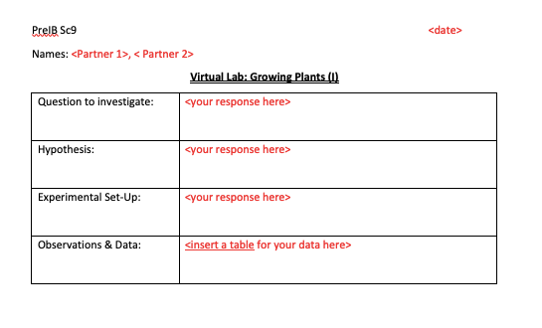
VIRTUAL LAB
Growing plants

Slide 5
The Question
What effect does _____ have on _____?
Measurable?
IV
DV
Qualitative (categorical)
Quantitative (numerical)
Bar graph
(good for preliminary research, not relationship)
Scatter graph (allows us to see relationship)

Slide 6
The Hypothesis
If ___________________________________,
then _______________________________,
because _________________________
what you are doing to IV
what you expect to happen to DV as a result
scientific rationale

Slide 7
The Hypothesis
Remember this?
“I" “we”
Keep it to facts.

Slide 8
Experimental Set-Up
Bulleted list or table
What type of plant?
Soil additives?
How many lights (If not IV)?
Location of lights?
How much water (if not IV)?
Controlled Variables (CV)

Slide 9
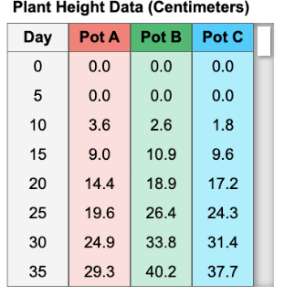
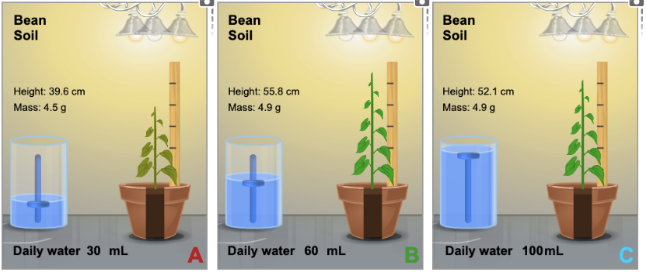
Data Collection
What type of qualitative data is relevant?
Is “Pot A” relevant? What do these represent?
Is “day” relevant?
If no, why?
If yes, how?
Include averages

Slide 10
Formatting Tips
How to insert a (good) data table skeleton in Word
How to format your report before you turn it in
Font → consistent, Times/Arial 12, black
Guide table → hide lines
How to insert a photo of a graph into Word

Slide 11
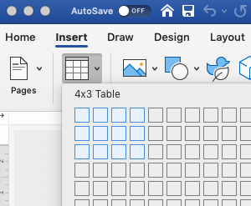
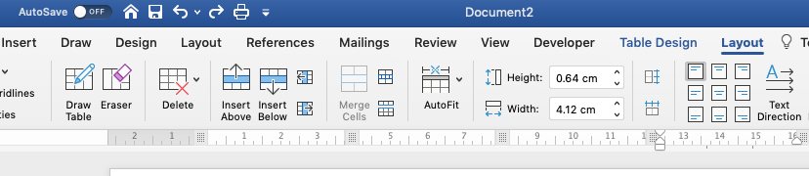
To add/remove rows or columns
Shades cells of table
Adds/Removes table lines

Slide 12
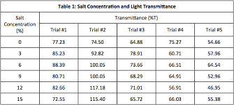
example
average

Slide 13
We’ll stop here for today. Tomorrow we can touch up any formatting and then create and insert a graph.

